Slide 1
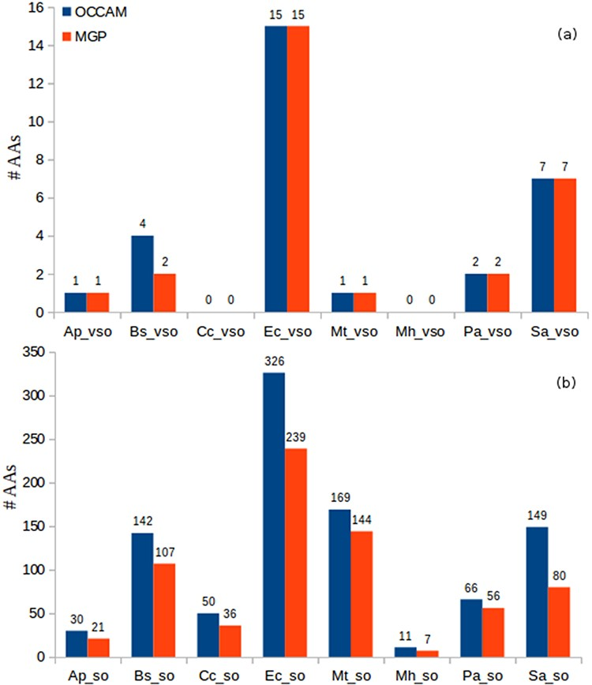
Figure 8. Identification of AAs in OCCAM and MGP for all datasets. (a) vsORF chart. (b) sORF chart. Total number of AAs ...
Notes:
Figure 8. Identification of AAs in OCCAM and MGP for all datasets. (a) vsORF chart. (b) sORF chart. Total number of AAs for OCCAM: 973. Total number of AAs for MGP: 718. The difference of 255 is exactly the number of hits with e-value > 10−5.
Unless provided in the caption above, the following copyright applies to the content of this slide: © The Author(s) 2020. Published by Oxford University Press.This is an Open Access article distributed under the terms of the Creative Commons Attribution License (http://creativecommons.org/licenses/by/4.0/), which permits unrestricted reuse, distribution, and reproduction in any medium, provided the original work is properly cited.

