Slide 1
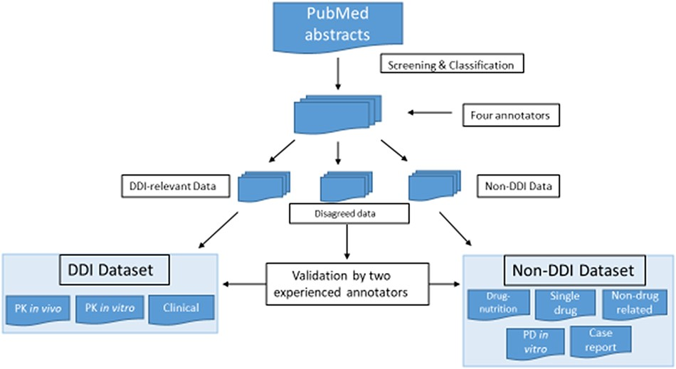
Figure 1. Screening and classification of PubMed abstracts for corpus development. PubMed abstracts were initially ...
Notes:
Figure 1. Screening and classification of PubMed abstracts for corpus development. PubMed abstracts were initially screened by four annotators into DDI-relevant, non-DDI and disagreed data. The four annotators included two experienced ones and two novice ones. The two experienced annotators had drug–interaction research experience, and two novice annotators were new bioinformatics master novices with biology and pharmacology background. All the abstracts were classified by these four annotators independently, and each abstract was labeled by two annotators. The disagreed data were further validated by two experienced annotators.
Unless provided in the caption above, the following copyright applies to the content of this slide: © The Author(s) 2022. Published by Oxford University Press.This is an Open Access article distributed under the terms of the Creative Commons Attribution-NonCommercial License (https://creativecommons.org/licenses/by-nc/4.0/), which permits non-commercial re-use, distribution, and reproduction in any medium, provided the original work is properly cited. For commercial re-use, please contact journals.permissions@oup.com

Slide 2
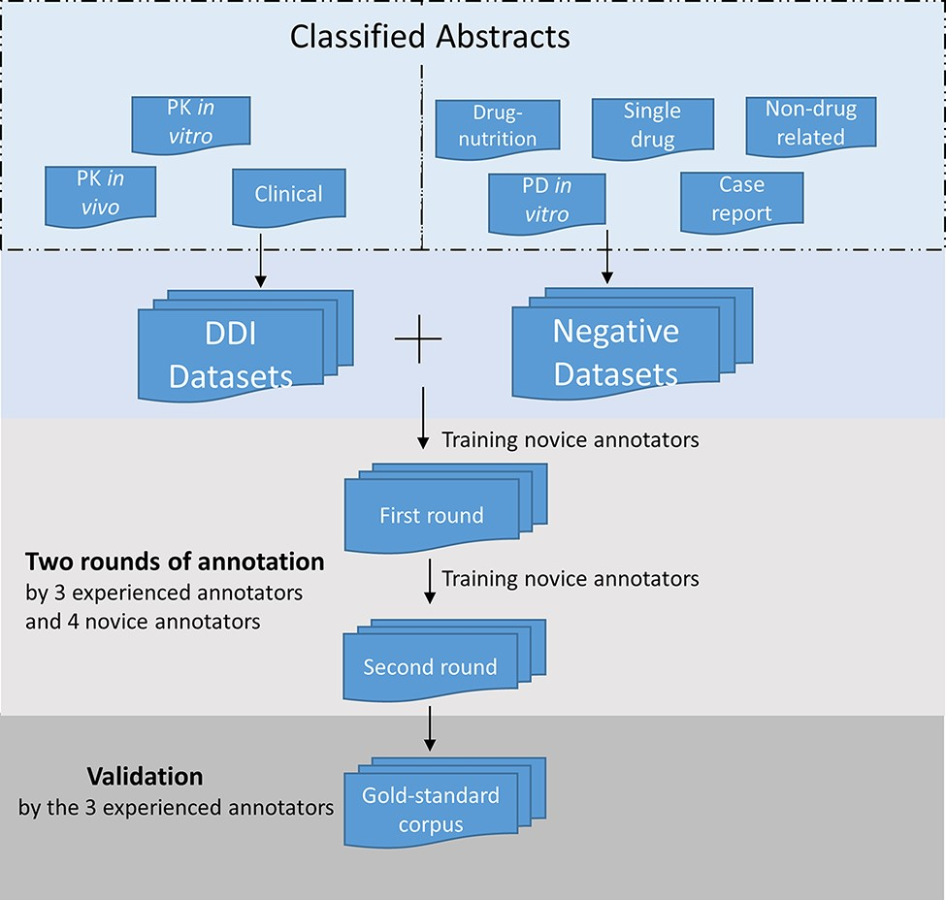
Figure 2. Annotation process for the corpus development. The DDI corpus was constructed by three experienced annotators ...
Notes:
Figure 2. Annotation process for the corpus development. The DDI corpus was constructed by three experienced annotators and four novice annotators. Novice annotators received two rounds of training of sentence-level annotation. After the initial training, each abstract in the corpus was assigned randomly to two annotators for the first-round annotation. Then the novice annotators underwent additional training. In the second-round annotation, the annotators reviewed and revised their annotation. The annotations were validated and finalized by the experienced annotators.
Unless provided in the caption above, the following copyright applies to the content of this slide: © The Author(s) 2022. Published by Oxford University Press.This is an Open Access article distributed under the terms of the Creative Commons Attribution-NonCommercial License (https://creativecommons.org/licenses/by-nc/4.0/), which permits non-commercial re-use, distribution, and reproduction in any medium, provided the original work is properly cited. For commercial re-use, please contact journals.permissions@oup.com

Slide 3
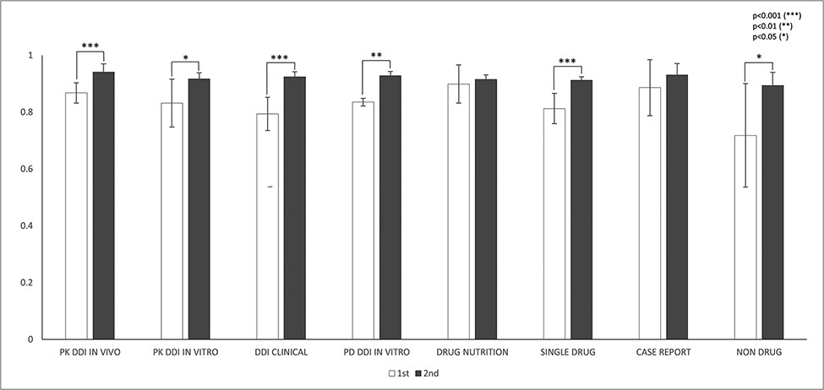
Figure 3. IAAs in fragmentation for eight abstract subcategories. This figure shows the IAAs (mean ± SEM) of two round ...
Notes:
Figure 3. IAAs in fragmentation for eight abstract subcategories. This figure shows the IAAs (mean ± SEM) of two round annotations for fragmentation across eight abstract subcategories. The IAAs of Round 1 are shown as white bars and IAAs of Round 2 are black bars. The asterisk brackets added above the bars indicate statistically significant differences. Error bar represents the standard error of mean. The x-axis labels the eight annotation dimensions, and y-axis represents the IAA.
Unless provided in the caption above, the following copyright applies to the content of this slide: © The Author(s) 2022. Published by Oxford University Press.This is an Open Access article distributed under the terms of the Creative Commons Attribution-NonCommercial License (https://creativecommons.org/licenses/by-nc/4.0/), which permits non-commercial re-use, distribution, and reproduction in any medium, provided the original work is properly cited. For commercial re-use, please contact journals.permissions@oup.com

Slide 4
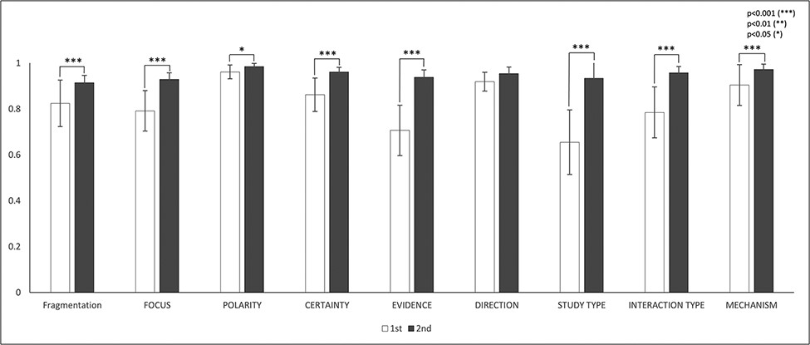
Figure 4. IAAs in eight annotation dimensions. This figure shows the IAAs (mean ± SEM) for eight dimensions in Round 1 ...
Notes:
Figure 4. IAAs in eight annotation dimensions. This figure shows the IAAs (mean ± SEM) for eight dimensions in Round 1 and 2 annotations. The IAAs of Round 1 are shown in white bars and the agreements of Round 2 are black bars. The asterisk brackets added above the bars indicate statistically significant differences. Error bar represents the standard error of mean. The x-axis labels the eight annotation dimensions, and y-axis represents the IAA.
Unless provided in the caption above, the following copyright applies to the content of this slide: © The Author(s) 2022. Published by Oxford University Press.This is an Open Access article distributed under the terms of the Creative Commons Attribution-NonCommercial License (https://creativecommons.org/licenses/by-nc/4.0/), which permits non-commercial re-use, distribution, and reproduction in any medium, provided the original work is properly cited. For commercial re-use, please contact journals.permissions@oup.com

Slide 5
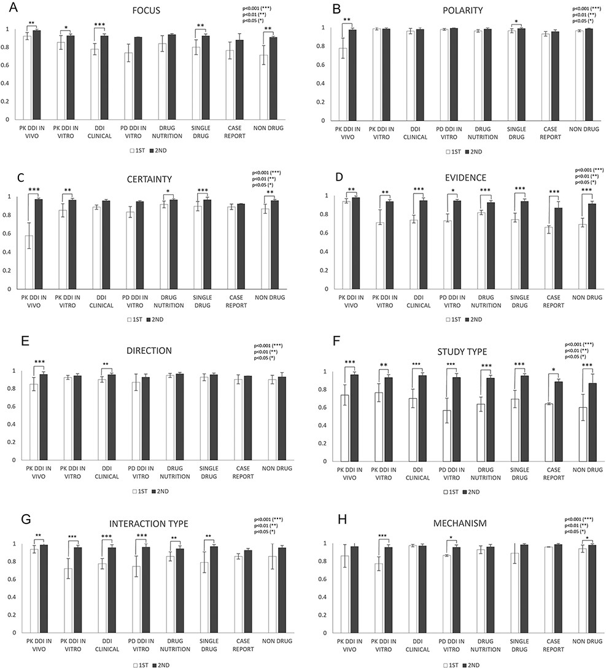
Figure 5. IAAs in eight annotation dimensions among different abstract subcategories. This figure shows IAAs ...
Notes:
Figure 5. IAAs in eight annotation dimensions among different abstract subcategories. This figure shows IAAs (mean ± SEM) for each dimension in different abstract subcategories. The IAAs of Round 1 are shown as white bars and the IAAs of Round 2 are black bars. The asterisk brackets added above the bars indicate statistically significant differences. Error bar represents the standard error of mean. The x-axis labels the eight annotation dimensions, and y-axis represents the IAA.
Unless provided in the caption above, the following copyright applies to the content of this slide: © The Author(s) 2022. Published by Oxford University Press.This is an Open Access article distributed under the terms of the Creative Commons Attribution-NonCommercial License (https://creativecommons.org/licenses/by-nc/4.0/), which permits non-commercial re-use, distribution, and reproduction in any medium, provided the original work is properly cited. For commercial re-use, please contact journals.permissions@oup.com

Slide 6
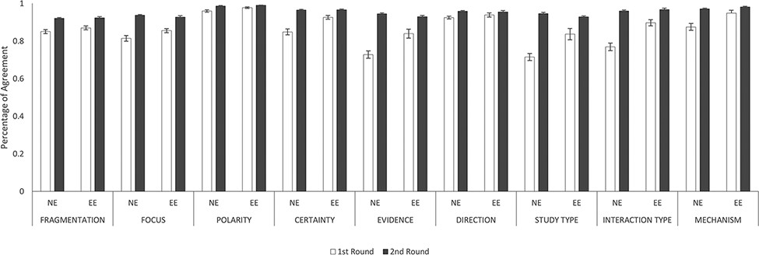
Figure 6. IAAs between novice and experienced annotators and between two experienced annotators. This figure shows the ...
Notes:
Figure 6. IAAs between novice and experienced annotators and between two experienced annotators. This figure shows the IAAs (mean ± SEM) between novice and experienced annotators (NE) and between two experienced annotators (EE), in fragmentation and eight annotation dimensions. The IAAs of Round 1 are shown as white bars and Round 2 IAAs are black bars. Error bar represents standard error of mean. The x-axis labels the eight annotation dimensions, and y-axis represents the IAA.
Unless provided in the caption above, the following copyright applies to the content of this slide: © The Author(s) 2022. Published by Oxford University Press.This is an Open Access article distributed under the terms of the Creative Commons Attribution-NonCommercial License (https://creativecommons.org/licenses/by-nc/4.0/), which permits non-commercial re-use, distribution, and reproduction in any medium, provided the original work is properly cited. For commercial re-use, please contact journals.permissions@oup.com

