Slide 1
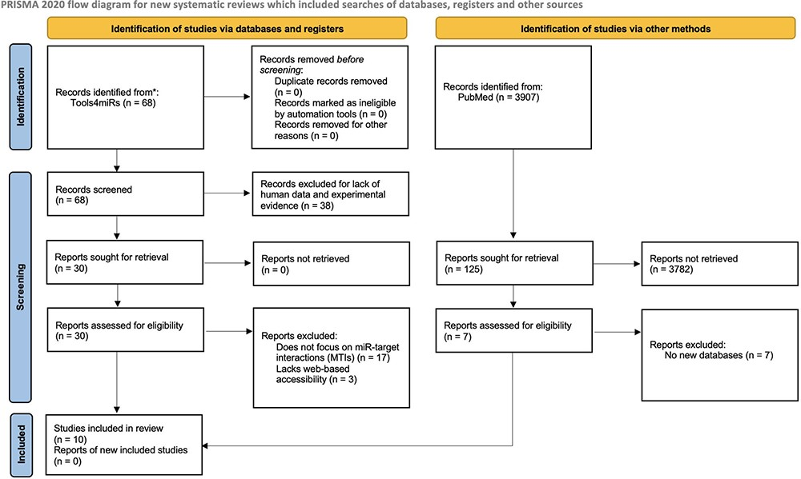
Figure 1. PRISMA flow diagram depicting the systematic selection process of databases for experimentally validated ...
Notes:
Figure 1. PRISMA flow diagram depicting the systematic selection process of databases for experimentally validated human MTIs.
Unless provided in the caption above, the following copyright applies to the content of this slide: © The Author(s) 2023. Published by Oxford University Press.This is an Open Access article distributed under the terms of the Creative Commons Attribution License (https://creativecommons.org/licenses/by/4.0/), which permits unrestricted reuse, distribution, and reproduction in any medium, provided the original work is properly cited.

Slide 2
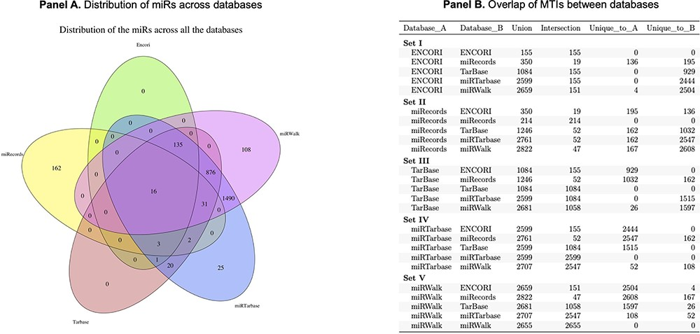
Figure 2. Panel A is a Venn diagram to show the total number of overlapping MTIs across the top five databases. Panel B ...
Notes:
Figure 2. Panel A is a Venn diagram to show the total number of overlapping MTIs across the top five databases. Panel B is a table to show the number of total MTIs in each combination of two databases (Union), the number of MTIs overlapping between each combination of two databases (Intersection) and how many were unique to each database in combinations of two.
Unless provided in the caption above, the following copyright applies to the content of this slide: © The Author(s) 2023. Published by Oxford University Press.This is an Open Access article distributed under the terms of the Creative Commons Attribution License (https://creativecommons.org/licenses/by/4.0/), which permits unrestricted reuse, distribution, and reproduction in any medium, provided the original work is properly cited.

