Slide 1
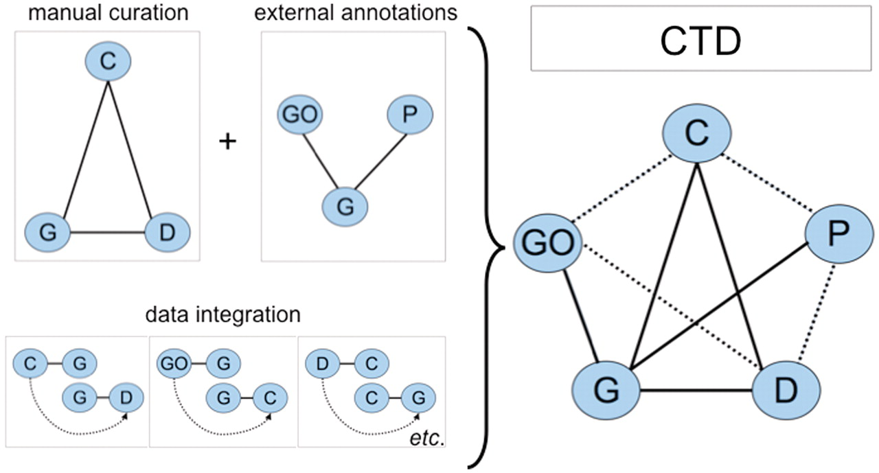
Figure 1. CTD data. Biocurators manually curate a triad of core interactions (solid lines) between chemicals (C), genes ...
Notes:
Figure 1. CTD data. Biocurators manually curate a triad of core interactions (solid lines) between chemicals (C), genes (G) and diseases (D) from the literature. These data are combined with external annotations from Gene Ontology (GO) and KEGG/Reactome pathways (P) via the shared use of NCBI Gene IDs. A unique feature of CTD is the inferred relationships generated by data integration: if a GO term is annotated to gene G, and independently gene G directly interacts with chemical C (via a curated interaction), then the GO term has an inferred relationship to chemical C (inferred via gene G). Data integration between these five nodes (C, G, D, GO and P) additionally yields novel, inferred relationships (dashed lines). In total, CTD becomes larger and more informative than the sum of its individual curated parts.
Unless provided in the caption above, the following copyright applies to the content of this slide: © The Author(s) 2011. Published by Oxford University Press.This is Open Access article distributed under the terms of the Creative Commons Attribution Non-Commercial License (http://creativecommons.org/licenses/by-nc/2.5), which permits unrestricted non-commercial use, distribution, and reproduction in any medium, provided the original work is properly cited.

