Slide 1
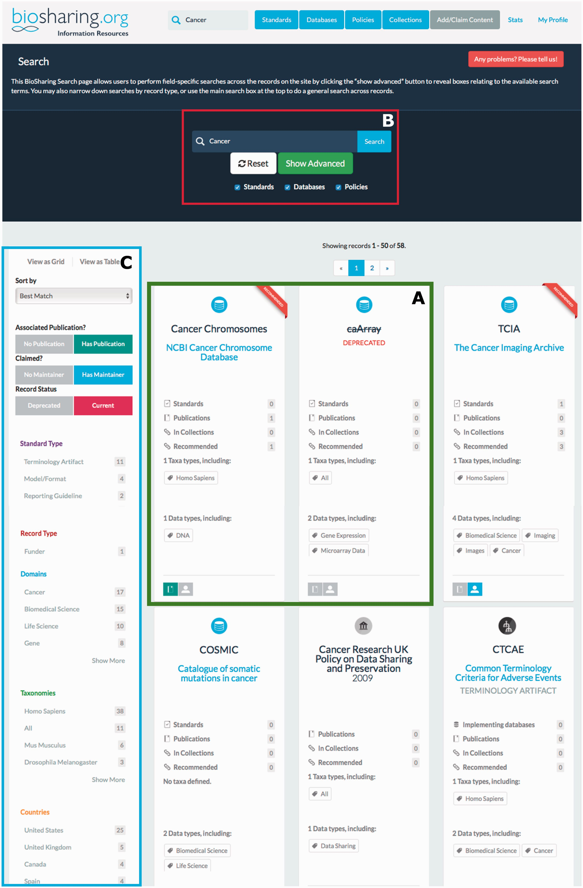
Figure 3 Searching BioSharing. Every search in BioSharing returns a hit list displayed as either a table or grid. In ...
Notes:
Figure 3 Searching BioSharing. Every search in BioSharing returns a hit list displayed as either a table or grid. In this example search, for the text ‘cancer’, 56 records have been retrieved from across the three registries and collections. Each record ‘card’ provides a snapshot of information. Note that the first search hit is recommended, and the second search hit, caArray, is a deprecated database ( A —both highlighted in green). This search can be defined further by clicking on the advanced search option in the top search section ( B —highlighted in red), which leads to a field-specific search. The search can be refined using the filter matrix, found down the left-hand side of the search results ( C —highlighted in blue). This filter allows the selection of records based on a range of information. For example, whether they have a publication associated with them, if they pertain to a particular species or domain, or are associated with a particular country or funding agency.
Unless provided in the caption above, the following copyright applies to the content of this slide: © The Author(s) 2016. Published by Oxford University Press. This is an Open Access article distributed under the terms of the Creative Commons Attribution License ( http://creativecommons.org/licenses/by/4.0/ ), which permits unrestricted reuse, distribution, and reproduction in any medium, provided the original work is properly cited.

