Slide 1
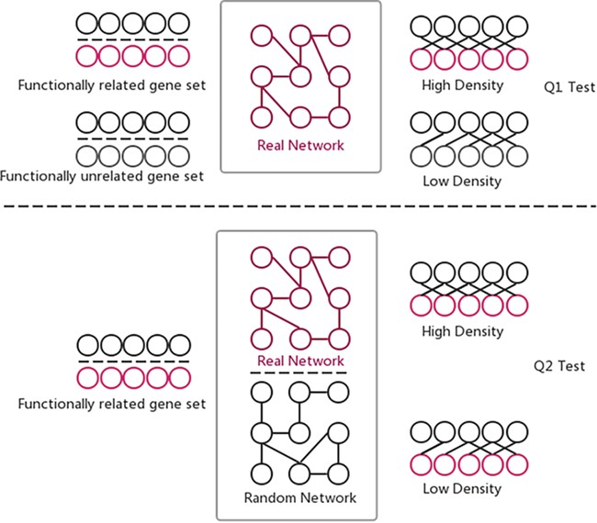
Figure 4 Two hypothesis tests that GSLA used to identify significant functional associations between two gene sets ...
Notes:
Figure 4 Two hypothesis tests that GSLA used to identify significant functional associations between two gene sets that are biologically meaningful. Q1 tests whether the density of functional associations between two biologically meaningful gene sets is higher than random gene pairs, while Q2 tests whether the strong functional associations observed between two gene sets can only be observed from the biologically correct network, rather than any random interactomes.
Unless provided in the caption above, the following copyright applies to the content of this slide: © The Author(s) 2020. Published by Oxford University Press.This article is published and distributed under the terms of the Oxford University Press, Standard Journals Publication Model (https://academic.oup.com/journals/pages/open_access/funder_policies/chorus/standard_publication_model)

