Slide 1
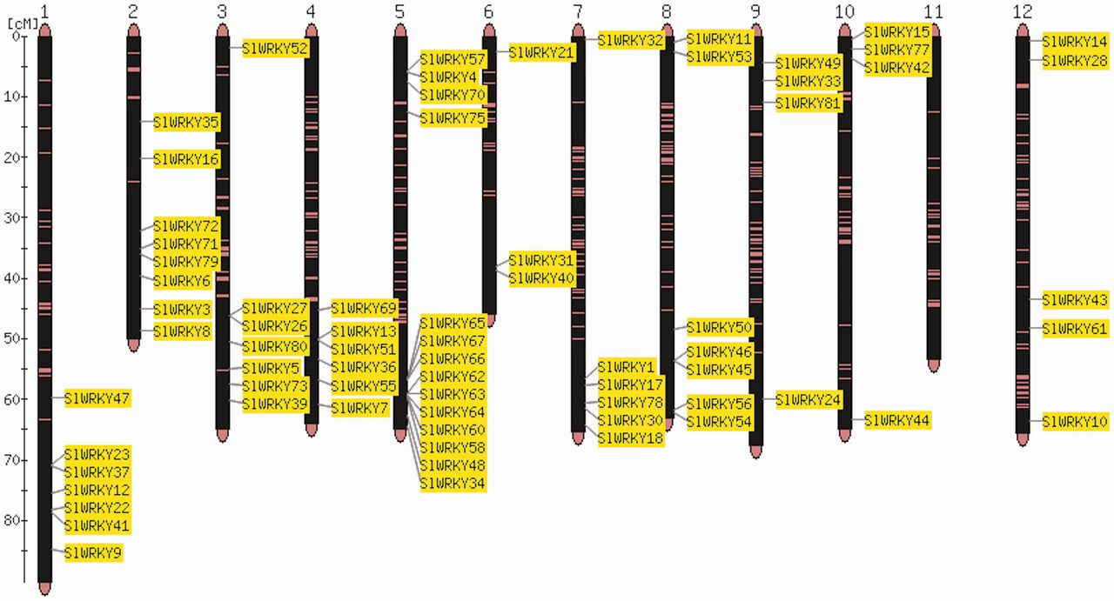
Figure 1. Map viewer. Chromosome distribution of the 82 members of the tomato WRKY gene family. The shown locations are ...
Notes:
Figure 1. Map viewer. Chromosome distribution of the 82 members of the tomato WRKY gene family. The shown locations are based on the physical position of each corresponding genome gene model, based on the ITAG2.3 annotation of the tomato genome.
Unless provided in the caption above, the following copyright applies to the content of this slide: © The Author(s) 2013. Published by Oxford University Press.This is an Open Access article distributed under the terms of the Creative Commons Attribution Non-Commercial License (http://creativecommons.org/licenses/by-nc/3.0/), which permits unrestricted non-commercial use, distribution, and reproduction in any medium, provided the original work is properly cited.

