Slide 1
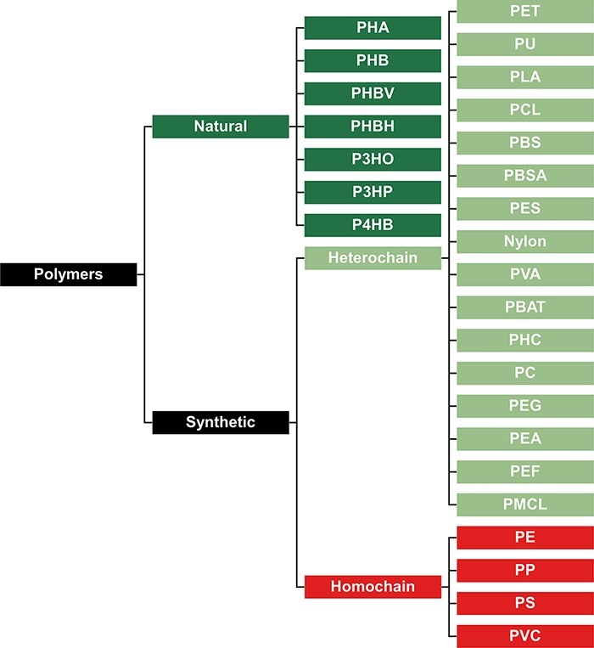
Figure 2. Classification of polymers to represent their presumed biodegradation potential. Natural polymers are more ...
Notes:
Figure 2. Classification of polymers to represent their presumed biodegradation potential. Natural polymers are more biodegradable, synthetic heterochain polymers have an intermediate biodegradability, and synthetic homochain polymers are the least biodegradable.
Unless provided in the caption above, the following copyright applies to the content of this slide: © The Author(s) 2022. Published by Oxford University Press.This is an Open Access article distributed under the terms of the Creative Commons Attribution License (https://creativecommons.org/licenses/by/4.0/), which permits unrestricted reuse, distribution, and reproduction in any medium, provided the original work is properly cited.

