Slide 1
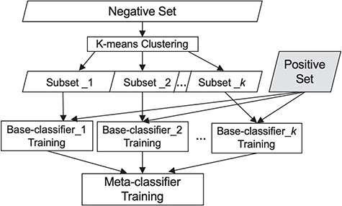
Figure 1 Our classification scheme, combining clustering and meta-classification. The irrelevant training set is ...
Notes:
Figure 1 Our classification scheme, combining clustering and meta-classification. The irrelevant training set is partitioned into K subsets via K-means clustering. Each of the K base-classifiers is trained using one of these K irrelevant subsets along with the relevant training set.
Unless provided in the caption above, the following copyright applies to the content of this slide: © The Author(s) 2019. Published by Oxford University Press.This is an Open Access article distributed under the terms of the Creative Commons Attribution License (http://creativecommons.org/licenses/by/4.0/), which permits unrestricted reuse, distribution, and reproduction in any medium, provided the original work is properly cited.

