Slide 1
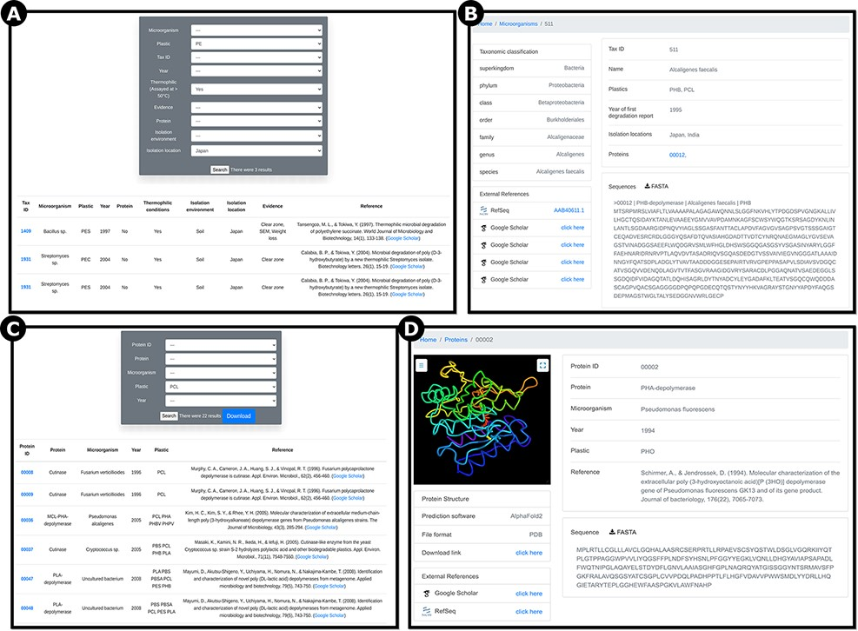
Figure 4. Screenshots of example pages showing information on reported plastic-degrading microorganisms and proteins. ...
Notes:
Figure 4. Screenshots of example pages showing information on reported plastic-degrading microorganisms and proteins. A) ‘Microorganisms’ page showing search results filtered for polyethylene (PE), thermophilic organisms, and isolation location in Japan; B) ‘Microorganisms’ page outputs showing Alcaligenes faecalis, a bacterium reported to degrade PHB and PCL; C) ‘Proteins’ page showing 22 results for the plastic type polycaprolactone (PCL). D) ‘Proteins’ page showing Pseudomonas fluorescens PHA-depolymerase, reported to break down polyhydroxyoctanoate (PHO; RefSeq ID AAA64538.1). Users can visualize the predicted protein structure, download the prediction in PDB file format and download the sequence in FASTA file format.
Unless provided in the caption above, the following copyright applies to the content of this slide: © The Author(s) 2022. Published by Oxford University Press.This is an Open Access article distributed under the terms of the Creative Commons Attribution License (https://creativecommons.org/licenses/by/4.0/), which permits unrestricted reuse, distribution, and reproduction in any medium, provided the original work is properly cited.

