Slide 1
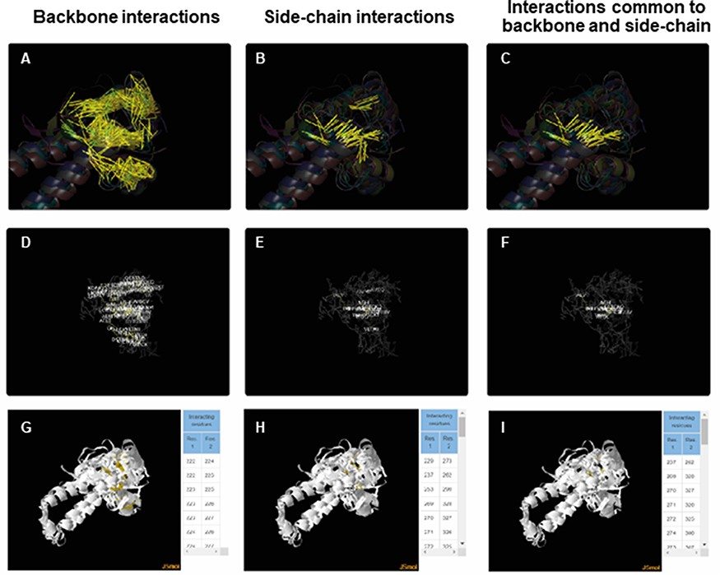
Figure 5. ACIs plotted on superposed structures for the Tubulin C-terminal domain-like superfamily (SCOPe ID 55307). ...
Notes:
Figure 5. ACIs plotted on superposed structures for the Tubulin C-terminal domain-like superfamily (SCOPe ID 55307). The top panel (A–C) consists of figures showing ACIs on superposed structures for backbone, side chain and those common to both of them. The middle panel (D–F) consists of figures showing ACI networks with possible residues at respective positions on the representative structure of the superfamily. The bottom panel (G–I) shows the interactive views available for the three types of ACIs.
Unless provided in the caption above, the following copyright applies to the content of this slide: © The Author(s) 2022. Published by Oxford University Press.This is an Open Access article distributed under the terms of the Creative Commons Attribution License (https://creativecommons.org/licenses/by/4.0/), which permits unrestricted reuse, distribution, and reproduction in any medium, provided the original work is properly cited.

