Slide 1
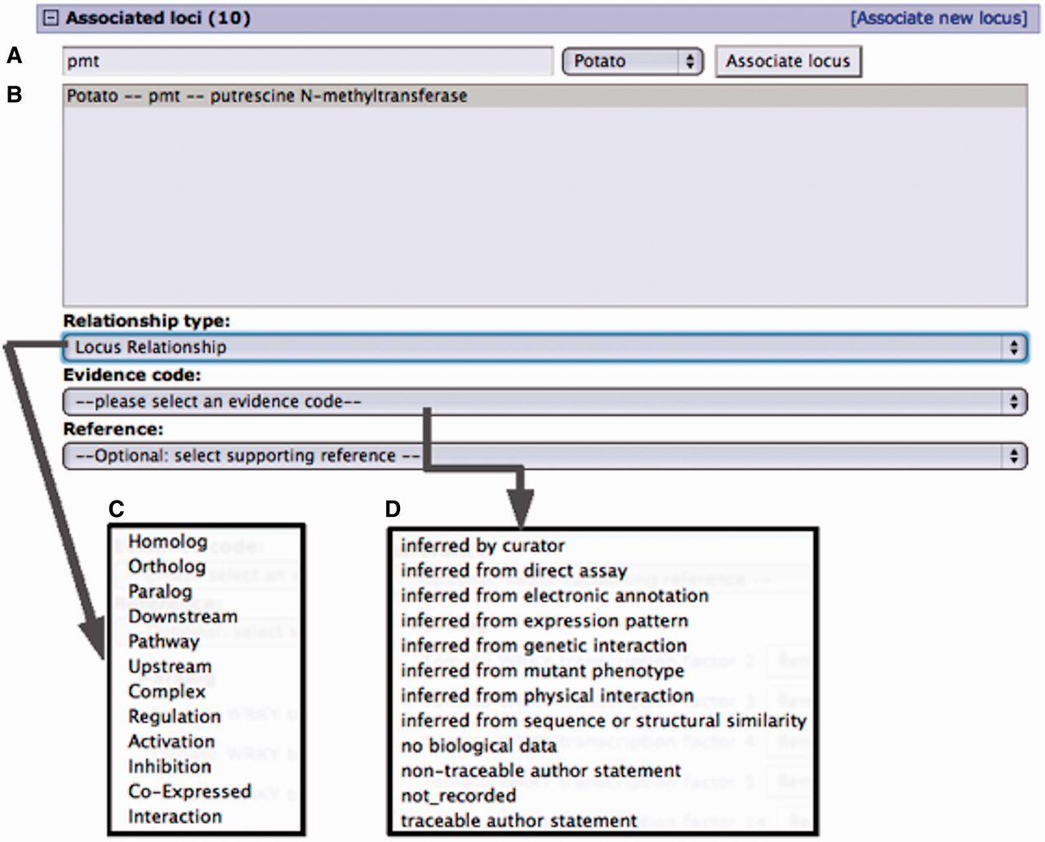
Figure 2. Curation interface for associating a locus from an existing locus page. (A) A search for a locus name by the ...
Notes:
Figure 2. Curation interface for associating a locus from an existing locus page. (A) A search for a locus name by the organism common name. (B) Select locus from the result list pop-up menu. (C) Select the relationship type from the pop-up menu. (D) Select evidence code for the described locus relationship. Adding a reference is optional. Only references associated with the loci involved are presented in the pop-up menu.
Unless provided in the caption above, the following copyright applies to the content of this slide: © The Author(s) 2013. Published by Oxford University Press.This is an Open Access article distributed under the terms of the Creative Commons Attribution Non-Commercial License (http://creativecommons.org/licenses/by-nc/3.0/), which permits unrestricted non-commercial use, distribution, and reproduction in any medium, provided the original work is properly cited.

