Slide 1
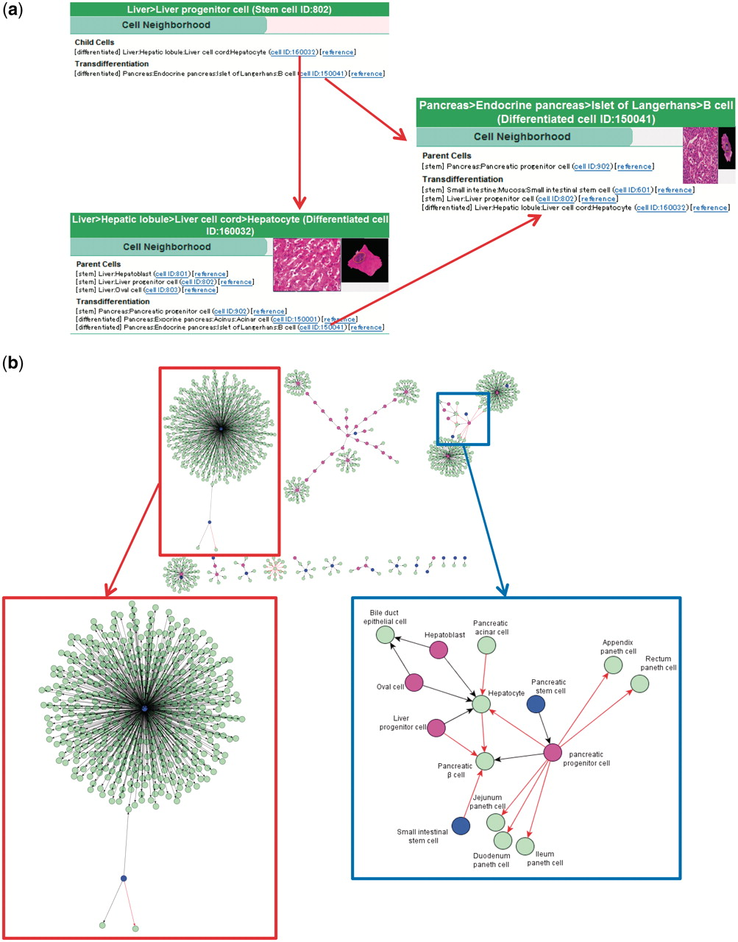
Figure 4. Cell neighborhood links. (a) Cell neighborhood links with the hepatocyte: cell differentiation or ...
Notes:
Figure 4. Cell neighborhood links. (a) Cell neighborhood links with the hepatocyte: cell differentiation or transdifferentiation pathways can be deductively traced. (b) Cell differentiation map constructed with 934 collected binary relationships. Circles filled with different colors indicate levels of differentiated cells (blue: stem cells, wine red: progenitor cells and light green: differentiated cells). Black and red arrows indicate differentiation and transdifferentiation pathways, respectively. The red box shows the mesenchymal stem cell cluster in a magnified view. The blue box shows a part of the endoderm cluster in a magnified view.
Unless provided in the caption above, the following copyright applies to the content of this slide: © The Author(s) 2011. Published by Oxford University Press.This is Open Access article distributed under the terms of the Creative Commons Attribution Non-Commercial License (http://creativecommons.org/licenses/by-nc/2.5), which permits unrestricted non-commercial use, distribution, and reproduction in any medium, provided the original work is properly cited.

