Slide 1
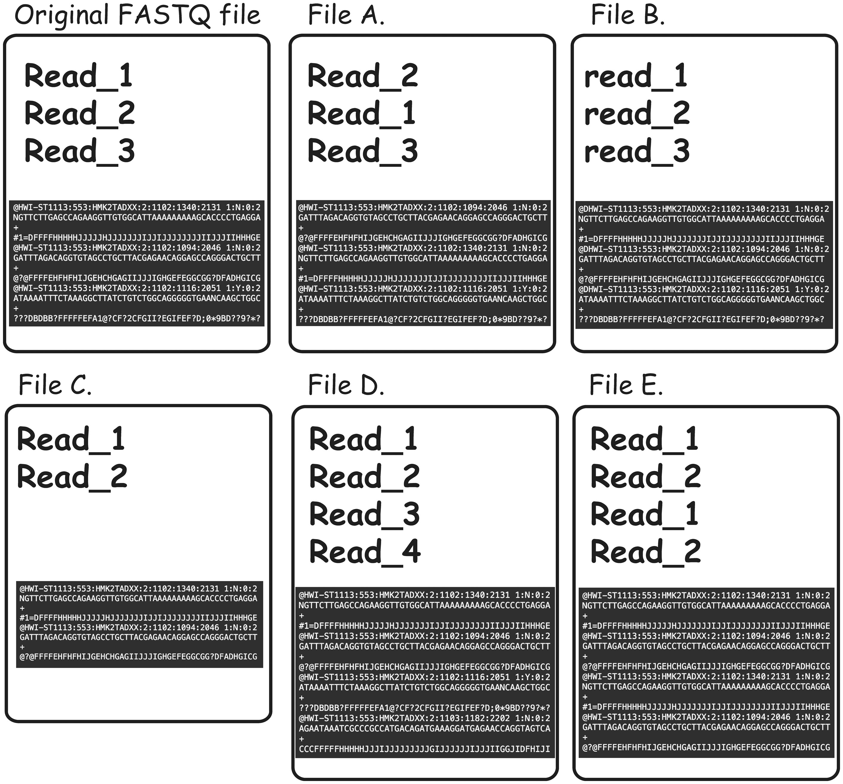
Figure 4. Types of FASTQ file duplications detectable using FASTQ signature heuristic. It is important to note that all ...
Notes:
Figure 4. Types of FASTQ file duplications detectable using FASTQ signature heuristic. It is important to note that all the cases presented here are not detectable using MD5 hash or content MD5 hash function approaches, as those functions’ results will be different from the original FASTQ file for all listed files. File A represents a case where reads from original file are out of order. FASTQ signature heuristic would detect duplication of this type. File B is identical to the original file, except for a small change in read names making detection of file content duplication challenging. Since FASTQ signatures are constructed using only parts of the read name, the ability of the heuristic to detect duplication will rely on the exact places the read names were modified. File C contains subset of the reads from original file and will be detected by FASTQ signature heuristic. File D contains reads not present in original file; however, it will be reported as a potential duplication because it contains reads identical to the content of original FASTQ file. File E will be reported as duplication of the original FASTQ file, since Read_1 and Read_2 appear in both files. However, File E contains both internal duplication and external duplication of the original FASTQ file. The internal duplication is not detectable using our current FASTQ signature approach.
Unless provided in the caption above, the following copyright applies to the content of this slide: © The Author(s) 2018. Published by Oxford University Press.This is an Open Access article distributed under the terms of the Creative Commons Attribution License (http://creativecommons.org/licenses/by/4.0/), which permits unrestricted reuse, distribution, and reproduction in any medium, provided the original work is properly cited.

