Slide 1
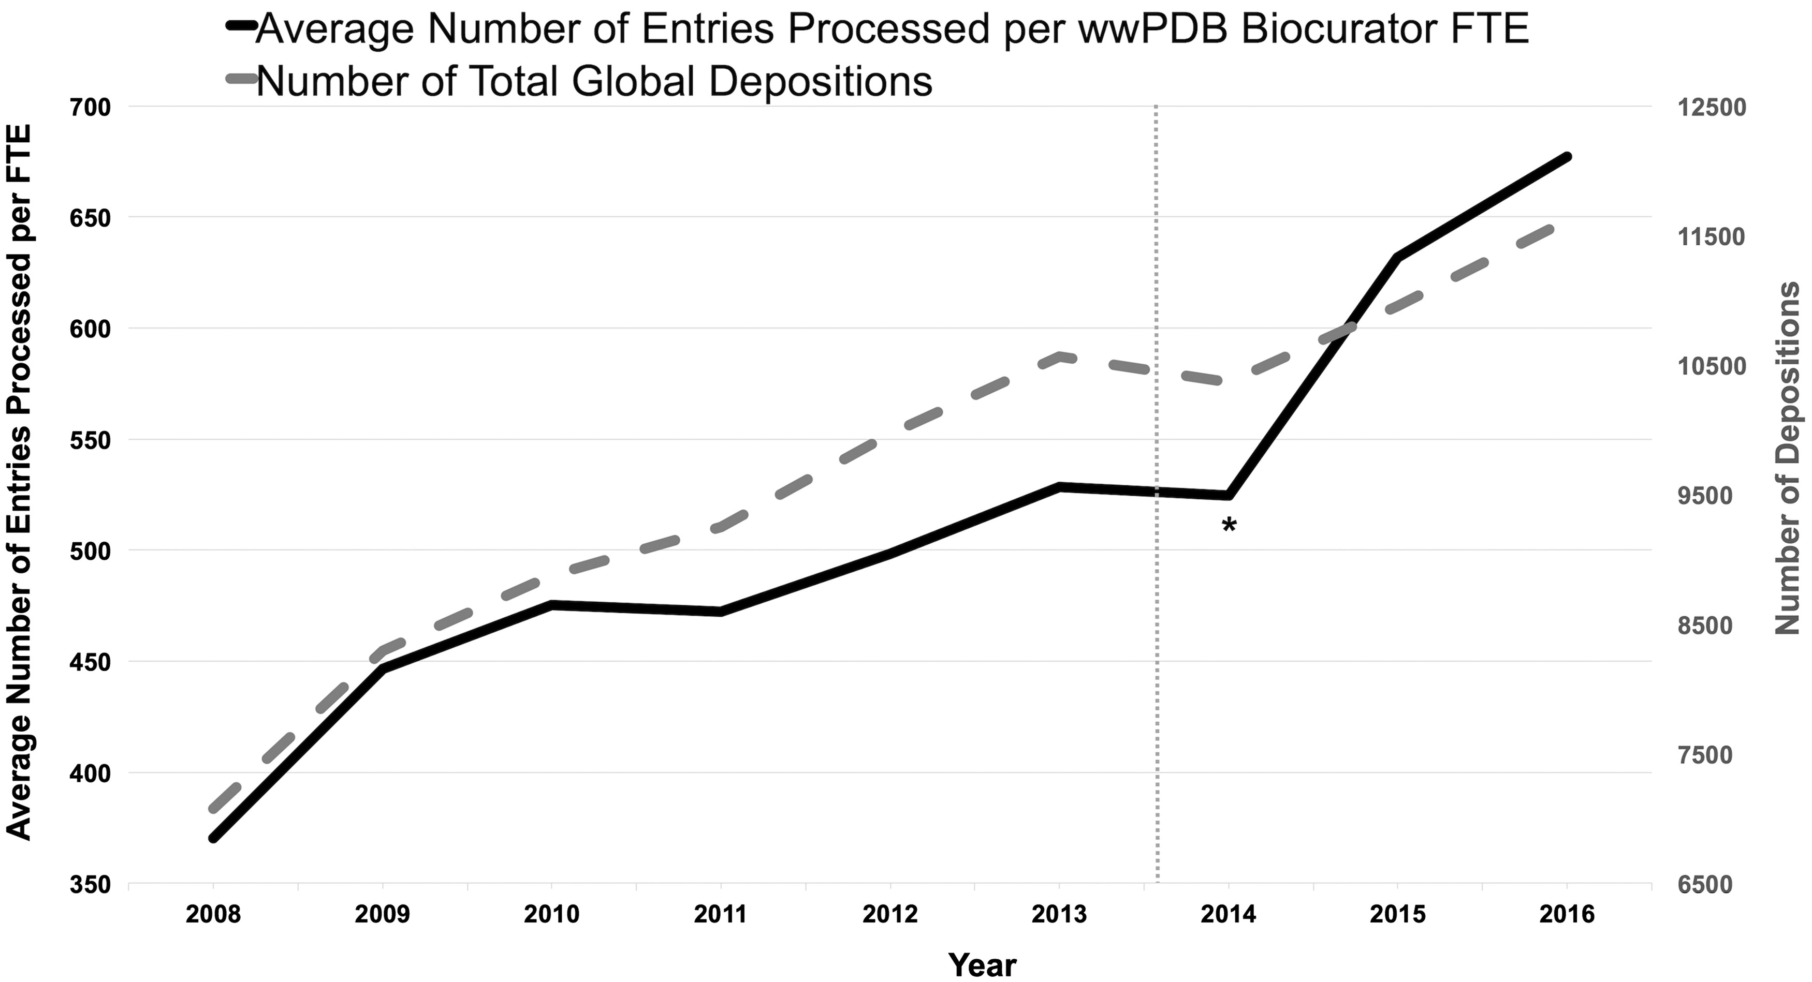
Figure 6. Average number of entries processed per wwPDB biocurator FTE and number of total global depositions per year. ...
Notes:
Figure 6. Average number of entries processed per wwPDB biocurator FTE and number of total global depositions per year. The processing productivity per wwPDB biocurator FTE has nearly doubled since 2008 as shown in this graph. This graph also reflects that the productivity was accelerated with the OneDep system. The label * indicates the transition period when both new OneDep and legacy systems were operated in parallel. The dash line indicates when the wwPDB validation report was first introduced in August 2013.
Unless provided in the caption above, the following copyright applies to the content of this slide: © The Author(s) 2018. Published by Oxford University Press.This is an Open Access article distributed under the terms of the Creative Commons Attribution License (http://creativecommons.org/licenses/by/4.0/), which permits unrestricted reuse, distribution, and reproduction in any medium, provided the original work is properly cited.

