Slide 1
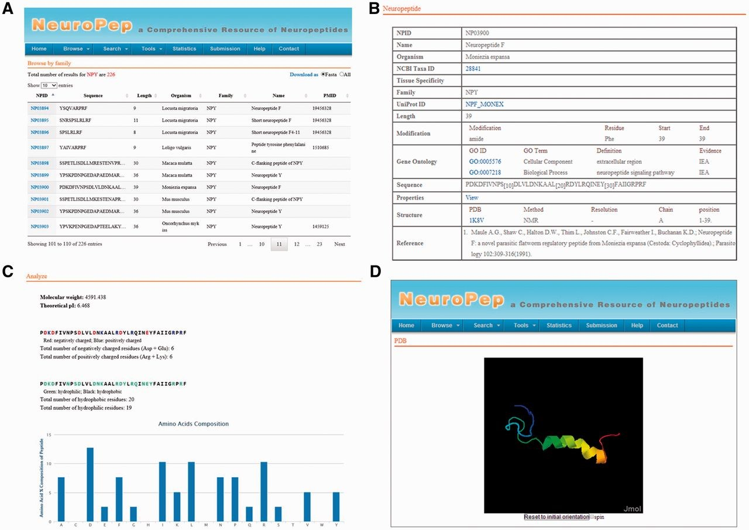
Figure 1. An overview of the user interface of NeuroPep. ( A ) The browse output of NPY neuropeptide family. ( B ) An ...
Notes:
Figure 1. An overview of the user interface of NeuroPep. ( A ) The browse output of NPY neuropeptide family. ( B ) An example of an entry NP03900 of the NPY family. ( C ) The properties page of the entry NP03900. ( D ) The structure view page of the entry NP03900.
Unless provided in the caption above, the following copyright applies to the content of this slide: © The Author(s) 2015. Published by Oxford University Press.This is an Open Access article distributed under the terms of the Creative Commons Attribution License (http://creativecommons.org/licenses/by/4.0/), which permits unrestricted reuse, distribution, and reproduction in any medium, provided the original work is properly cited.

Slide 2
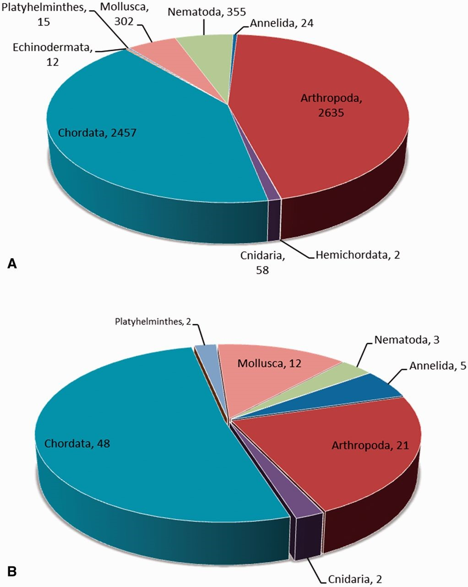
Figure 2. ( A ) The neuropeptide frequency distribution based on phyla. ( B ) The neuropeptide family distribution ...
Notes:
Figure 2. ( A ) The neuropeptide frequency distribution based on phyla. ( B ) The neuropeptide family distribution based on phyla.
Unless provided in the caption above, the following copyright applies to the content of this slide: © The Author(s) 2015. Published by Oxford University Press.This is an Open Access article distributed under the terms of the Creative Commons Attribution License (http://creativecommons.org/licenses/by/4.0/), which permits unrestricted reuse, distribution, and reproduction in any medium, provided the original work is properly cited.

Slide 3
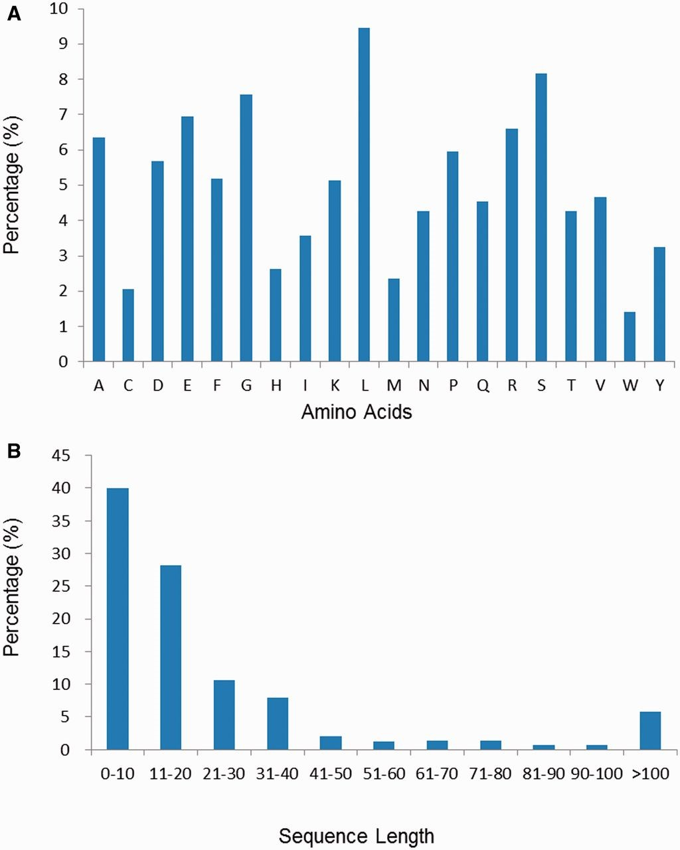
Figure 3. ( A ) The amino acid composition distribution of neuropeptides in NeuroPep database. ( B ) The amino acid ...
Notes:
Figure 3. ( A ) The amino acid composition distribution of neuropeptides in NeuroPep database. ( B ) The amino acid length distribution of neuropeptides in NeuroPep database.
Unless provided in the caption above, the following copyright applies to the content of this slide: © The Author(s) 2015. Published by Oxford University Press.This is an Open Access article distributed under the terms of the Creative Commons Attribution License (http://creativecommons.org/licenses/by/4.0/), which permits unrestricted reuse, distribution, and reproduction in any medium, provided the original work is properly cited.

