Slide 1
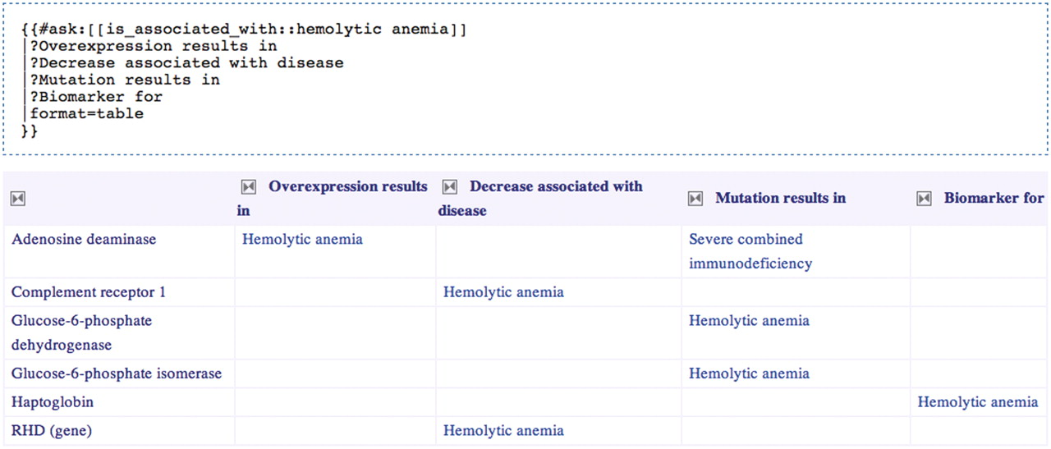
Figure 6 Selecting genes related to hemolytic anemia and exposing the nature of those relationships. The Semantic ...
Notes:
Figure 6 Selecting genes related to hemolytic anemia and exposing the nature of those relationships. The Semantic MediaWiki query is presented above the results table that it generates.
Unless provided in the caption above, the following copyright applies to the content of this slide: © The Author(s) 2012. Published by Oxford University Press.This is an Open Access article distributed under the terms of the Creative Commons Attribution Non-Commercial License (http://creativecommons.org/licenses/by-nc/3.0), which permits unrestricted non-commercial use, distribution, and reproduction in any medium, provided the original work is properly cited.

