Slide 1
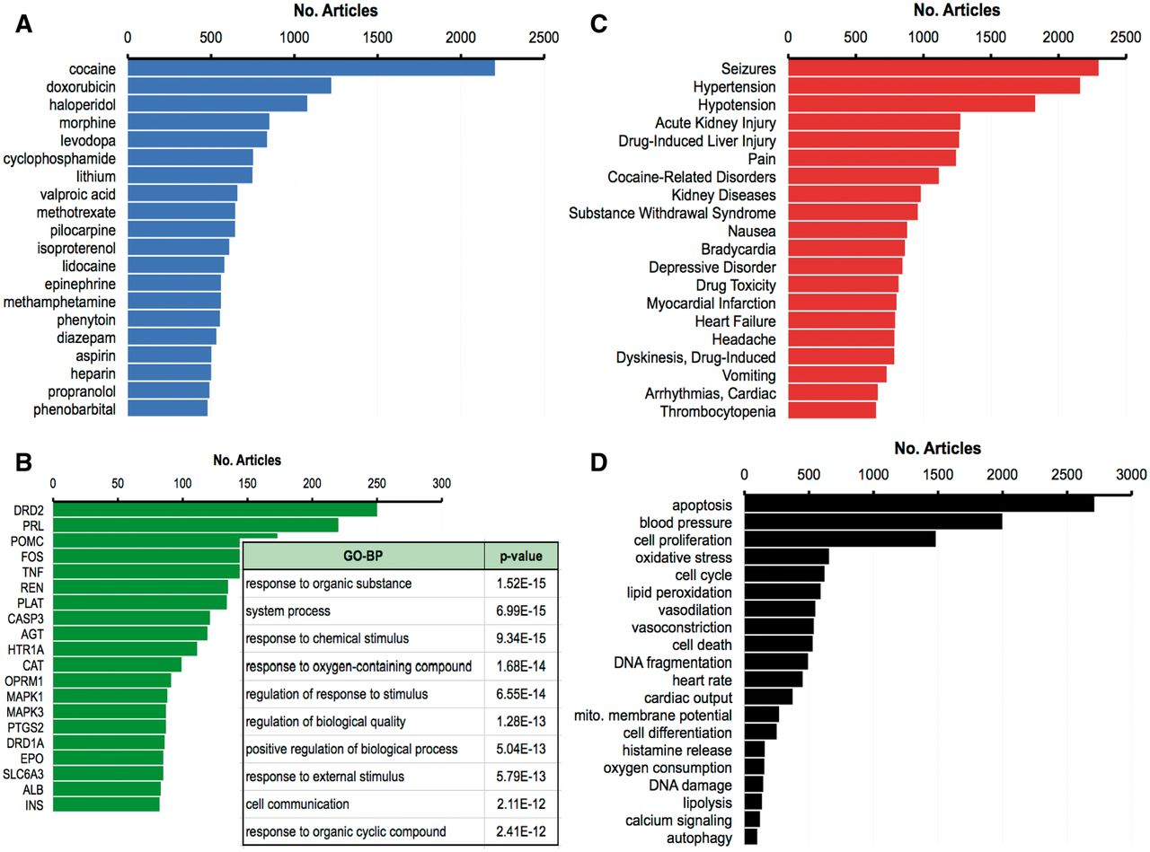
Figure 2. Top 20 curated terms. The 20 most frequently curated chemicals (A, blue), genes (B, green) and diseases (C, ...
Notes:
Figure 2. Top 20 curated terms. The 20 most frequently curated chemicals (A, blue), genes (B, green) and diseases (C, red) from the drug–disease corpus, as measured by the number of articles from whence the term was curated, out of 51 884 total curated articles for this corpus. The inset in (B) lists the 10 most significantly enriched GO-BP and their corrected p-value (Bonferroni multiple testing adjustment) for the top 20 genes. (D) The 20 most frequently curated phenotypes (black) from the drug–phenotype corpus (out of a total of 9646 curated articles).
Unless provided in the caption above, the following copyright applies to the content of this slide: © The Author(s) 2013. Published by Oxford University Press.This is an Open Access article distributed under the terms of the Creative Commons Attribution License (http://creativecommons.org/licenses/by/3.0/), which permits unrestricted reuse, distribution, and reproduction in any medium, provided the original work is properly cited.

