Slide 1
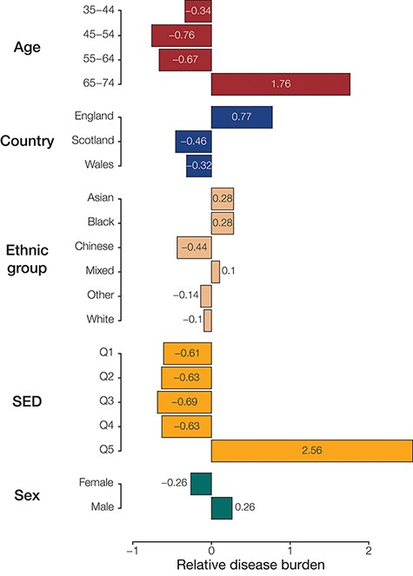
Figure 3. Population (sub)group disease burdens. Relative disease burden values are shown for population groups’ ...
Notes:
Figure 3. Population (sub)group disease burdens. Relative disease burden values are shown for population groups’ constituent subgroups.
Unless provided in the caption above, the following copyright applies to the content of this slide: Published by Oxford University Press 2023. This work is written by (a) US Government employee(s) and is in the public domain in the US.This work is written by (a) US Government employee(s) and is in the public domain in the US.

