Slide 1
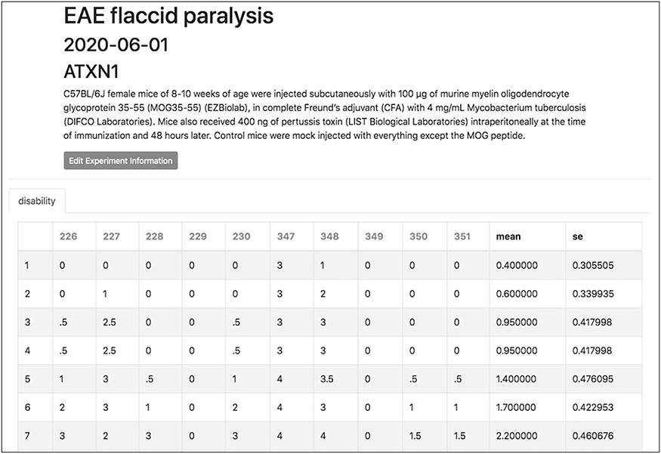
Figure 6. The experiment interface of TopoDB allows the efficient organization and storage of experimental data points. ...
Notes:
Figure 6. The experiment interface of TopoDB allows the efficient organization and storage of experimental data points. In this example, the EAE scores collected on a cohort of 10 mice up to 11 days postimmunization are organized in a spreadsheet format. The individual mouse ID numbers are displayed on the top row. Mean values and SEs are also automatically calculated for each day.
Unless provided in the caption above, the following copyright applies to the content of this slide: © The Author(s) 2020. Published by Oxford University Press.This is an Open Access article distributed under the terms of the Creative Commons Attribution License (http://creativecommons.org/licenses/by/4.0/), which permits unrestricted reuse, distribution, and reproduction in any medium, provided the original work is properly cited.

