Slide 1
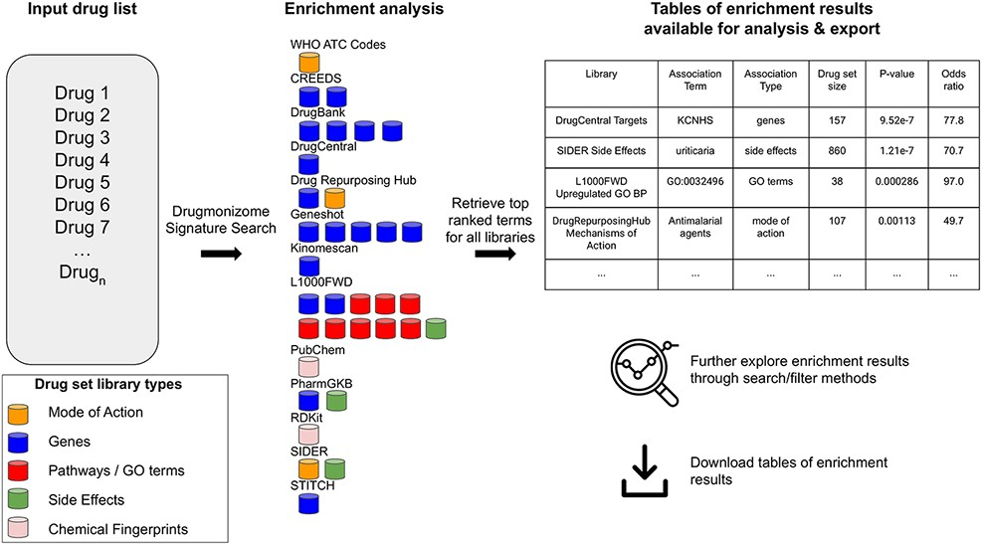
Figure 2. The Drugmonizome signature search workflow. A set of drugs is submitted for enrichment analysis across all ...
Notes:
Figure 2. The Drugmonizome signature search workflow. A set of drugs is submitted for enrichment analysis across all the Drugmonizome gene set libraries. The enrichment results are provided in tables that enable further exploration of the overlapping drugs.
Unless provided in the caption above, the following copyright applies to the content of this slide: © The Author(s) 2021. Published by Oxford University Press.This is an Open Access article distributed under the terms of the Creative Commons Attribution License (http://creativecommons.org/licenses/by/4.0/), which permits unrestricted reuse, distribution, and reproduction in any medium, provided the original work is properly cited.

