Slide 1
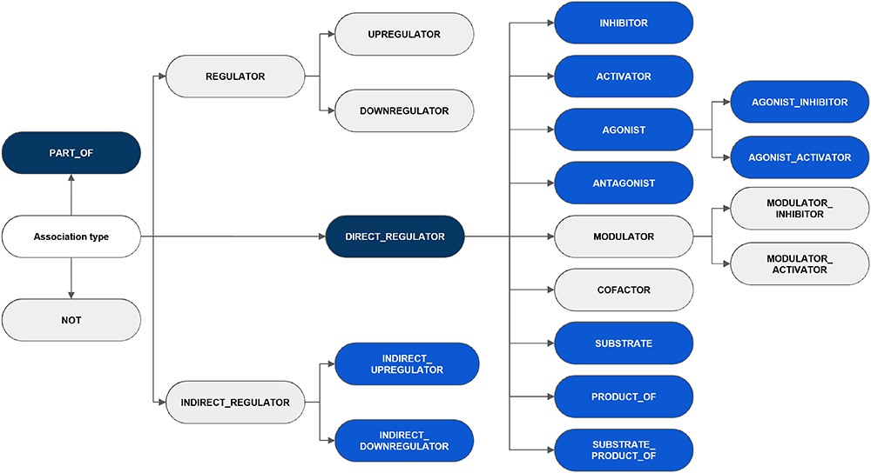
Figure 3. An overview of the hierarchy of DrugProt relation types and classification considered in annotation ...
Notes:
Figure 3. An overview of the hierarchy of DrugProt relation types and classification considered in annotation guidelines. The elements in blue represent those chosen for the DrugProt task, with dark-blue indicating the classes and light-blue representing the subclasses. They were selected based on their impact, the number of annotated instances, the internal consistency of the relation tree and the prediction performance determined by a baseline system (37).
Unless provided in the caption above, the following copyright applies to the content of this slide: © The Author(s) 2023. Published by Oxford University Press.This is an Open Access article distributed under the terms of the Creative Commons Attribution License (https://creativecommons.org/licenses/by/4.0/), which permits unrestricted reuse, distribution, and reproduction in any medium, provided the original work is properly cited.

