Slide 1
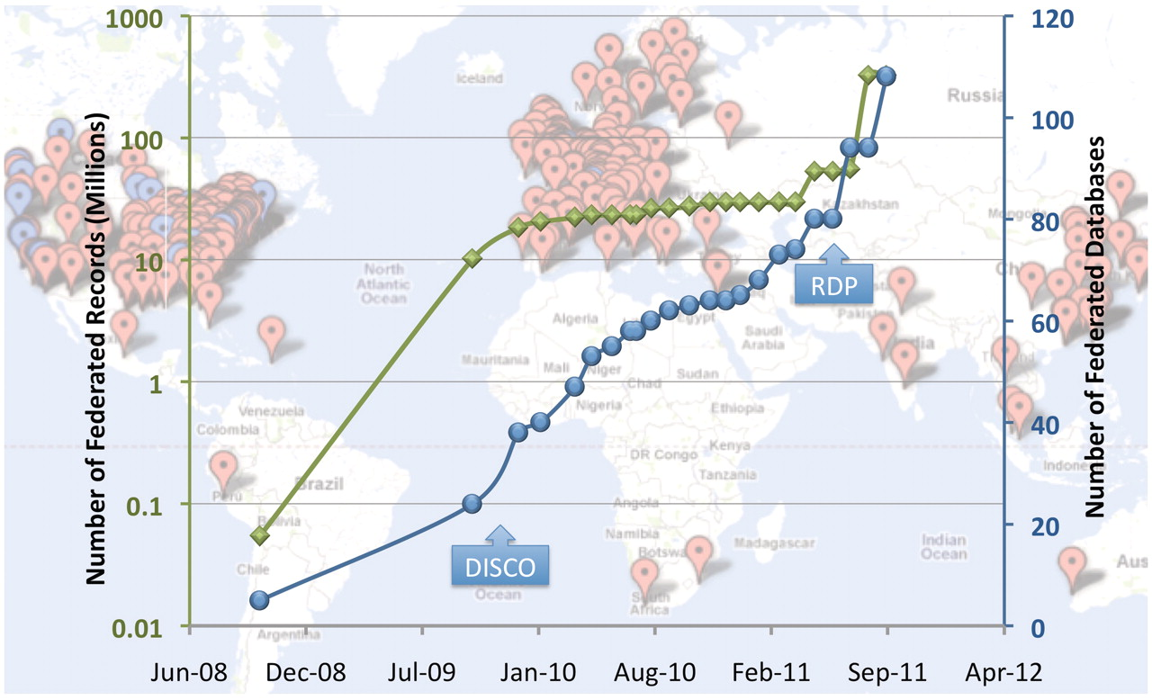
Figure 1. NIF Resource Landscape. Background: each point on the map represents a global location that houses one or ...
Notes:
Figure 1. NIF Resource Landscape. Background: each point on the map represents a global location that houses one or more resources registered with the NIF (via NeuroLex). Red points represent NIF registry entries and blue points represent databases and data sets incorporated into the data federation. Foreground: the blue line represents a plot of the number of federated data sources over time, and the green line represents the number of records in the NIF Data Federation over the same time (note these records come from only the blue dots and that the scale is logarithmic). The DISCO protocols and automated resource crawling were integrated into NIF system function in November 2009 and led to a growth of NIF holdings and in mid 2011, significant enhancements of the DISCO protocols allowing for enhanced automation of data ingestion, as well as the current resource discovery pipeline (RDP) were implemented.
Unless provided in the caption above, the following copyright applies to the content of this slide: © The Author(s) 2012. Published by Oxford University Press.This is an Open Access article distributed under the terms of the Creative Commons Attribution Non-Commercial License (http://creativecommons.org/licenses/by-nc/3.0), which permits unrestricted non-commercial use, distribution, and reproduction in any medium, provided the original work is properly cited.

