Slide 1
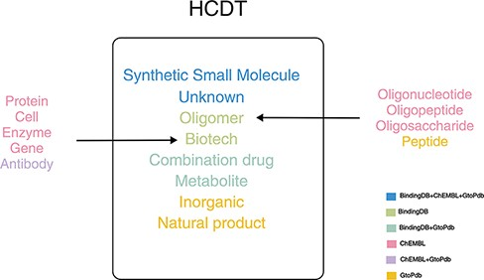
Figure 1. Drug classifications in HCDT database.
Notes:
Figure 1. Drug classifications in HCDT database.
Unless provided in the caption above, the following copyright applies to the content of this slide: © The Author(s) 2022. Published by Oxford University Press.This is an Open Access article distributed under the terms of the Creative Commons Attribution-NonCommercial License (https://creativecommons.org/licenses/by-nc/4.0/), which permits non-commercial re-use, distribution, and reproduction in any medium, provided the original work is properly cited. For commercial re-use, please contact journals.permissions@oup.com

Slide 2
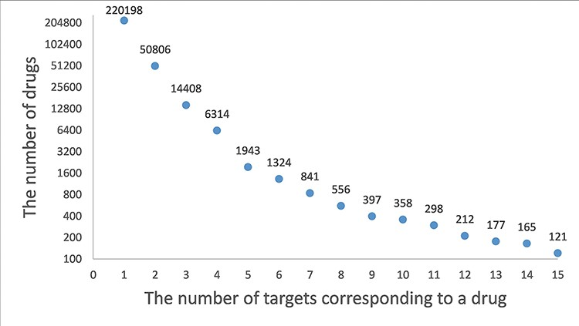
Figure 2. A frequency plot of the number of targets for a drug. The x-axis indicates the number of targets ...
Notes:
Figure 2. A frequency plot of the number of targets for a drug. The x-axis indicates the number of targets corresponding to a drug and the y-axis indicates the number of drugs. In this figure, only the drugs with less than 15 target genes are shown which account for 99.5% of the drugs.
Unless provided in the caption above, the following copyright applies to the content of this slide: © The Author(s) 2022. Published by Oxford University Press.This is an Open Access article distributed under the terms of the Creative Commons Attribution-NonCommercial License (https://creativecommons.org/licenses/by-nc/4.0/), which permits non-commercial re-use, distribution, and reproduction in any medium, provided the original work is properly cited. For commercial re-use, please contact journals.permissions@oup.com

Slide 3
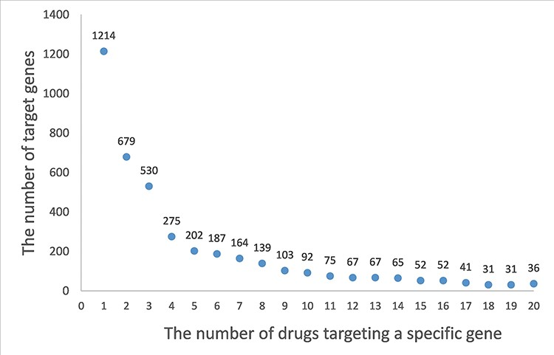
Figure 3. A frequency plot of the number of drugs targeting a specific gene. The x-axis indicates the number of drugs ...
Notes:
Figure 3. A frequency plot of the number of drugs targeting a specific gene. The x-axis indicates the number of drugs targeting a specific gene, and y-axis indicates the number of target genes. In this figure, only the genes with less than 20 related drugs are shown which account for 73% of the target genes.
Unless provided in the caption above, the following copyright applies to the content of this slide: © The Author(s) 2022. Published by Oxford University Press.This is an Open Access article distributed under the terms of the Creative Commons Attribution-NonCommercial License (https://creativecommons.org/licenses/by-nc/4.0/), which permits non-commercial re-use, distribution, and reproduction in any medium, provided the original work is properly cited. For commercial re-use, please contact journals.permissions@oup.com

Slide 4
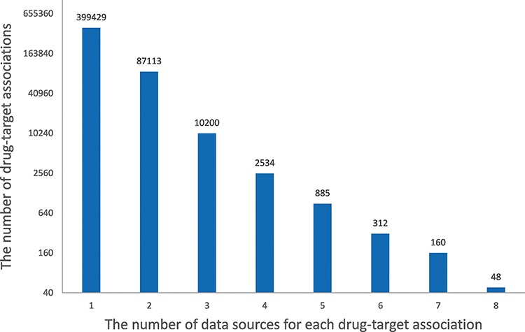
Figure 4. Histogram of the number of data sources for each drug–target association. The x-axis indicates the number of ...
Notes:
Figure 4. Histogram of the number of data sources for each drug–target association. The x-axis indicates the number of data sources for each drug–target association, and the y-axis indicates the number of drug–target associations.
Unless provided in the caption above, the following copyright applies to the content of this slide: © The Author(s) 2022. Published by Oxford University Press.This is an Open Access article distributed under the terms of the Creative Commons Attribution-NonCommercial License (https://creativecommons.org/licenses/by-nc/4.0/), which permits non-commercial re-use, distribution, and reproduction in any medium, provided the original work is properly cited. For commercial re-use, please contact journals.permissions@oup.com

