Slide 1
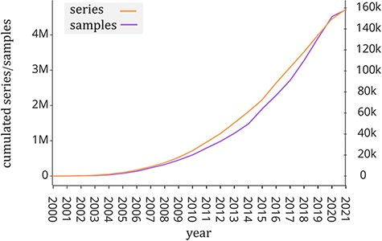
Figure 1. Number of samples (GSM, left y-axis) and experiments (GSE, right y-axis) made available by the GEO portal; ...
Notes:
Figure 1. Number of samples (GSM, left y-axis) and experiments (GSE, right y-axis) made available by the GEO portal; raw data were extracted from https://www.ncbi.nlm.nih.gov/geo/browse/?view=samples and https://www.ncbi.nlm.nih.gov/geo/browse/?view=series).
Unless provided in the caption above, the following copyright applies to the content of this slide: © The Author(s) 2022. Published by Oxford University Press.This is an Open Access article distributed under the terms of the Creative Commons Attribution License (https://creativecommons.org/licenses/by/4.0/), which permits unrestricted reuse, distribution, and reproduction in any medium, provided the original work is properly cited.

Slide 2
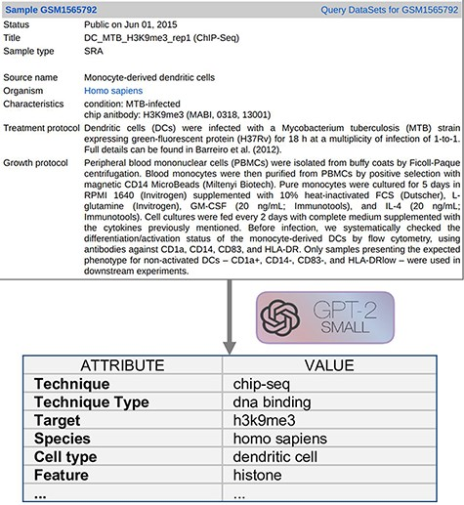
Figure 2. Example input document and possible output format.
Notes:
Figure 2. Example input document and possible output format.
Unless provided in the caption above, the following copyright applies to the content of this slide: © The Author(s) 2022. Published by Oxford University Press.This is an Open Access article distributed under the terms of the Creative Commons Attribution License (https://creativecommons.org/licenses/by/4.0/), which permits unrestricted reuse, distribution, and reproduction in any medium, provided the original work is properly cited.

Slide 3
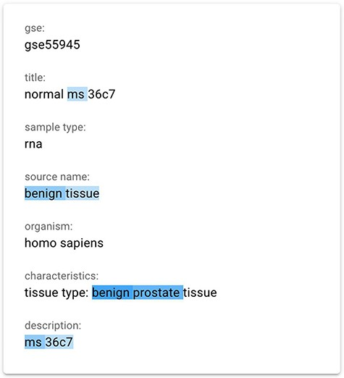
Figure 3. The gradient-based saliency map implemented in the GeMI tool. The words referring to the prediction of the ...
Notes:
Figure 3. The gradient-based saliency map implemented in the GeMI tool. The words referring to the prediction of the ‘Sex’ attribute for the GSM1348947, ‘ms’, ‘benign tissue’, ‘benign prostate’ and ‘ms 36c7’ are highlighted because they are used by the model to predict the necessary fields.
Unless provided in the caption above, the following copyright applies to the content of this slide: © The Author(s) 2022. Published by Oxford University Press.This is an Open Access article distributed under the terms of the Creative Commons Attribution License (https://creativecommons.org/licenses/by/4.0/), which permits unrestricted reuse, distribution, and reproduction in any medium, provided the original work is properly cited.

Slide 4
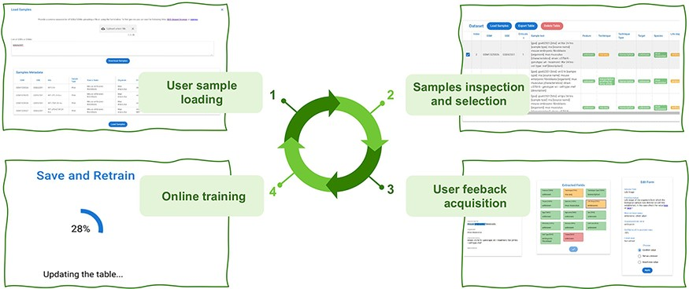
Figure 4. The four iterative phases of the AL framework.
Notes:
Figure 4. The four iterative phases of the AL framework.
Unless provided in the caption above, the following copyright applies to the content of this slide: © The Author(s) 2022. Published by Oxford University Press.This is an Open Access article distributed under the terms of the Creative Commons Attribution License (https://creativecommons.org/licenses/by/4.0/), which permits unrestricted reuse, distribution, and reproduction in any medium, provided the original work is properly cited.

Slide 5
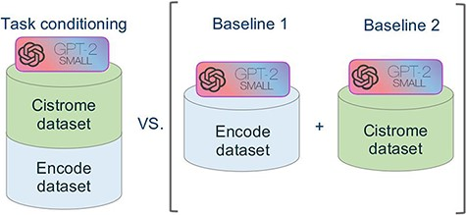
Figure 5. Schematic representation of the comparative experimental setting. On the right, separate models were trained ...
Notes:
Figure 5. Schematic representation of the comparative experimental setting. On the right, separate models were trained on the ENCODE and Cistrome datasets (as presented in (7)). On the left, the task conditional setting presented in this work, employing the two training datasets together.
Unless provided in the caption above, the following copyright applies to the content of this slide: © The Author(s) 2022. Published by Oxford University Press.This is an Open Access article distributed under the terms of the Creative Commons Attribution License (https://creativecommons.org/licenses/by/4.0/), which permits unrestricted reuse, distribution, and reproduction in any medium, provided the original work is properly cited.

Slide 6
Figure 6. Bar plot representing the accuracy of experiments on the two separate baselines (trained on ENCODE or ...
Notes:
Figure 6. Bar plot representing the accuracy of experiments on the two separate baselines (trained on ENCODE or Cistrome data) and on our new model. On the x-axis we report all the attributes considered for prediction.
Unless provided in the caption above, the following copyright applies to the content of this slide: © The Author(s) 2022. Published by Oxford University Press.This is an Open Access article distributed under the terms of the Creative Commons Attribution License (https://creativecommons.org/licenses/by/4.0/), which permits unrestricted reuse, distribution, and reproduction in any medium, provided the original work is properly cited.

Slide 7
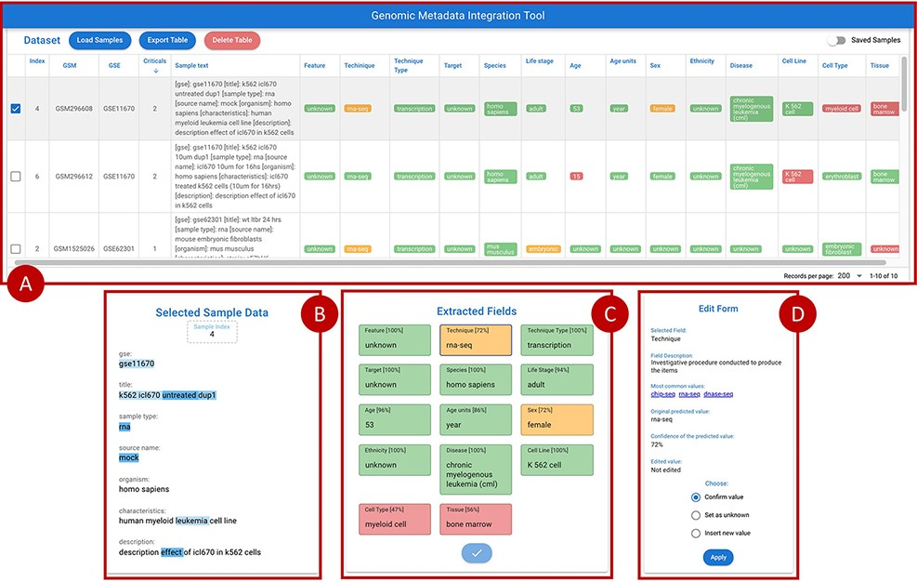
Figure 7. Overview of the GeMI interface, divided in four panels. Panel A represents loaded samples with original and ...
Notes:
Figure 7. Overview of the GeMI interface, divided in four panels. Panel A represents loaded samples with original and predicted information. Panel B provides the gradient-based saliency map related to the sample selected in the table above. Panel C shows the predicted values for the selected sample, also reporting the for accuracy of the prediction. Panel D allows users to actively modify the prediction of the model and save the suggestions.
Unless provided in the caption above, the following copyright applies to the content of this slide: © The Author(s) 2022. Published by Oxford University Press.This is an Open Access article distributed under the terms of the Creative Commons Attribution License (https://creativecommons.org/licenses/by/4.0/), which permits unrestricted reuse, distribution, and reproduction in any medium, provided the original work is properly cited.

Slide 8
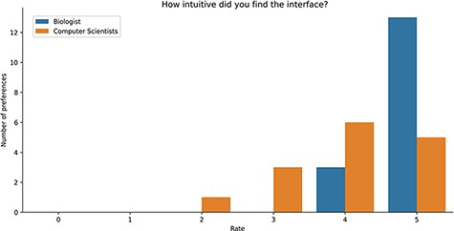
Figure 8. Bar plot of the answers to the question about the intuitiveness of GeMI according to the survey participant.
Notes:
Figure 8. Bar plot of the answers to the question about the intuitiveness of GeMI according to the survey participant.
Unless provided in the caption above, the following copyright applies to the content of this slide: © The Author(s) 2022. Published by Oxford University Press.This is an Open Access article distributed under the terms of the Creative Commons Attribution License (https://creativecommons.org/licenses/by/4.0/), which permits unrestricted reuse, distribution, and reproduction in any medium, provided the original work is properly cited.

Slide 9
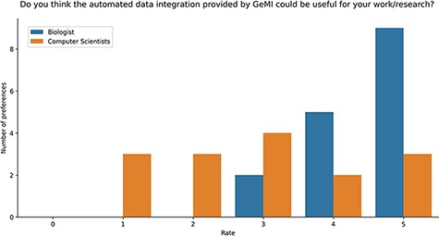
Figure 9. Bar plot of the answers to the question about the usefulness of GeMI for user’s future researches according ...
Notes:
Figure 9. Bar plot of the answers to the question about the usefulness of GeMI for user’s future researches according to the survey participants.
Unless provided in the caption above, the following copyright applies to the content of this slide: © The Author(s) 2022. Published by Oxford University Press.This is an Open Access article distributed under the terms of the Creative Commons Attribution License (https://creativecommons.org/licenses/by/4.0/), which permits unrestricted reuse, distribution, and reproduction in any medium, provided the original work is properly cited.

