Slide 1
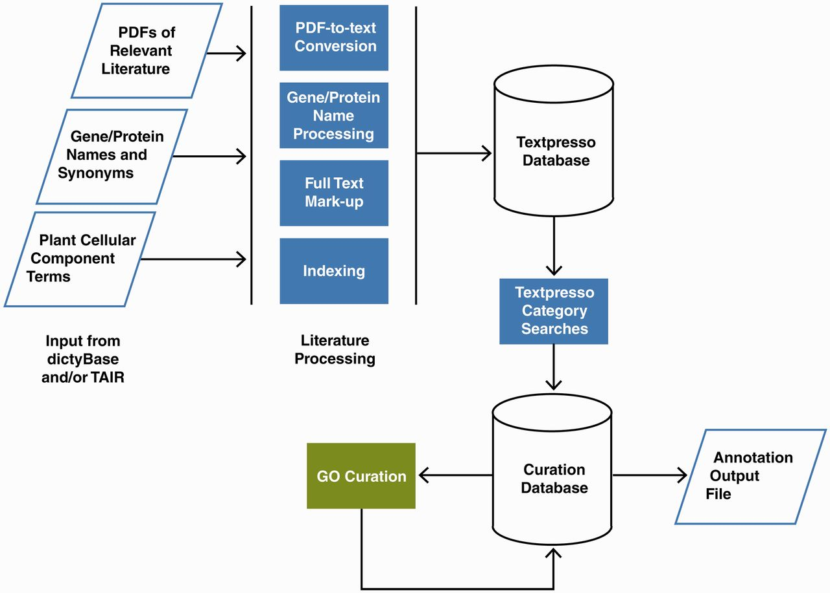
Figure 2 Pipeline for Textpresso for Cellular Component Curation for dictyBase and TAIR. PDFs of publications included ...
Notes:
Figure 2 Pipeline for Textpresso for Cellular Component Curation for dictyBase and TAIR. PDFs of publications included in the dictyBase and TAIR curation corpora and files of Dictyostelium and Arabidopsis gene and protein names and synonyms are uploaded to a Textpresso server at Caltech. PDFs are converted to text; gene and protein names and synonyms are processed to include variants (e.g. upper- and lower-case versions), and organism-specific terms are added to the Textpresso cellular component ontology. Full text is then marked up using the new categories. Four- and five-category searches are performed on the full text and results formatted and stored for use in the curation database. Using a Web-based curation form, curators make annotations that are subsequently stored in the curation database and available for export as annotation files.
Unless provided in the caption above, the following copyright applies to the content of this slide: © The Author(s) 2012. Published by Oxford University Press.This is an Open Access article distributed under the terms of the Creative Commons Attribution License (http://creativecommons.org/licenses/by-nc/3.0/), which permits non-commercial reuse, distribution, and reproduction in any medium, provided the original work is properly cited. For commercial re-use, please contact journals.permissions@oup.com.

