Slide 1
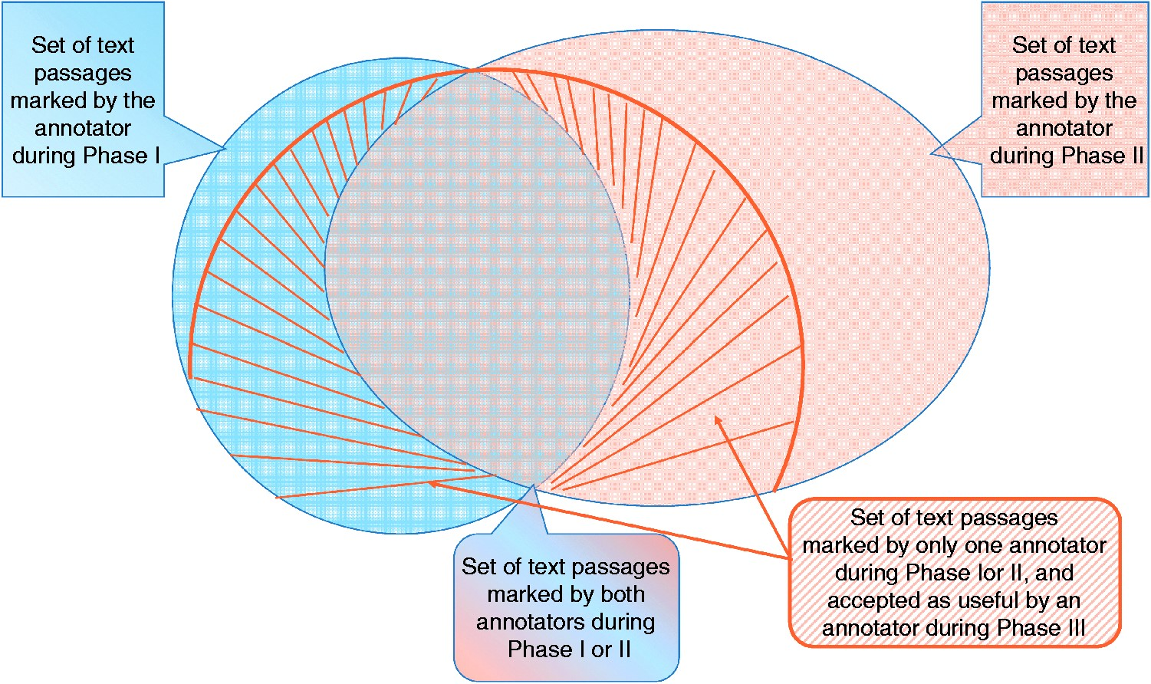
Figure 4. Graphic representation of IAA. For each article, an annotator highlighted several text passages as useful ...
Notes:
Figure 4. Graphic representation of IAA. For each article, an annotator highlighted several text passages as useful annotations for curation during Phase I. A second annotator reading the same article marked a different set of passages (Phase II). The two sets overlap, and also contain differences. Annotations of Phases I and II, which marked sentences that did not overlap, were re-assessed by two different curators in Phase III, where they decided whether that passage was useful or not. The striped area shows the set that was accepted during Phase III.
Unless provided in the caption above, the following copyright applies to the content of this slide: Published by Oxford University Press 2017. This work is written by US Government employees and is in the public domain in the US.

