Slide 1
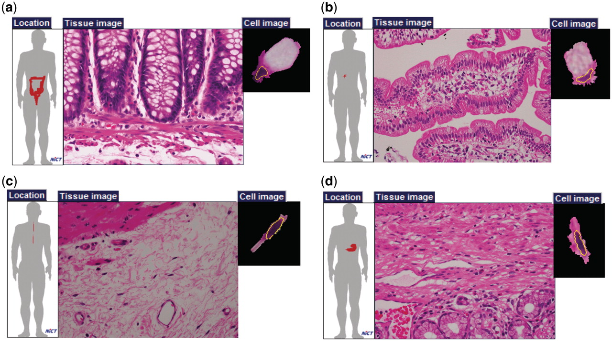
Figure 3. Examples of cells with the same names. Goblet cells of (a) large intestine and (b) small intestine; and ...
Notes:
Figure 3. Examples of cells with the same names. Goblet cells of (a) large intestine and (b) small intestine; and fibroblasts of (c) esophageal submucosa and (d) pylorus.
Unless provided in the caption above, the following copyright applies to the content of this slide: © The Author(s) 2011. Published by Oxford University Press.This is Open Access article distributed under the terms of the Creative Commons Attribution Non-Commercial License (http://creativecommons.org/licenses/by-nc/2.5), which permits unrestricted non-commercial use, distribution, and reproduction in any medium, provided the original work is properly cited.

