Slide 1
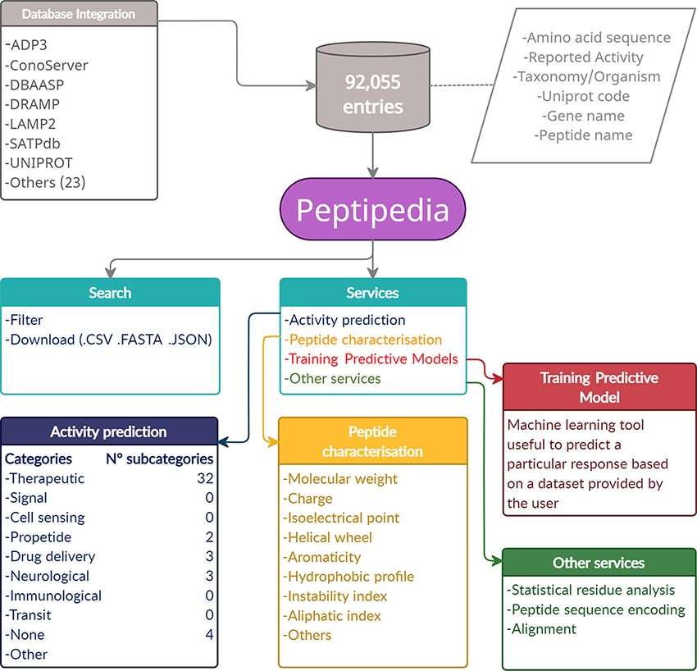
Figure 1. Representative scheme of building and characteristics of Peptipedia. Peptipedia is a computational tool for ...
Notes:
Figure 1. Representative scheme of building and characteristics of Peptipedia. Peptipedia is a computational tool for peptide sequence analysis. The information presented by our tool was consolidated from 30 databases, considering information on the sequence, taxonomy and different properties of stored peptides. Searching for sequences and relevant information in our web application is easy, personalized and intuitive, allowing download of the information in multiple formats. Peptipedia has enabled different tools that will help characterize and analyse sequences, as well as functionalities supported by machine learning methods that facilitate the development of predictive models and a biological activity predictor system.
Unless provided in the caption above, the following copyright applies to the content of this slide: © The Author(s) 2021. Published by Oxford University Press.This is an Open Access article distributed under the terms of the Creative Commons Attribution License (https://creativecommons.org/licenses/by/4.0/), which permits unrestricted reuse, distribution, and reproduction in any medium, provided the original work is properly cited.

Slide 2
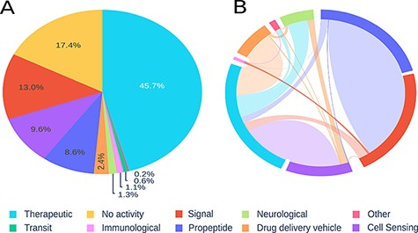
Figure 2. Visualization of registered peptides on Peptipedia. Representation of the information contained in ...
Notes:
Figure 2. Visualization of registered peptides on Peptipedia. Representation of the information contained in Peptipedia. A: distribution of peptides according to the categories proposed in this work. B: analysis of the relationship of simultaneous activities for the same type of peptide; the most significant trends are seen between therapeutics and cell sensing peptides, and between propeptides and signal.
Unless provided in the caption above, the following copyright applies to the content of this slide: © The Author(s) 2021. Published by Oxford University Press.This is an Open Access article distributed under the terms of the Creative Commons Attribution License (https://creativecommons.org/licenses/by/4.0/), which permits unrestricted reuse, distribution, and reproduction in any medium, provided the original work is properly cited.

Slide 3
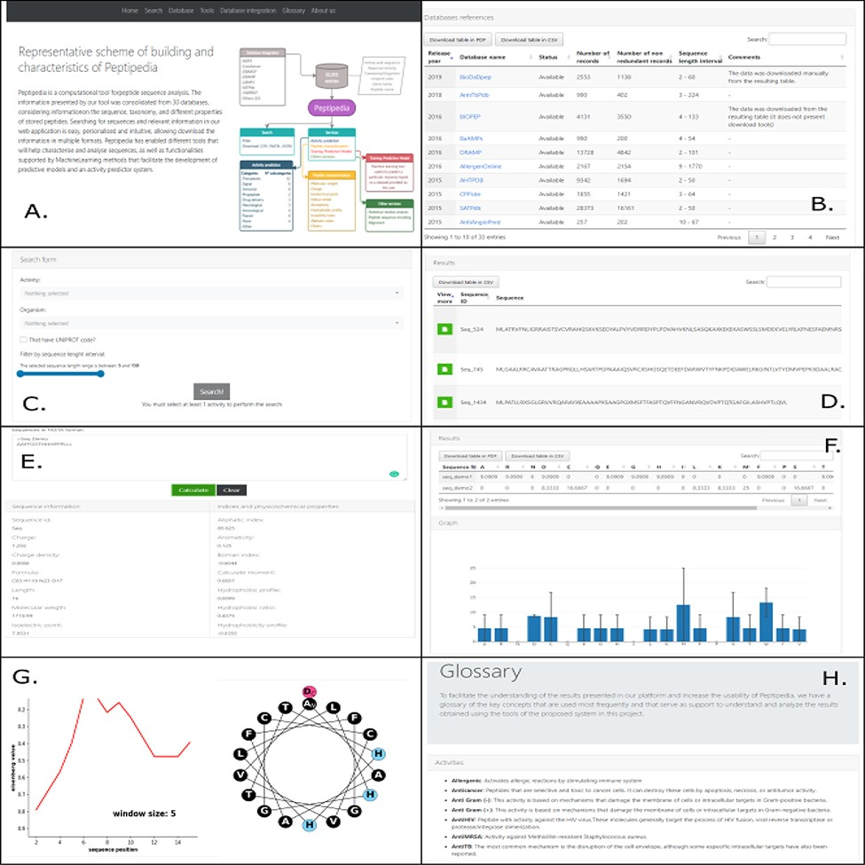
Figure 3. Different visualizations of the Peptipedia web interface. Home Page of Peptipedia (A). Different web tools ...
Notes:
Figure 3. Different visualizations of the Peptipedia web interface. Home Page of Peptipedia (A). Different web tools and previously reported database used to generate the integrated collection of peptides in the proposed tool on this work (B). The search in Peptipedia is easy, you can filter by activity and add more specific filters to personalize the search. The results are disposed in a summary table (C and D). Peptipedia has different services or tools to increase the usability of the web platform; to use any tool, you need to insert a sequence in FASTA format and execute the tool. The results will be displayed depending on the selected service, which could be a summary table, graphic summary and specialized graphic (E, F and G). Finally a glossary with different terms is available on Peptipedia to help the understanding of results generated by the application tool (H).
Unless provided in the caption above, the following copyright applies to the content of this slide: © The Author(s) 2021. Published by Oxford University Press.This is an Open Access article distributed under the terms of the Creative Commons Attribution License (https://creativecommons.org/licenses/by/4.0/), which permits unrestricted reuse, distribution, and reproduction in any medium, provided the original work is properly cited.

Slide 4
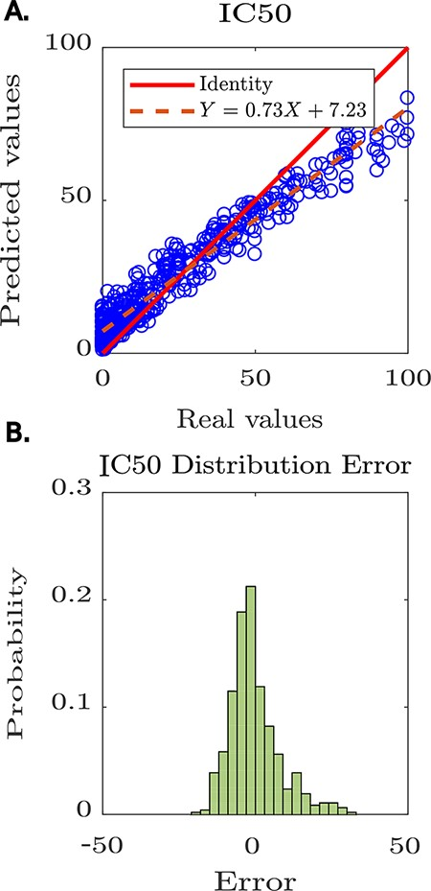
Figure 4. Predictive modelling of IC₅₀ for anti-HIV peptides using Peptipedia. A: scatter plot prediction vs ...
Notes:
Figure 4. Predictive modelling of IC50 for anti-HIV peptides using Peptipedia. A: scatter plot prediction vs reality, denoting the performance of the predictive model. In general, there is no tendency to over-adjust or under-adjust in any particular range, which shows that the cross-validation strategies were correctly applied. B: histogram of the error distribution. The probability of error analysis indicates no tendency for significant errors that adversely alter the model predictions. The errors are mainly concentrated between -5 and 5, which is quite acceptable considering the nature of the entered values, where the largest reach 100 and the smallest are close to zero.
Unless provided in the caption above, the following copyright applies to the content of this slide: © The Author(s) 2021. Published by Oxford University Press.This is an Open Access article distributed under the terms of the Creative Commons Attribution License (https://creativecommons.org/licenses/by/4.0/), which permits unrestricted reuse, distribution, and reproduction in any medium, provided the original work is properly cited.

