Slide 1
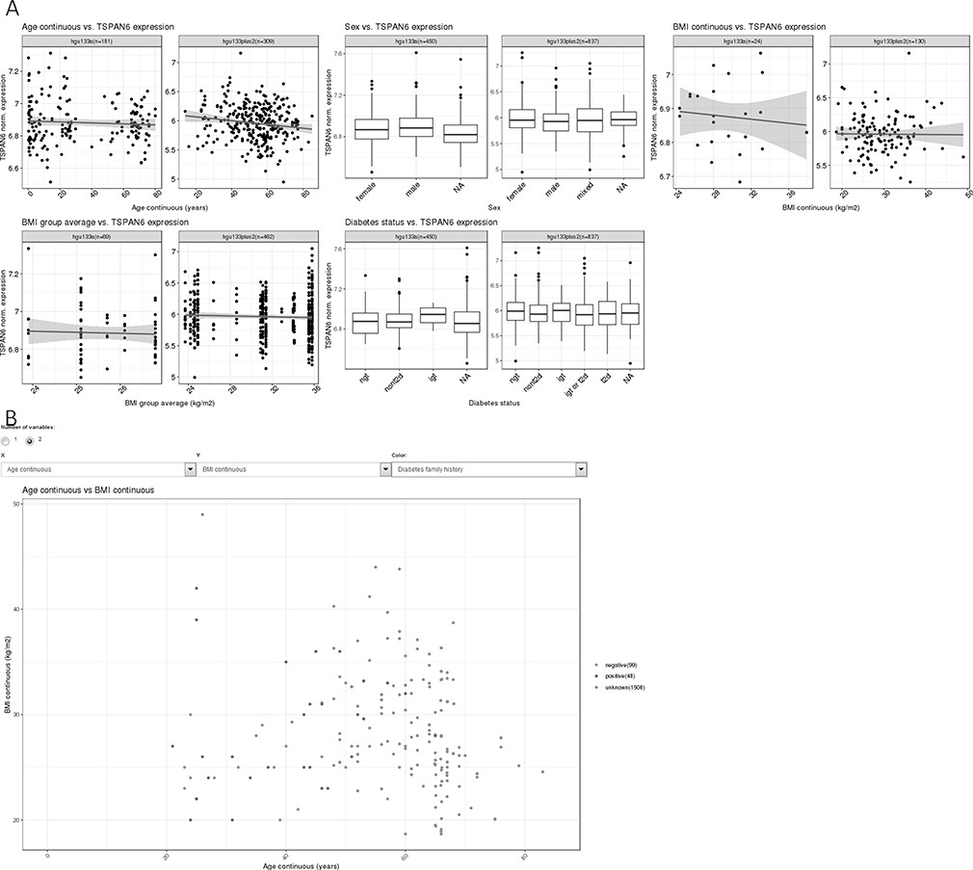
Figure 1. (A) Example of the gene summary view, showing expression data for the gene H3 histone, family 3B (H3F3B) in ...
Notes:
Figure 1. (A) Example of the gene summary view, showing expression data for the gene H3 histone, family 3B (H3F3B) in relation to important phenotypes. (B) One example of two-variable plots produced by MuscleAtlasExplorer, i.e. scatter plots for two different continuous variables (exemplified by age and BMI, with coloring set to signify diabetes family history).
Unless provided in the caption above, the following copyright applies to the content of this slide: © The Author(s) 2021. Published by Oxford University Press.This is an Open Access article distributed under the terms of the Creative Commons Attribution License (http://creativecommons.org/licenses/by/4.0/), which permits unrestricted reuse, distribution, and reproduction in any medium, provided the original work is properly cited.

