Slide 1
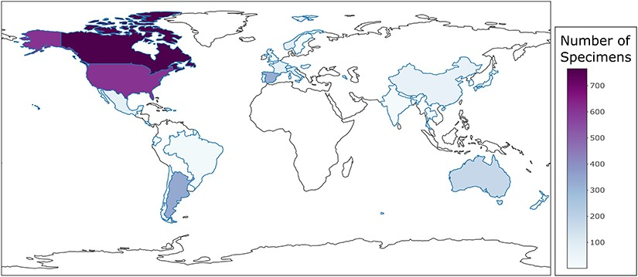
Figure 4. Country-level choropleth map of trichomycetes generated using the CIGAF user interface. The legend shows the ...
Notes:
Figure 4. Country-level choropleth map of trichomycetes generated using the CIGAF user interface. The legend shows the trichomycetes specimen intensity, with the darker purple color indicating the larger number of associated collection records. Countries that show a white color without a defined blue outline have zero collection records within the database.
Unless provided in the caption above, the following copyright applies to the content of this slide: © The Author(s) 2023. Published by Oxford University Press.This is an Open Access article distributed under the terms of the Creative Commons Attribution License (https://creativecommons.org/licenses/by/4.0/), which permits unrestricted reuse, distribution, and reproduction in any medium, provided the original work is properly cited.

