Slide 1
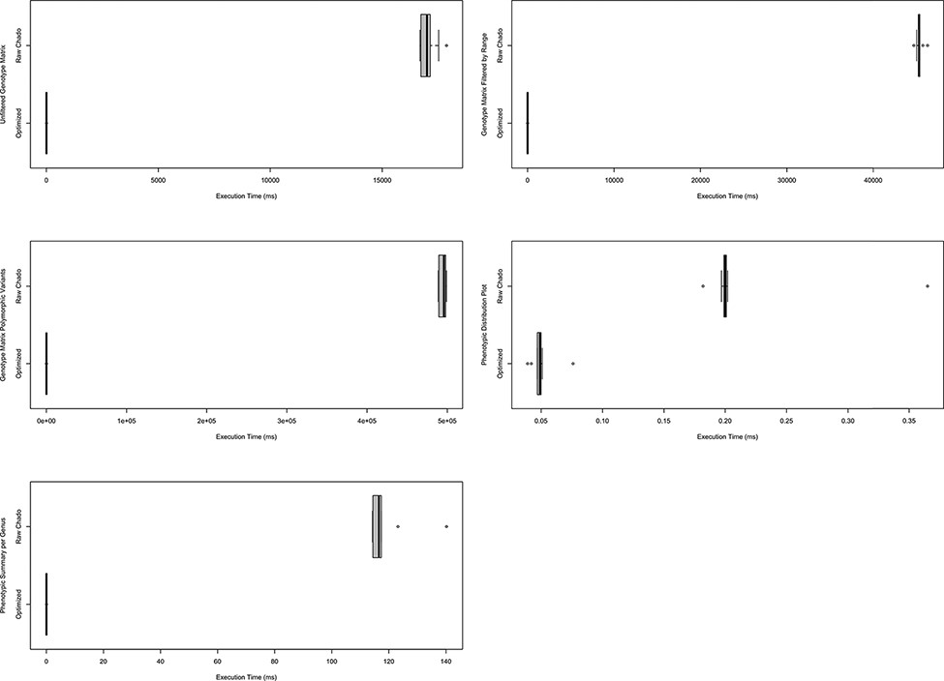
Figure 9. Comparison of timings for functional queries on indexed materialized views versus Chado. The left column ...
Notes:
Figure 9. Comparison of timings for functional queries on indexed materialized views versus Chado. The left column shows timings for genotypic data-focused queries and the right focuses on phenotypic data queries. Each box plot represents functionality in either Analyzed Phenotypes or ND Genotypes with the x-axis indicating the execution time of the query is milliseconds and the y-axis indicating the query performed. All box plots show the optimized form of the query was substantially faster than querying Chado directly. These timings were taken on a production database with nine replicates over the course of 1 day. Queries are fully described in Supplementary Data 1 and methods were described under Systems and Methods: Benchmarking.
Unless provided in the caption above, the following copyright applies to the content of this slide: © The Author(s) 2021. Published by Oxford University Press.This is an Open Access article distributed under the terms of the Creative Commons Attribution License (http://creativecommons.org/licenses/by/4.0/), which permits unrestricted reuse, distribution, and reproduction in any medium, provided the original work is properly cited.

