Slide 1
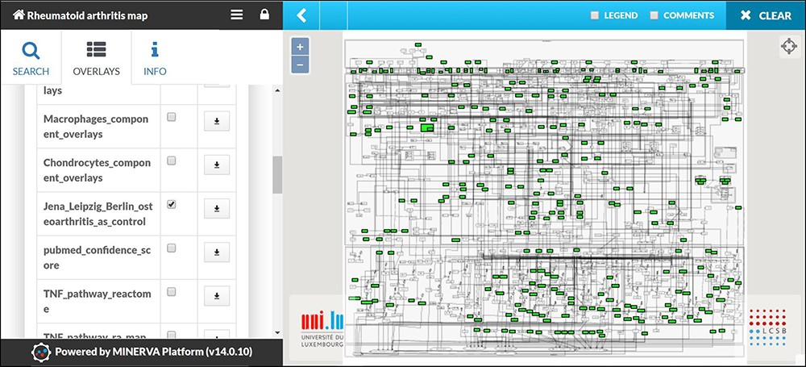
Figure 6 Mapping of Omic datasets from RA synovial tissue. The apoptosis and angiogenesis phenotypes appear to be ...
Notes:
Figure 6 Mapping of Omic datasets from RA synovial tissue. The apoptosis and angiogenesis phenotypes appear to be inactive as no molecule leading to these cellular phenotypes is mapped.
Unless provided in the caption above, the following copyright applies to the content of this slide: © The Author(s) 2020. Published by Oxford University Press.This is an Open Access article distributed under the terms of the Creative Commons Attribution License (http://creativecommons.org/licenses/by/4.0/), which permits unrestricted reuse, distribution, and reproduction in any medium, provided the original work is properly cited.

