Slide 1
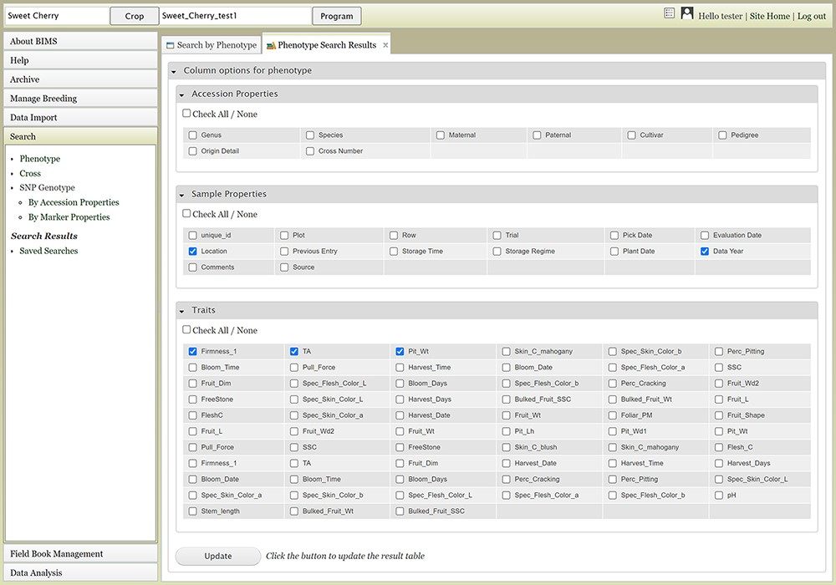
Figure 10. Upper section of the Phenotype search results tab where users can add more columns in the result table.
Notes:
Figure 10. Upper section of the Phenotype search results tab where users can add more columns in the result table.
Unless provided in the caption above, the following copyright applies to the content of this slide: © The Author(s) 2021. Published by Oxford University Press.This is an Open Access article distributed under the terms of the Creative Commons Attribution License (http://creativecommons.org/licenses/by/4.0/), which permits unrestricted reuse, distribution, and reproduction in any medium, provided the original work is properly cited.

Slide 2
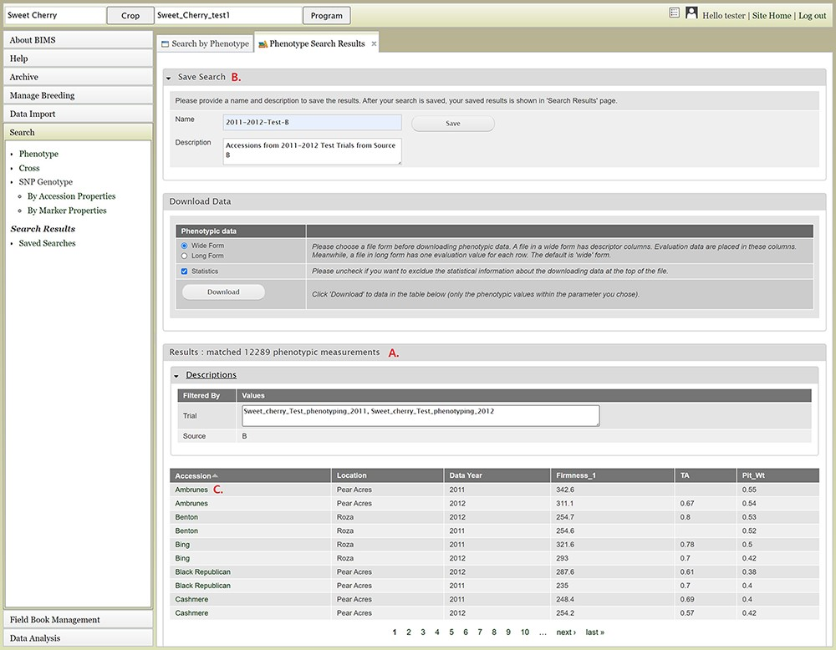
Figure 11. Lower section of the Phenotype search results tab. A. Result table section. B. Save Search and Download Data ...
Notes:
Figure 11. Lower section of the Phenotype search results tab. A. Result table section. B. Save Search and Download Data section. C. Any data under Accession column of the result table has hyperlinks to open a new tab to view the phenotype details of the specific sample.
Unless provided in the caption above, the following copyright applies to the content of this slide: © The Author(s) 2021. Published by Oxford University Press.This is an Open Access article distributed under the terms of the Creative Commons Attribution License (http://creativecommons.org/licenses/by/4.0/), which permits unrestricted reuse, distribution, and reproduction in any medium, provided the original work is properly cited.

Slide 3
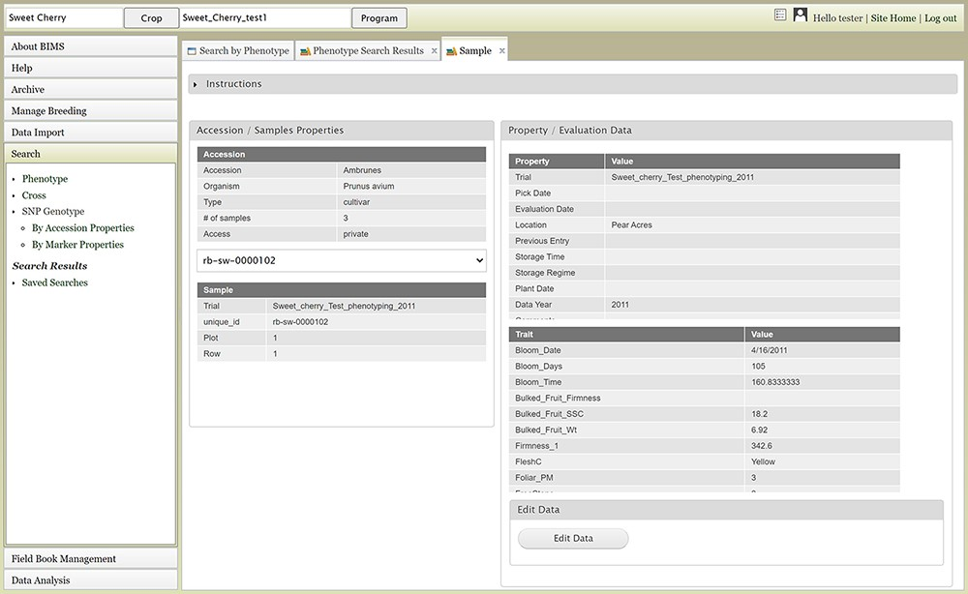
Figure 12. Sample tab where users can view and edit the phenotype details of a specific sample.
Notes:
Figure 12. Sample tab where users can view and edit the phenotype details of a specific sample.
Unless provided in the caption above, the following copyright applies to the content of this slide: © The Author(s) 2021. Published by Oxford University Press.This is an Open Access article distributed under the terms of the Creative Commons Attribution License (http://creativecommons.org/licenses/by/4.0/), which permits unrestricted reuse, distribution, and reproduction in any medium, provided the original work is properly cited.

Slide 4
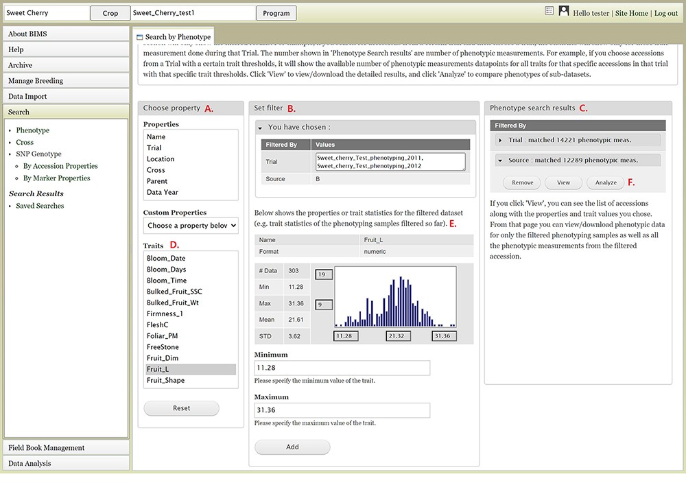
Figure 9. BIMS interface to search phenotype data. A. Choose a property section where users can filter the dataset by ...
Notes:
Figure 9. BIMS interface to search phenotype data. A. Choose a property section where users can filter the dataset by choosing various properties or traits. B. Set filter section that is populated with options for the data type when users choose a property or a trait. C. Phenotype search results section that shows the selected filter. D. Trait list in the Choose property section. E. Diagram of the trait value distribution for the previously filtered dataset. F. Remove, View, and Analyze buttons in the Phenotype search results section.
Unless provided in the caption above, the following copyright applies to the content of this slide: © The Author(s) 2021. Published by Oxford University Press.This is an Open Access article distributed under the terms of the Creative Commons Attribution License (http://creativecommons.org/licenses/by/4.0/), which permits unrestricted reuse, distribution, and reproduction in any medium, provided the original work is properly cited.

Slide 5
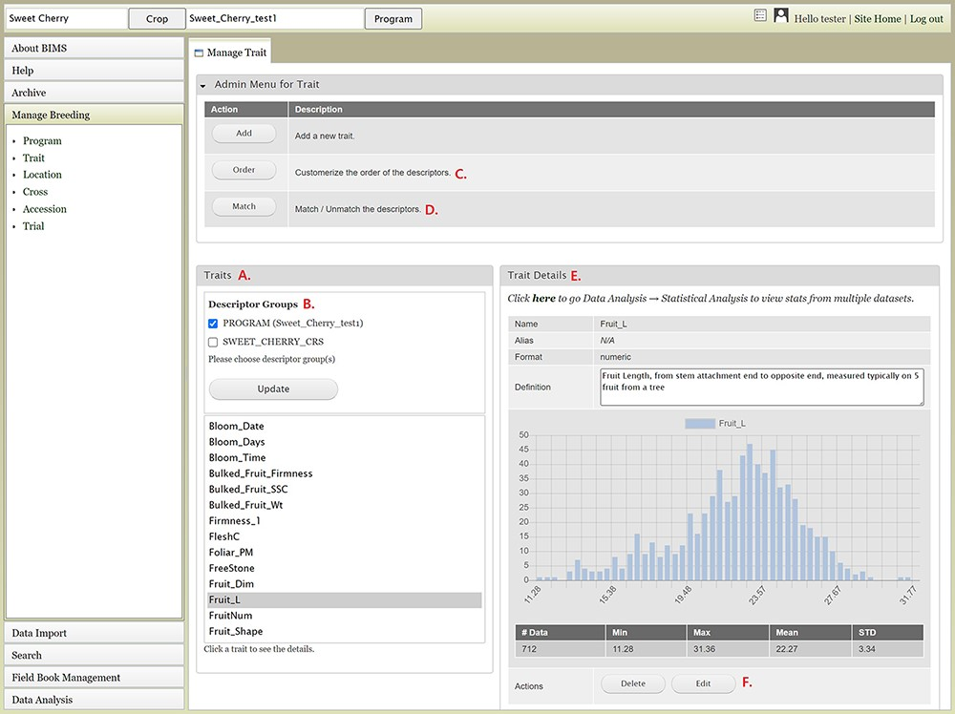
Figure 8. BIMS interface to view, create, or edit data for Trait. A. Trait section in Manage Trait tab where all the ...
Notes:
Figure 8. BIMS interface to view, create, or edit data for Trait. A. Trait section in Manage Trait tab where all the traits in the program are listed. B. Descriptor groups section where users can choose one to view the traits that belong to the descriptor. C. Order button under Admin Menu for Traits that opens up a new tab to change the order of trait descriptors in Traits section. D. Match button under Admin Menu for Traits that allows users to merge the same descriptor in different descriptor groups when they represent the same descriptor with the same unit and phenotyping method. E. Trait Details section that shows the details of the trait descriptor along with a graph that shows the distribution of the trait values in the entire data loaded to BIMS along with the statistical values. F. The Edit button in the Trait Details section that opens a new tab where users can edit the details of the trait.
Unless provided in the caption above, the following copyright applies to the content of this slide: © The Author(s) 2021. Published by Oxford University Press.This is an Open Access article distributed under the terms of the Creative Commons Attribution License (http://creativecommons.org/licenses/by/4.0/), which permits unrestricted reuse, distribution, and reproduction in any medium, provided the original work is properly cited.

Slide 6
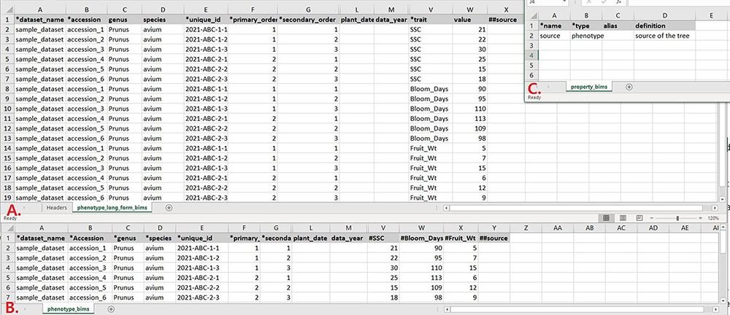
Figure 7. Example data templates in Excel. A. A template for phenotype data where trait names are entered in a column. ...
Notes:
Figure 7. Example data templates in Excel. A. A template for phenotype data where trait names are entered in a column. B. A template for phenotype data where trait names are entered as a column heading. C. A template where users can enter data for user-defined column headings.
Unless provided in the caption above, the following copyright applies to the content of this slide: © The Author(s) 2021. Published by Oxford University Press.This is an Open Access article distributed under the terms of the Creative Commons Attribution License (http://creativecommons.org/licenses/by/4.0/), which permits unrestricted reuse, distribution, and reproduction in any medium, provided the original work is properly cited.

Slide 7
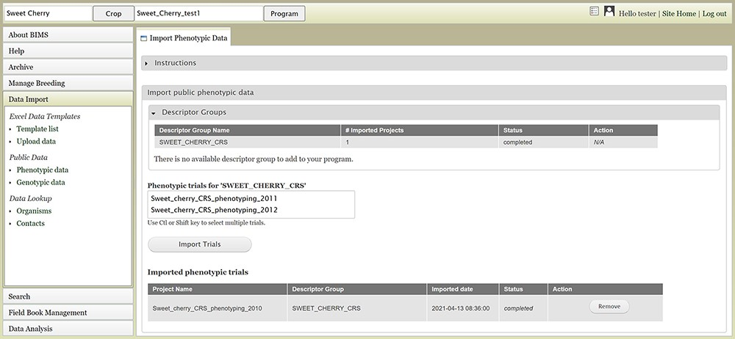
Figure 6. BIMS interface for uploading public phenotype data. Users can import any publicly available dataset to their ...
Notes:
Figure 6. BIMS interface for uploading public phenotype data. Users can import any publicly available dataset to their program.
Unless provided in the caption above, the following copyright applies to the content of this slide: © The Author(s) 2021. Published by Oxford University Press.This is an Open Access article distributed under the terms of the Creative Commons Attribution License (http://creativecommons.org/licenses/by/4.0/), which permits unrestricted reuse, distribution, and reproduction in any medium, provided the original work is properly cited.

Slide 8
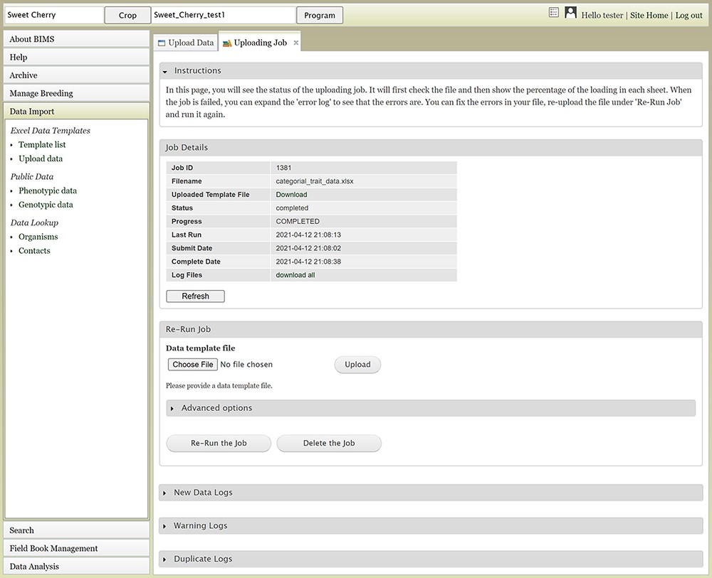
Figure 5. The Uploading Job tab that shows the progress of an uploading job. When the job is completed or failed, the ...
Notes:
Figure 5. The Uploading Job tab that shows the progress of an uploading job. When the job is completed or failed, the tab displays various logs such as New Data Log, Warning Log, Duplicate Log and Error Log.
Unless provided in the caption above, the following copyright applies to the content of this slide: © The Author(s) 2021. Published by Oxford University Press.This is an Open Access article distributed under the terms of the Creative Commons Attribution License (http://creativecommons.org/licenses/by/4.0/), which permits unrestricted reuse, distribution, and reproduction in any medium, provided the original work is properly cited.

Slide 9
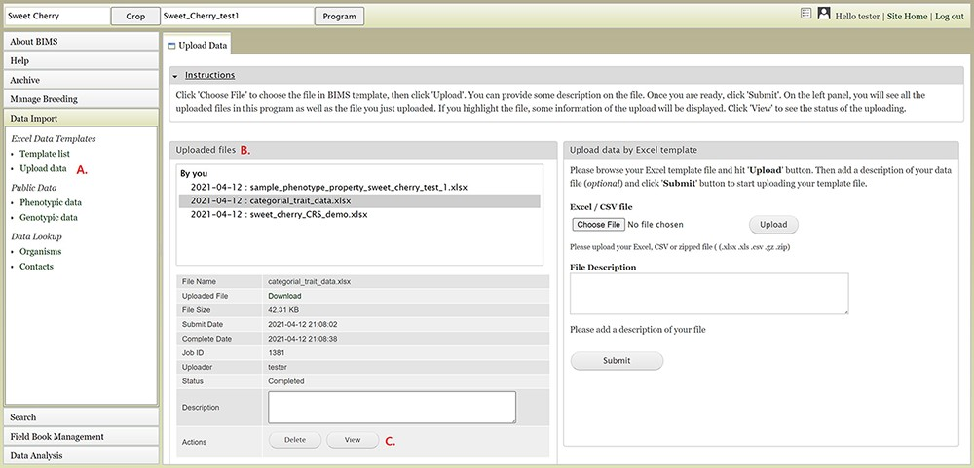
Figure 4. BIMS interface for uploading data in templates. A. Upload data link under Data Import section. B. Uploaded ...
Notes:
Figure 4. BIMS interface for uploading data in templates. A. Upload data link under Data Import section. B. Uploaded files section In the Upload Data tab that shows the name of the files that have been submitted or uploaded. C. View link that opens a new tab that shows the progress of an upload job.
Unless provided in the caption above, the following copyright applies to the content of this slide: © The Author(s) 2021. Published by Oxford University Press.This is an Open Access article distributed under the terms of the Creative Commons Attribution License (http://creativecommons.org/licenses/by/4.0/), which permits unrestricted reuse, distribution, and reproduction in any medium, provided the original work is properly cited.

Slide 10
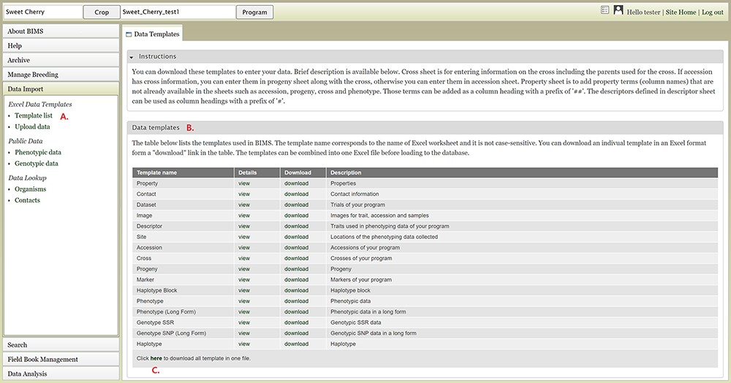
Figure 3. BIMS interface for downloading data templates. A. Template list section under Data Import menu. B. Data ...
Notes:
Figure 3. BIMS interface for downloading data templates. A. Template list section under Data Import menu. B. Data templates section that lists all the data templates with hyperlinks to view and download. C. Link where users can also download all the templates as a single Excel file.
Unless provided in the caption above, the following copyright applies to the content of this slide: © The Author(s) 2021. Published by Oxford University Press.This is an Open Access article distributed under the terms of the Creative Commons Attribution License (http://creativecommons.org/licenses/by/4.0/), which permits unrestricted reuse, distribution, and reproduction in any medium, provided the original work is properly cited.

Slide 11
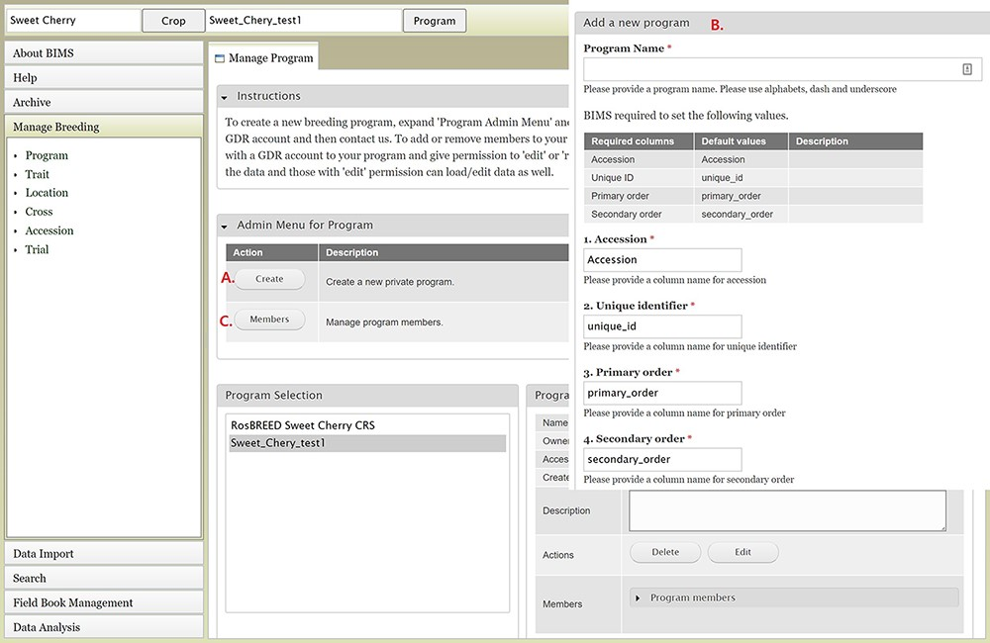
Figure 2. BIMS interfaces for creating, editing and managing programs. A. Manage Program tab showing the list of ...
Notes:
Figure 2. BIMS interfaces for creating, editing and managing programs. A. Manage Program tab showing the list of programs, the details of the highlighted program and admin menu for managing program. B. Add Program tab where users can enter the new program name and modify the four column names required in the BIMS template and Field Book to match their dataset. C. Members tab where users can add other account holders as members of the breeding program with edit or read-only privilege.
Unless provided in the caption above, the following copyright applies to the content of this slide: © The Author(s) 2021. Published by Oxford University Press.This is an Open Access article distributed under the terms of the Creative Commons Attribution License (http://creativecommons.org/licenses/by/4.0/), which permits unrestricted reuse, distribution, and reproduction in any medium, provided the original work is properly cited.

Slide 12
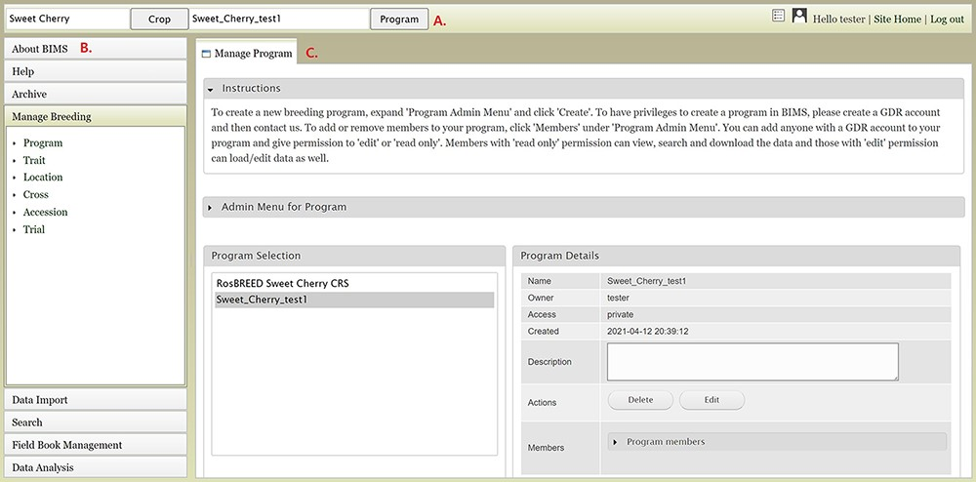
Figure 1. Main areas of the BIMS interface. A. The header region that displays the current crop and program on the left ...
Notes:
Figure 1. Main areas of the BIMS interface. A. The header region that displays the current crop and program on the left and links to configuration page, account page and home page on the right along with the user name. B. The accordion menu on the left that allows users to switch between various sections of the BIMS C. The tab region where users primarily interact with BIMS.
Unless provided in the caption above, the following copyright applies to the content of this slide: © The Author(s) 2021. Published by Oxford University Press.This is an Open Access article distributed under the terms of the Creative Commons Attribution License (http://creativecommons.org/licenses/by/4.0/), which permits unrestricted reuse, distribution, and reproduction in any medium, provided the original work is properly cited.

Slide 13
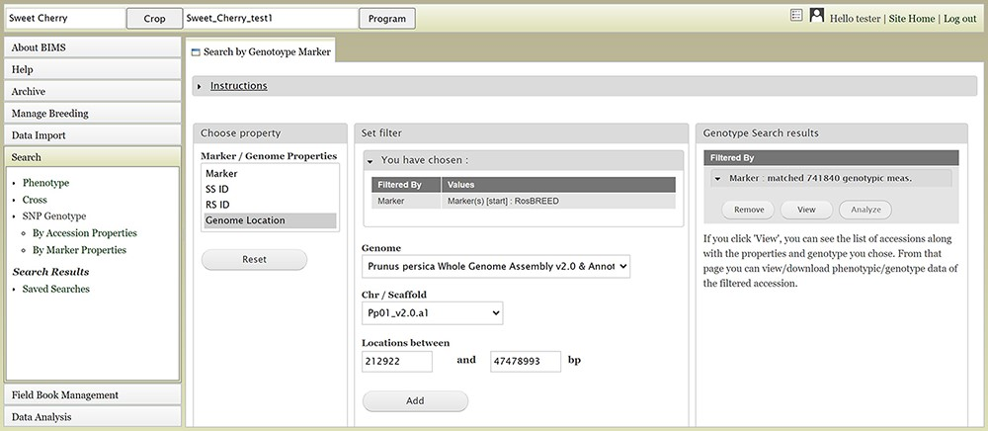
Figure 13. BIMS interface to search genotype data. Users can search SNP genotype data by accession properties or marker ...
Notes:
Figure 13. BIMS interface to search genotype data. Users can search SNP genotype data by accession properties or marker properties.
Unless provided in the caption above, the following copyright applies to the content of this slide: © The Author(s) 2021. Published by Oxford University Press.This is an Open Access article distributed under the terms of the Creative Commons Attribution License (http://creativecommons.org/licenses/by/4.0/), which permits unrestricted reuse, distribution, and reproduction in any medium, provided the original work is properly cited.

Slide 14
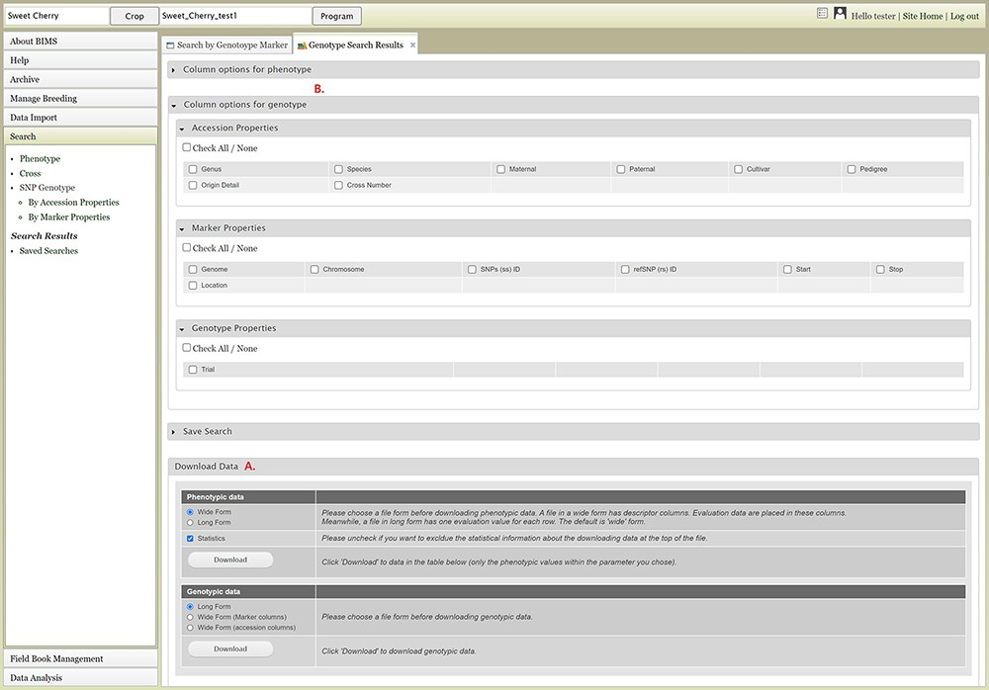
Figure 14. Genotype Search Results tab. A. Download Data section where users can download phenotype data as well as ...
Notes:
Figure 14. Genotype Search Results tab. A. Download Data section where users can download phenotype data as well as genotype data when the data is available. B. Column options section where users can add columns either for phenotype or genotype data. C. Link to the account page where users can access the downloaded data files.
Unless provided in the caption above, the following copyright applies to the content of this slide: © The Author(s) 2021. Published by Oxford University Press.This is an Open Access article distributed under the terms of the Creative Commons Attribution License (http://creativecommons.org/licenses/by/4.0/), which permits unrestricted reuse, distribution, and reproduction in any medium, provided the original work is properly cited.

Slide 15
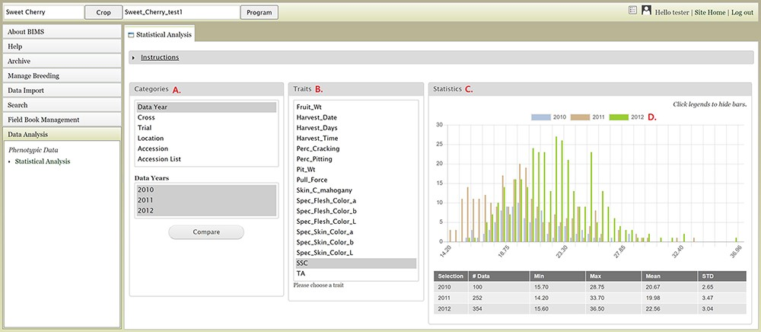
Figure 15. BIMS interface where users can compare trait values among different datasets. A. Categories section where ...
Notes:
Figure 15. BIMS interface where users can compare trait values among different datasets. A. Categories section where users can choose multiple datasets B. Traits section to choose a trait statistics of the chosen dataset. C. Statistics section where users can view a graph with the distribution of the trait values for each dataset. D. Legends can be deselected to view subsets.
Unless provided in the caption above, the following copyright applies to the content of this slide: © The Author(s) 2021. Published by Oxford University Press.This is an Open Access article distributed under the terms of the Creative Commons Attribution License (http://creativecommons.org/licenses/by/4.0/), which permits unrestricted reuse, distribution, and reproduction in any medium, provided the original work is properly cited.

Slide 16
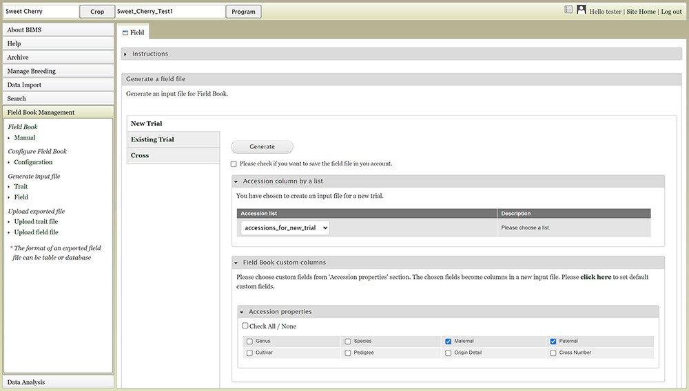
Figure 16. BIMS interface where users can create input files for the Field Book App.
Notes:
Figure 16. BIMS interface where users can create input files for the Field Book App.
Unless provided in the caption above, the following copyright applies to the content of this slide: © The Author(s) 2021. Published by Oxford University Press.This is an Open Access article distributed under the terms of the Creative Commons Attribution License (http://creativecommons.org/licenses/by/4.0/), which permits unrestricted reuse, distribution, and reproduction in any medium, provided the original work is properly cited.

Slide 17
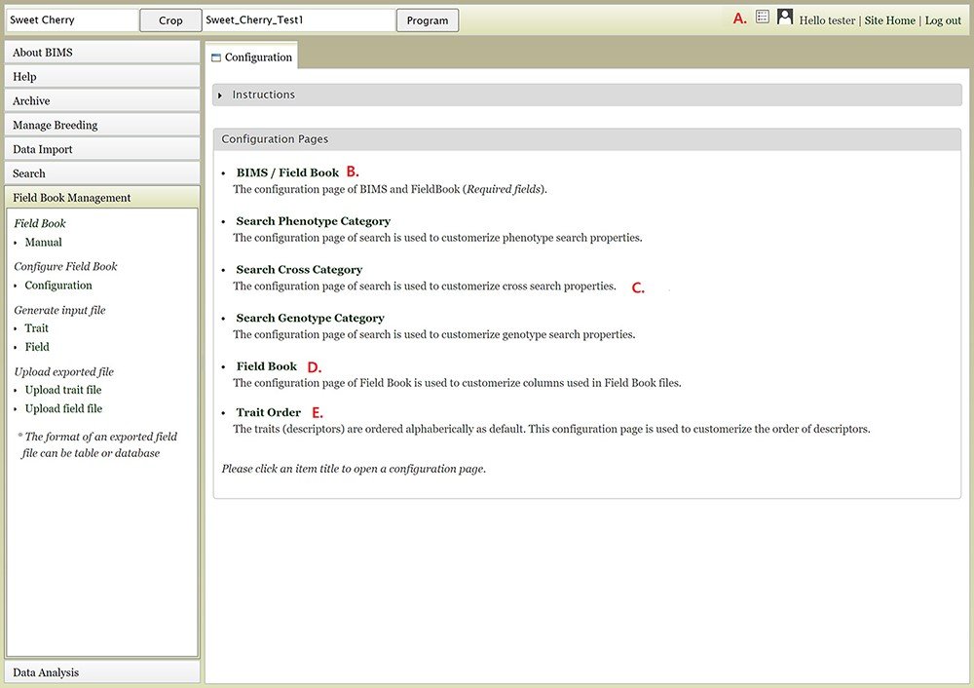
Figure 17. Configuration page of BIMS A. Hyperlink to the configuration page that is shown on top right of each BIMS ...
Notes:
Figure 17. Configuration page of BIMS A. Hyperlink to the configuration page that is shown on top right of each BIMS page. B. BIMS/Field Book link In the configuration page. C. Links to tabs where users can modify the categories in search pages for phenotype, genotype and cross. D. Field Book link in the configuration page where users can choose traits, accession properties, or sample properties to be displayed in the Generate Field Book Input file section. E. Trait Order link in the configuration page.
Unless provided in the caption above, the following copyright applies to the content of this slide: © The Author(s) 2021. Published by Oxford University Press.This is an Open Access article distributed under the terms of the Creative Commons Attribution License (http://creativecommons.org/licenses/by/4.0/), which permits unrestricted reuse, distribution, and reproduction in any medium, provided the original work is properly cited.

