Slide 1
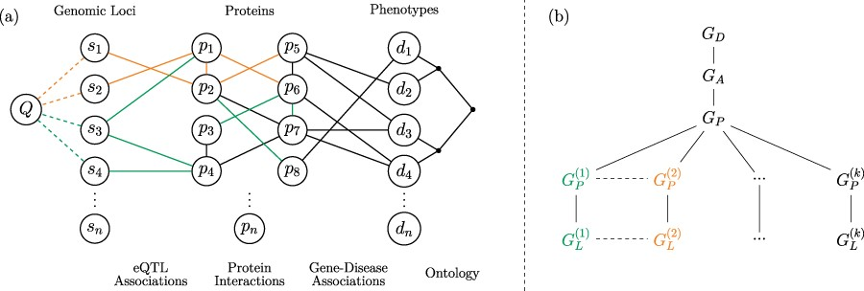
Fig. 1 Versioned heterogeneous network. (a) An example of a versioned network that is used to model the relationship ...
Notes:
Fig. 1 Versioned heterogeneous network. (a) An example of a versioned network that is used to model the relationship between genomic loci, proteins and diseases. The vertices consist of genomic loci, proteins and disease phenotypes, edges represent tissue-specific eQTL interactions, tissue-specific PPIs, gene–disease associations and relationships between diseases in the context of a disease ontology. Different versions represent interactions that occur within specific tissues. The interactions that occur in different versions are shown using different colors, where black edges represent generic interactions/associations. A proximity query on this network can be formulated using any subset of loci, proteins, diseases or any combination of these. As an example, vertex Q visualizes a sample query that aims to retrieve the diseases most closely associated with one or more genomic loci or a genomic region. (b) The version tree used to represent the integrated heterogeneous network in (a). The root node represents the generic disease ontology network. Version $G_A$ contains the generic gene–disease association network. $G_P$ represents the generic PPI network, consisting of the edges that are shared by the tissue-specific PPIs. The next level of the tree splits off into the different tissue-specific PPI networks, as shown using different colors. At the final level, the corresponding tissue-specific eQTL networks are added.
Unless provided in the caption above, the following copyright applies to the content of this slide: © The Author(s) 2020. Published by Oxford University Press.This is an Open Access article distributed under the terms of the Creative Commons Attribution License (http://creativecommons.org/licenses/by/4.0/), which permits unrestricted reuse, distribution, and reproduction in any medium, provided the original work is properly cited.

