Slide 1
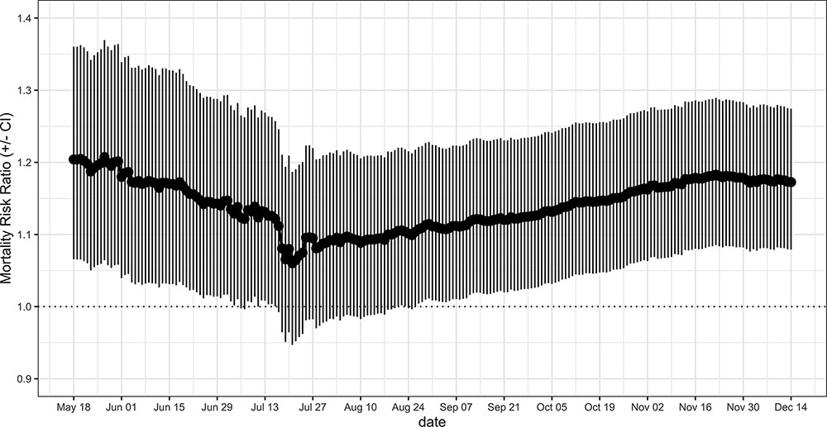
Figure 2. MRRs associated with an increment of 10% in county-level prevalence of diabetes and relative CIs. The ...
Notes:
Figure 2. MRRs associated with an increment of 10% in county-level prevalence of diabetes and relative CIs. The weighted MRR was calculated at different end points and by including counties with at least one confirmed case.
Unless provided in the caption above, the following copyright applies to the content of this slide: © The Author(s) 2021. Published by Oxford University Press.This is an Open Access article distributed under the terms of the Creative Commons Attribution License (http://creativecommons.org/licenses/by/4.0/), which permits unrestricted reuse, distribution, and reproduction in any medium, provided the original work is properly cited.

