Slide 1
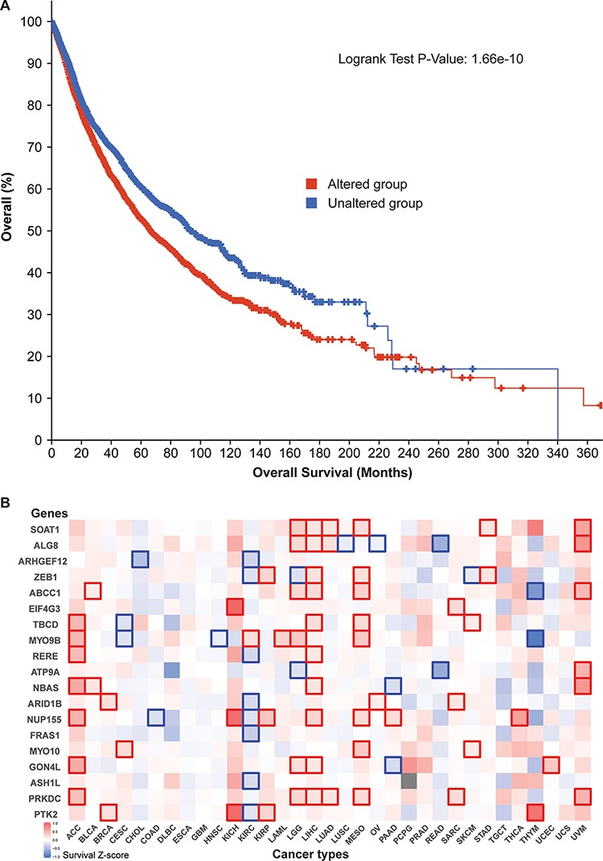
Figure 5. Cancer patient survival with regard to the 52 circRNA parental genes. (A) Overall survival analysis of 10 797 ...
Notes:
Figure 5. Cancer patient survival with regard to the 52 circRNA parental genes. (A) Overall survival analysis of 10 797 patients in our TCGA pan-cancer data set. See Figure 4 for definitions of altered and unaltered. (B) Cancer-type-specific survival analysis. Z-score polarities reflect the genes’ beneficial or detrimental effects on survival. Bolded squares highlight statistically significant survival differences.
Unless provided in the caption above, the following copyright applies to the content of this slide: © The Author(s) 2021. Published by Oxford University Press.This is an Open Access article distributed under the terms of the Creative Commons Attribution License (http://creativecommons.org/licenses/by/4.0/), which permits unrestricted reuse, distribution, and reproduction in any medium, provided the original work is properly cited.

