Slide 1
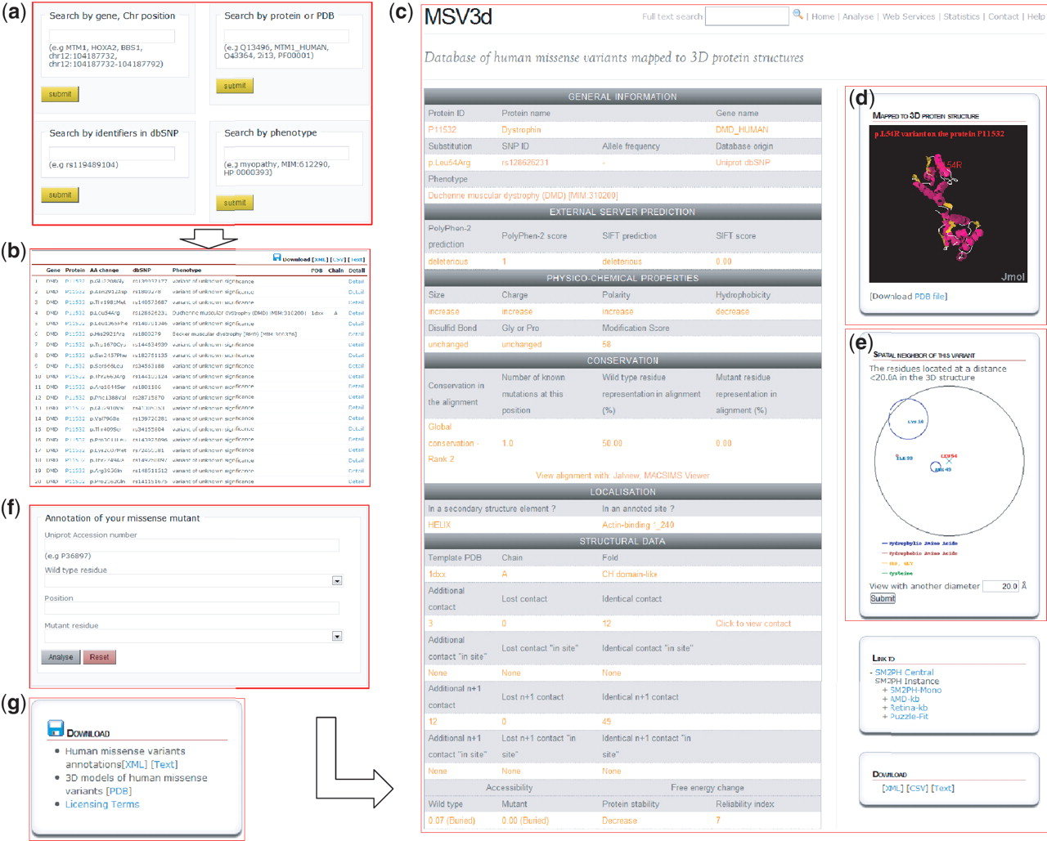
Figure 3 MSV3d web interface contains numerous functionalities including: (a) field search, (b) free text search, (c) ...
Notes:
Figure 3 MSV3d web interface contains numerous functionalities including: (a) field search, (b) free text search, (c) detailed information, (d) 3D structure visualization using Jmol, (e) spatial neighbouring residue visualization, (f) missense annotation service and (g) download service.
Unless provided in the caption above, the following copyright applies to the content of this slide: © The Author(s) 2012. Published by Oxford University Press.This is an Open Access article distributed under the terms of the Creative Commons Attribution Non-Commercial License (http://creativecommons.org/licenses/by-nc/3.0), which permits unrestricted non-commercial use, distribution, and reproduction in any medium, provided the original work is properly cited.

