Slide 1
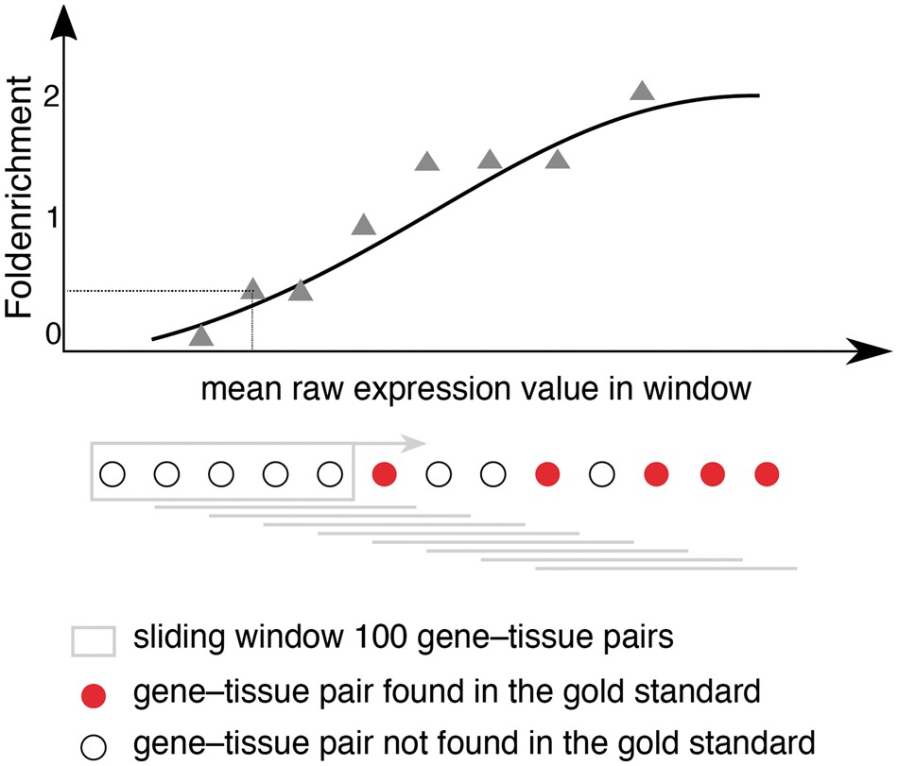
Figure 1. Schematic representation for calculating fold enrichment and fitting its relationship to raw expression ...
Notes:
Figure 1. Schematic representation for calculating fold enrichment and fitting its relationship to raw expression values. For a given dataset, we select gene–tissue pairs and their raw expression scores for a subset of tissues, which are common between all datasets and a subset of genes common between the dataset and the gold standard. Next, we sort these gene–tissue pairs by their raw expression value, and traverse them in sliding windows of a pre-defined size. The enrichment corresponding to each bin is then calculated as the fraction of gene–tissue pairs from that bin found in the gold standard, divided by the fraction of pairs that would be expected by random. Next, we use appropriate functions (see text) to fit the relationship between fold enrichment values and mean raw expression values in their corresponding windows.
Unless provided in the caption above, the following copyright applies to the content of this slide: © The Author(s) 2018. Published by Oxford University Press.This is an Open Access article distributed under the terms of the Creative Commons Attribution License (http://creativecommons.org/licenses/by/4.0/), which permits unrestricted reuse, distribution, and reproduction in any medium, provided the original work is properly cited.

Slide 2
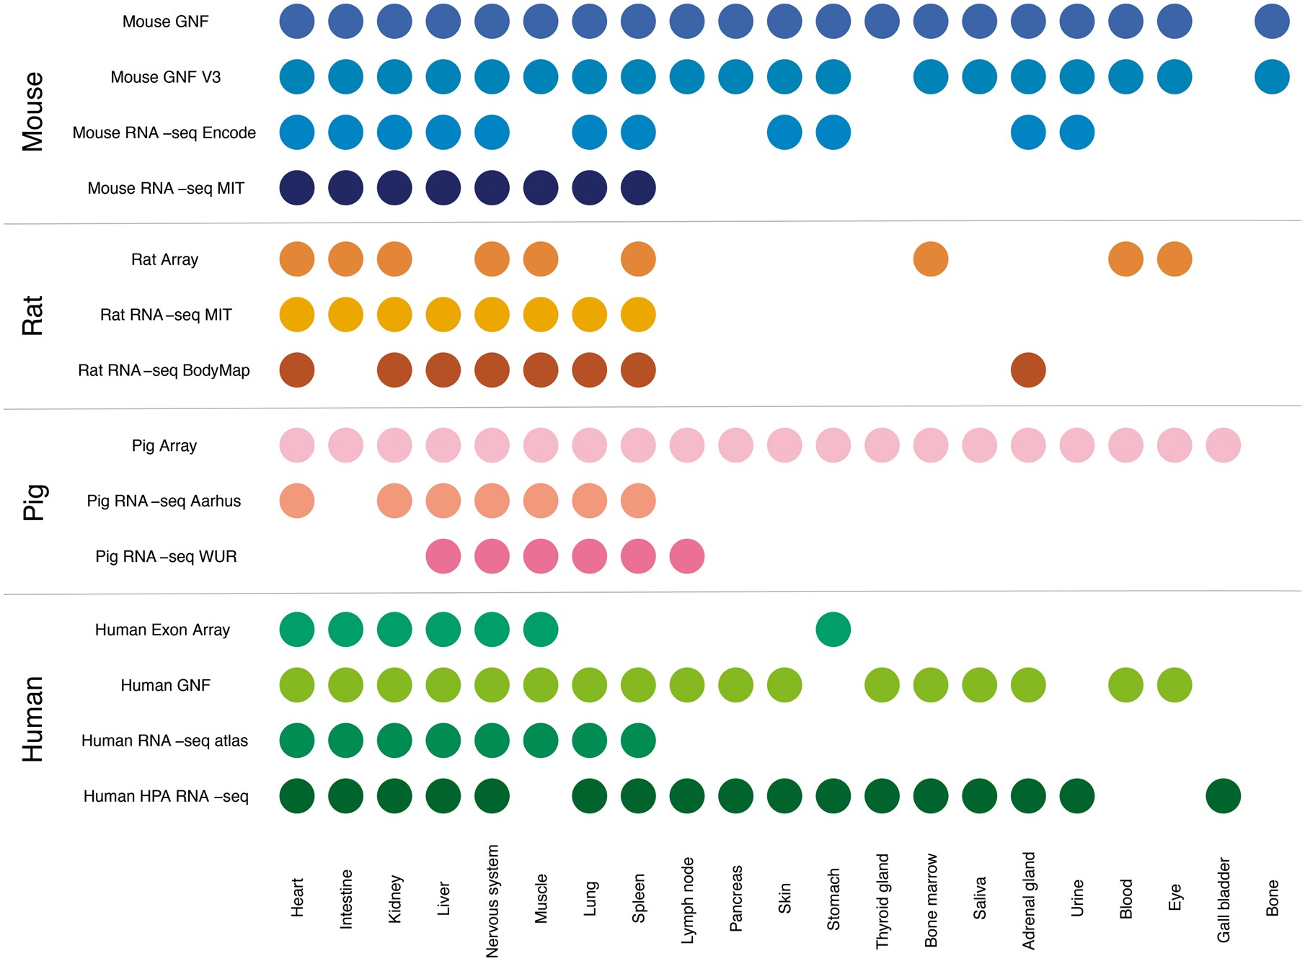
Figure 2. Summary of tissues present in each dataset. We mapped the newly integrated datasets from mouse, rat and pig, ...
Notes:
Figure 2. Summary of tissues present in each dataset. We mapped the newly integrated datasets from mouse, rat and pig, as well as the already existing human datasets, to 21 major tissues of interest. This figure shows which of these tissues are covered by which datasets.
Unless provided in the caption above, the following copyright applies to the content of this slide: © The Author(s) 2018. Published by Oxford University Press.This is an Open Access article distributed under the terms of the Creative Commons Attribution License (http://creativecommons.org/licenses/by/4.0/), which permits unrestricted reuse, distribution, and reproduction in any medium, provided the original work is properly cited.

Slide 3
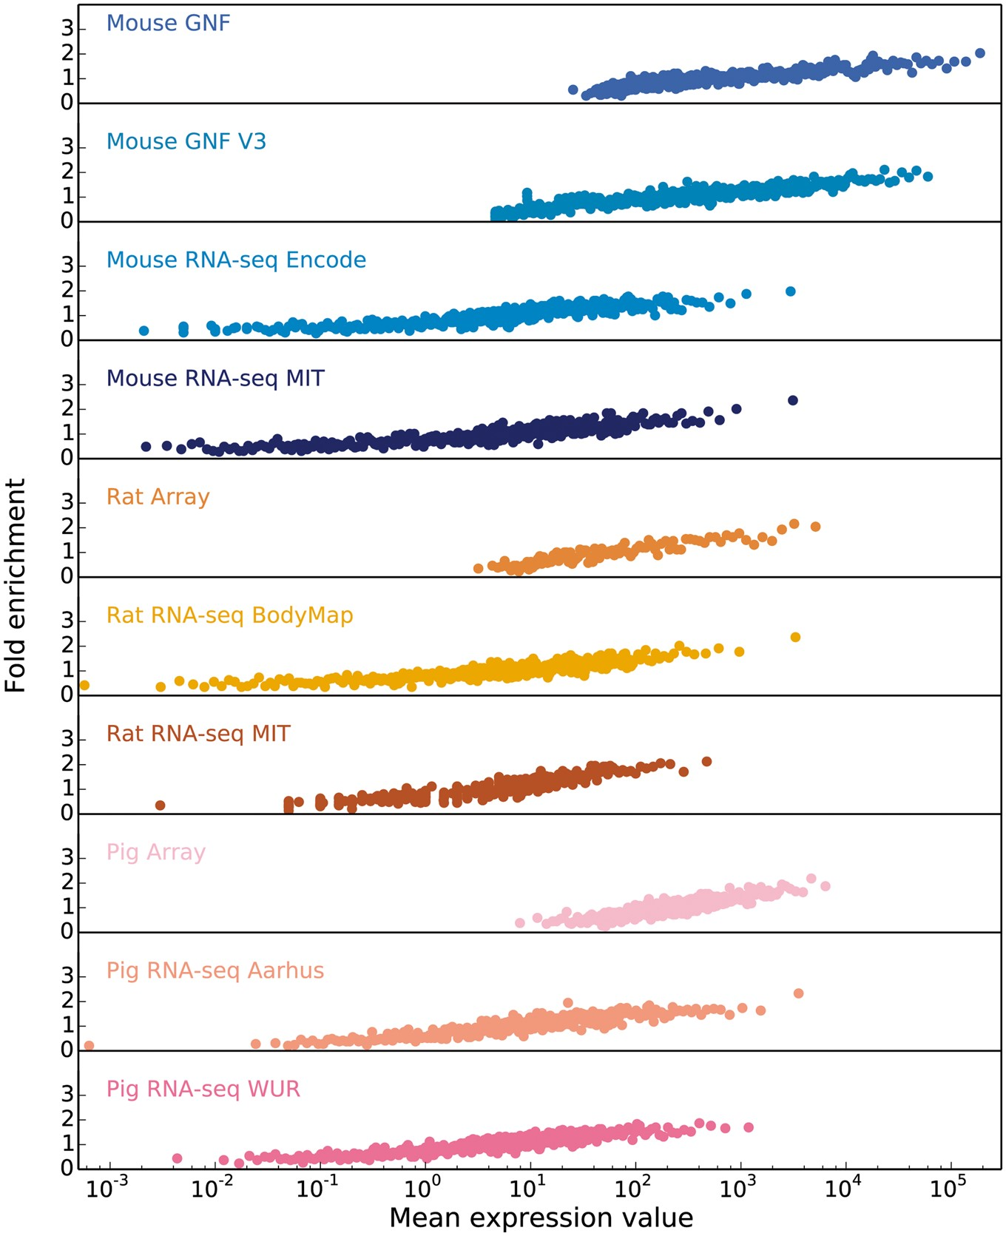
Figure 3. In order to obtain confidence scores for each gene–tissue pair, we assess the relationship between raw ...
Notes:
Figure 3. In order to obtain confidence scores for each gene–tissue pair, we assess the relationship between raw expression values and fold enrichment, defined as the agreement between each dataset and gold standard datasets specific to the organism. The gold standard datasets are based on the UniProtKB protein tissue annotations in human, filtered for 1-to-1 orthologs between human and each of the three organisms. The x-axis contains raw expression values for gene–tissue pairs, in units specific to the type of experiment or processing of data (e.g. intensity units for microarray studies, FPKMs for RNA-seq), and averaged across bins of 100 pairs.
Unless provided in the caption above, the following copyright applies to the content of this slide: © The Author(s) 2018. Published by Oxford University Press.This is an Open Access article distributed under the terms of the Creative Commons Attribution License (http://creativecommons.org/licenses/by/4.0/), which permits unrestricted reuse, distribution, and reproduction in any medium, provided the original work is properly cited.

Slide 4
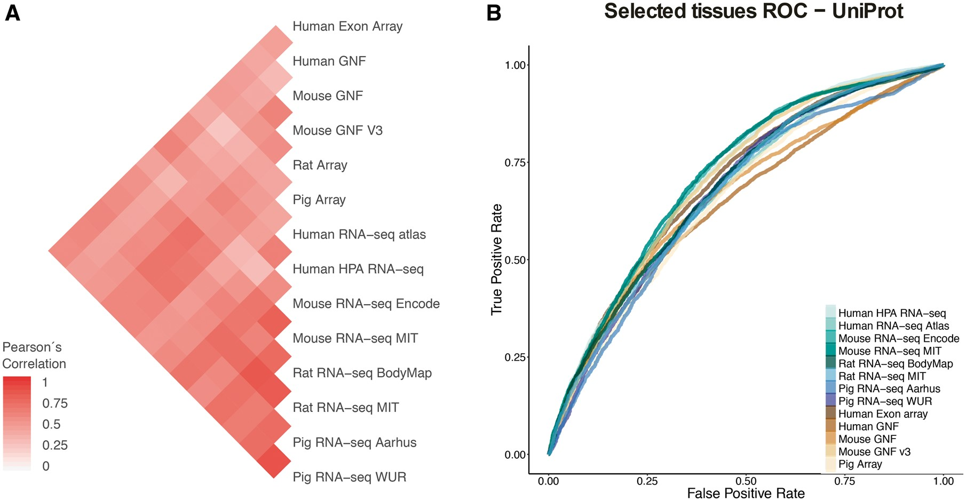
Figure 4. (A) Pearson’s correlation coefficients between final confidence scores of gene–tissue associations across ...
Notes:
Figure 4. (A) Pearson’s correlation coefficients between final confidence scores of gene–tissue associations across datasets. For each pair of datasets, we considered the set of common genes (genes being expressed in at least one tissue in each dataset), and common tissues between the two datasets. (B) In this panel, we compare the rates of True positives and False positives for each dataset for the common tissues to show that the correlation between datasets is mainly influenced by quality rather than by organism or technology.
Unless provided in the caption above, the following copyright applies to the content of this slide: © The Author(s) 2018. Published by Oxford University Press.This is an Open Access article distributed under the terms of the Creative Commons Attribution License (http://creativecommons.org/licenses/by/4.0/), which permits unrestricted reuse, distribution, and reproduction in any medium, provided the original work is properly cited.

Slide 5
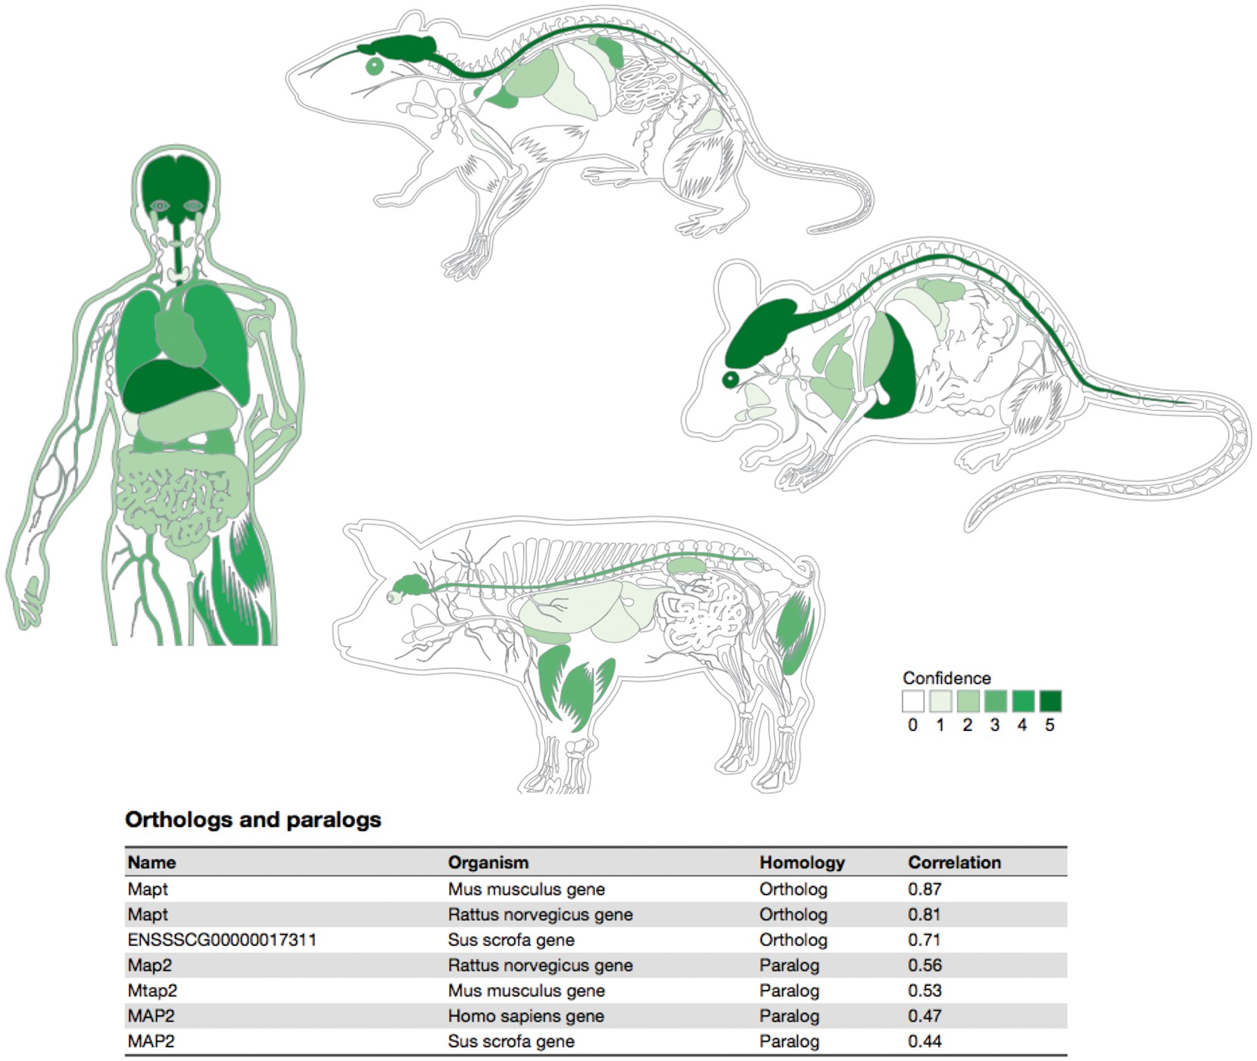
Figure 5. Summary figures for all the covered organisms. The web interface provides a comprehensive figure for each ...
Notes:
Figure 5. Summary figures for all the covered organisms. The web interface provides a comprehensive figure for each organism where the tissue associations for the queried gene are summarized. In this example, we are showing the tissue expression profile for the Microtubule-associated protein tau (MAPT) known to be related to Alzheimer’s disease (57). The ortholog–paralog table provides information about homologous proteins and their tissue–expression correlation with the query protein.
Unless provided in the caption above, the following copyright applies to the content of this slide: © The Author(s) 2018. Published by Oxford University Press.This is an Open Access article distributed under the terms of the Creative Commons Attribution License (http://creativecommons.org/licenses/by/4.0/), which permits unrestricted reuse, distribution, and reproduction in any medium, provided the original work is properly cited.

Slide 6
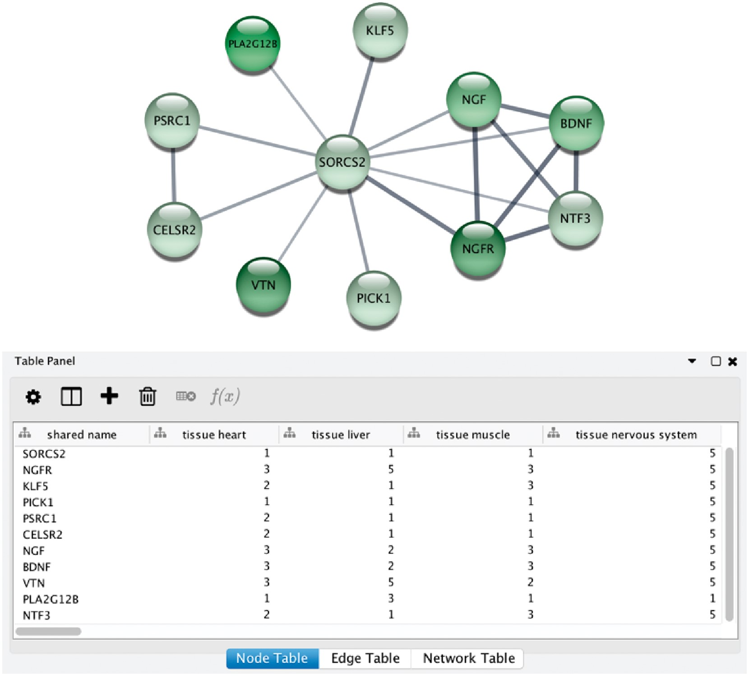
Figure 6. STRING app in Cytoscape with tissue information. (A) The newly developed stringApp for Cytoscape allows users ...
Notes:
Figure 6. STRING app in Cytoscape with tissue information. (A) The newly developed stringApp for Cytoscape allows users to get all the STRING functionality within Cytoscape and allows expression evidence from TISSUES to be visualized onto the network (in this example for liver). (B) The stringApp also shows the evidence score for each of the major tissues in the node attributes table.
Unless provided in the caption above, the following copyright applies to the content of this slide: © The Author(s) 2018. Published by Oxford University Press.This is an Open Access article distributed under the terms of the Creative Commons Attribution License (http://creativecommons.org/licenses/by/4.0/), which permits unrestricted reuse, distribution, and reproduction in any medium, provided the original work is properly cited.

