Slide 1
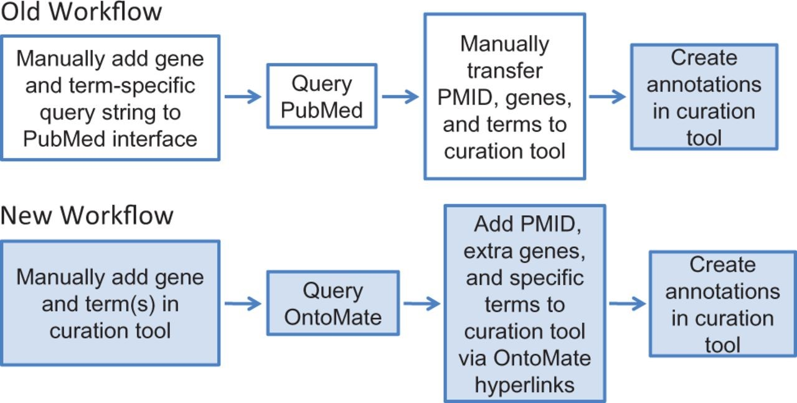
Figure 2. RGD’s old and new workflows for manual gene curation. White boxes represent tasks involving the PubMed ...
Notes:
Figure 2. RGD’s old and new workflows for manual gene curation. White boxes represent tasks involving the PubMed interface and colored boxes represent processes done in the RGD curation tool interface. The new workflow has reduced the processes of the old workflow from two interfaces to one interface.
Unless provided in the caption above, the following copyright applies to the content of this slide: © The Author(s) 2015. Published by Oxford University Press.This is an Open Access article distributed under the terms of the Creative Commons Attribution License (http://creativecommons.org/licenses/by/4.0/), which permits unrestricted reuse, distribution, and reproduction in any medium, provided the original work is properly cited.

