Slide 1
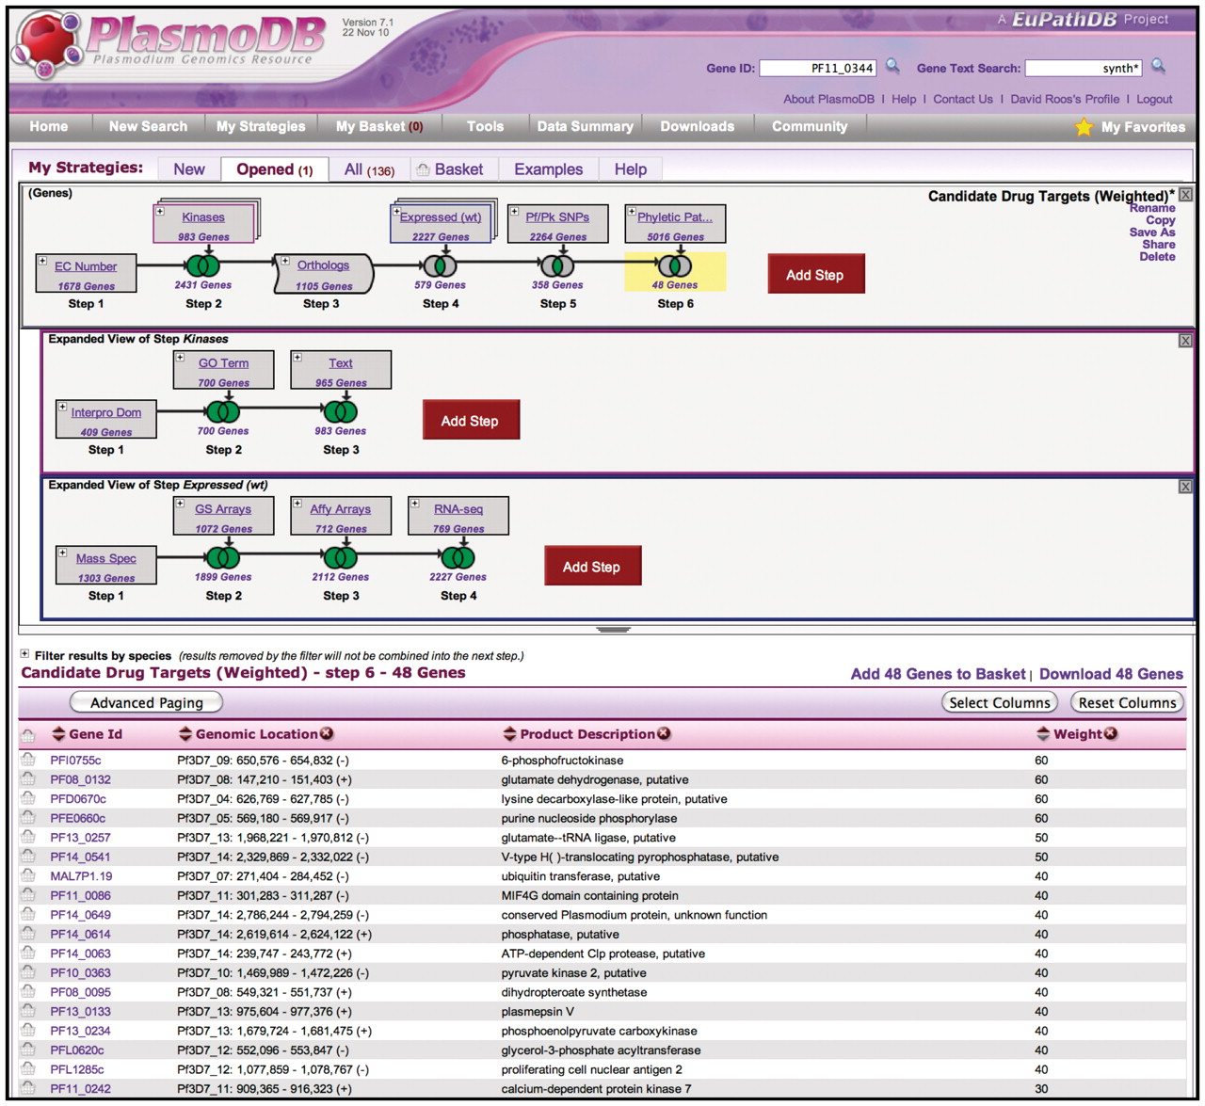
Figure 1. The WDK Strategies system in PlasmoDB.org. The top panel shows a strategy with a succession of gene searches ...
Notes:
Figure 1. The WDK Strategies system in PlasmoDB.org. The top panel shows a strategy with a succession of gene searches (strategy steps) proceeding from left to right, combined using set operators (e.g. union, intersection) indicated by Venn diagrams. Steps 2 and 4 are nested steps, indicated by an overlapping box icon with colored border. They are expanded as sub-strategies in the indented panels below, where their component steps are visible. Step 3 is a transform expanding the results from Step 2 to include orthologous genes. Strategies may be named and saved for future reference, refinement, or sharing with others. The bottom half of the display is the summary table which shows a page of results, where each row is one gene found. By default this display shows the result of the strategy as a whole (the last step so far), but clicking on any step box or Venn diagram highlights that box in yellow and shows the intermediate result at that point. Any of these results are downloadable. The summary table can be customized by adding any of approximately 50 columns, and by sorting, filtering and paging.
Unless provided in the caption above, the following copyright applies to the content of this slide: © The Author(s) 2011. Published by Oxford University Press.This is Open Access article distributed under the terms of the Creative Commons Attribution Non-Commercial License (http://creativecommons.org/licenses/by-nc/2.5), which permits unrestricted non-commercial use, distribution, and reproduction in any medium, provided the original work is properly cited.

Slide 2
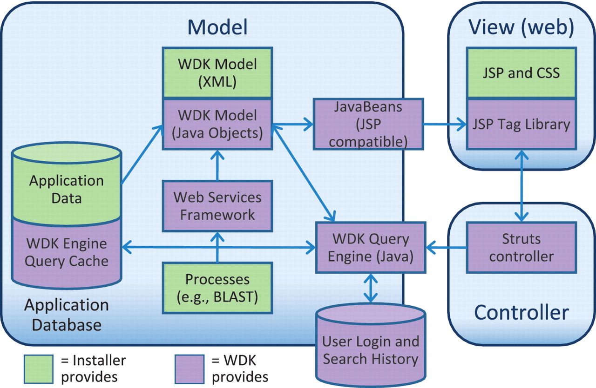
Figure 5. The Strategies WDK MVC design. Scientific data is stored in an application database of any design (supported ...
Notes:
Figure 5. The Strategies WDK MVC design. Scientific data is stored in an application database of any design (supported vendors are Oracle and PostgreSQL). The WDK’s query cache can reside in that database or a separate one. The WDK Model is specified in XML and instantiated into Java objects that represent records and searches. The WDK query engine uses the Java model to perform searches against the application database or using a web services framework. The Java model is made available to the front-end through a JSP-compatible JavaBeans API. The View is primarily comprised of JSP, JSP tags and CSS, and also uses JavaScript, JQuery and AJAX.
Unless provided in the caption above, the following copyright applies to the content of this slide: © The Author(s) 2011. Published by Oxford University Press.This is Open Access article distributed under the terms of the Creative Commons Attribution Non-Commercial License (http://creativecommons.org/licenses/by-nc/2.5), which permits unrestricted non-commercial use, distribution, and reproduction in any medium, provided the original work is properly cited.

Slide 3
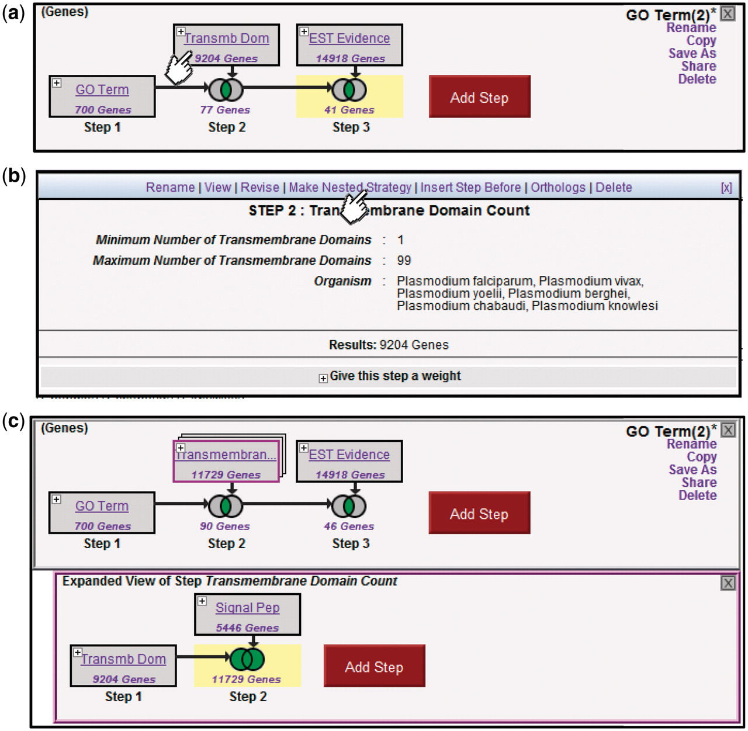
Figure 4. Creating nested Strategies. Clicking on the + icon in Step 2 of the three-step strategy shown (a) brings up a ...
Notes:
Figure 4. Creating nested Strategies. Clicking on the + icon in Step 2 of the three-step strategy shown (a) brings up a menu displaying the details of this step (b), and a set of available actions (Rename, View, Revise, Make Nested Strategy, Insert Step Before, Orthologs, Delete). Clicking on Make Nested Strategy expands the step into its own panel (c), where the user can add additional steps that become nested within the second step in the top panel (TB domain and/or signal peptide in the example shown).
Unless provided in the caption above, the following copyright applies to the content of this slide: © The Author(s) 2011. Published by Oxford University Press.This is Open Access article distributed under the terms of the Creative Commons Attribution Non-Commercial License (http://creativecommons.org/licenses/by-nc/2.5), which permits unrestricted non-commercial use, distribution, and reproduction in any medium, provided the original work is properly cited.

Slide 4
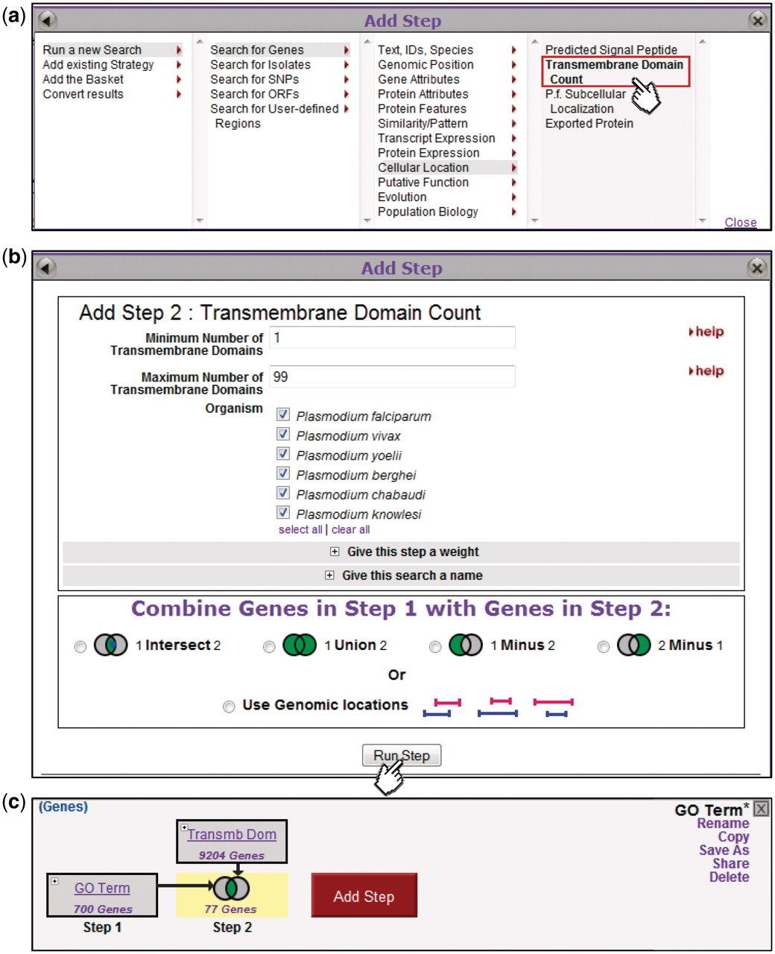
Figure 3. Adding steps to build a more complex strategy. Clicking on the Add Step button (Fig. 2) brings up an Add Step ...
Notes:
Figure 3. Adding steps to build a more complex strategy. Clicking on the Add Step button (Fig. 2) brings up an Add Step dialog box (a), from which the user selects which search to run. This brings up a display showing parameters for that search (b, top) and options for combining with the previous step (b, bottom). The new step is added to the strategy (c), and the combined result highlighted and returned as a list in the Summary Display (data not shown).
Unless provided in the caption above, the following copyright applies to the content of this slide: © The Author(s) 2011. Published by Oxford University Press.This is Open Access article distributed under the terms of the Creative Commons Attribution Non-Commercial License (http://creativecommons.org/licenses/by-nc/2.5), which permits unrestricted non-commercial use, distribution, and reproduction in any medium, provided the original work is properly cited.

Slide 5
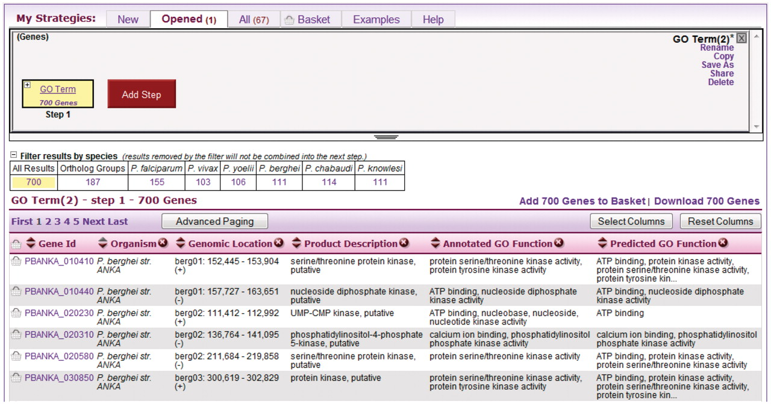
Figure 2. A single-step strategy. This is what the user sees after running a new search, in this case a search for ...
Notes:
Figure 2. A single-step strategy. This is what the user sees after running a new search, in this case a search for genes by GO term. The user clicks the Add Step button (red) to add another search to the strategy.
Unless provided in the caption above, the following copyright applies to the content of this slide: © The Author(s) 2011. Published by Oxford University Press.This is Open Access article distributed under the terms of the Creative Commons Attribution Non-Commercial License (http://creativecommons.org/licenses/by-nc/2.5), which permits unrestricted non-commercial use, distribution, and reproduction in any medium, provided the original work is properly cited.

