Slide 1
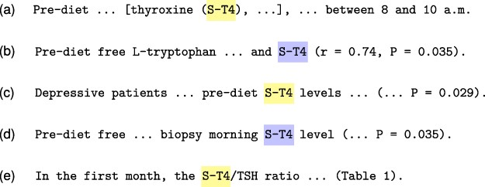
Figure 8. Example of the tagging inconsistency problem from the document PMC 555 756. Our model correctly predicted the ...
Notes:
Figure 8. Example of the tagging inconsistency problem from the document PMC 555 756. Our model correctly predicted the entity ST-4 for Sentences (b) and (d), but failed to predict the remainder ST-4 mentions in Sentences (a), (c) and (e), which renders a final document annotation that appears to be contradictory.
Unless provided in the caption above, the following copyright applies to the content of this slide: © The Author(s) 2022. Published by Oxford University Press.This is an Open Access article distributed under the terms of the Creative Commons Attribution-NonCommercial License (https://creativecommons.org/licenses/by-nc/4.0/), which permits non-commercial re-use, distribution, and reproduction in any medium, provided the original work is properly cited. For commercial re-use, please contact journals.permissions@oup.com

