Slide 1
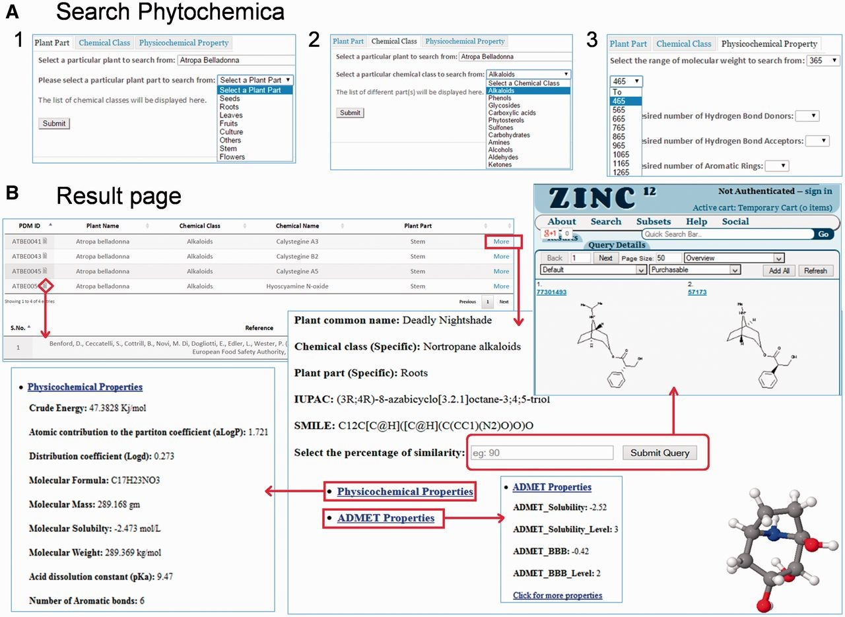
Figure 5. Features of Pytochemica interface. ( A ) Demonstration of accessible search options: ( 1 ) plant part, ( 2 ) ...
Notes:
Figure 5. Features of Pytochemica interface. ( A ) Demonstration of accessible search options: ( 1 ) plant part, ( 2 ) Chemical class as well as plant part and ( 3 ) physicochemical properties based search of PDMs. ( B ) Result of input query with list of associated PDMs that further provides information of IUPAC, SMILES, physicochemical properties and 3D visualization with associated references. User can download mol2 file of selected PDM. Similarity search of selected PDM against ZINC is also available at user-defined cut-off.
Unless provided in the caption above, the following copyright applies to the content of this slide: © The Author(s) 2015. Published by Oxford University Press. This is an Open Access article distributed under the terms of the Creative Commons Attribution License ( http://creativecommons.org/licenses/by/4.0/ ), which permits unrestricted reuse, distribution, and reproduction in any medium, provided the original work is properly cited.

