Slide 1
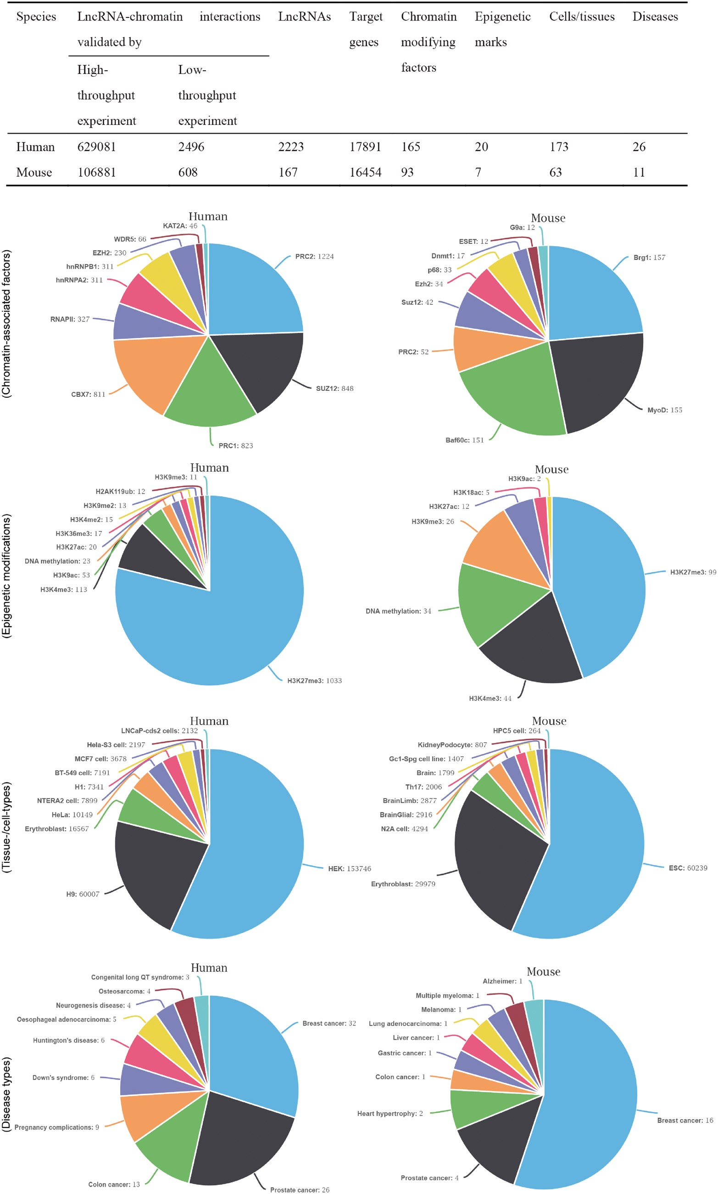
Figure 1. The statistics of lncRNA–chromatin interactions. The table shows the basic statistics of lncRNA–chromatin ...
Notes:
Figure 1. The statistics of lncRNA–chromatin interactions. The table shows the basic statistics of lncRNA–chromatin interactions. The pie chart shows the distribution of interactions based on cell/tissue types, disease types, chromatin-associated factors and epigenetic modifications. For each chart, the top 10 groups of interactions are shown.
Unless provided in the caption above, the following copyright applies to the content of this slide: © The Author(s) 2018. Published by Oxford University Press.This is an Open Access article distributed under the terms of the Creative Commons Attribution Non-Commercial License (http://creativecommons.org/licenses/by-nc/4.0/), which permits non-commercial re-use, distribution, and reproduction in any medium, provided the original work is properly cited. For commercial re-use, please contact journals.permissions@oup.com

Slide 2
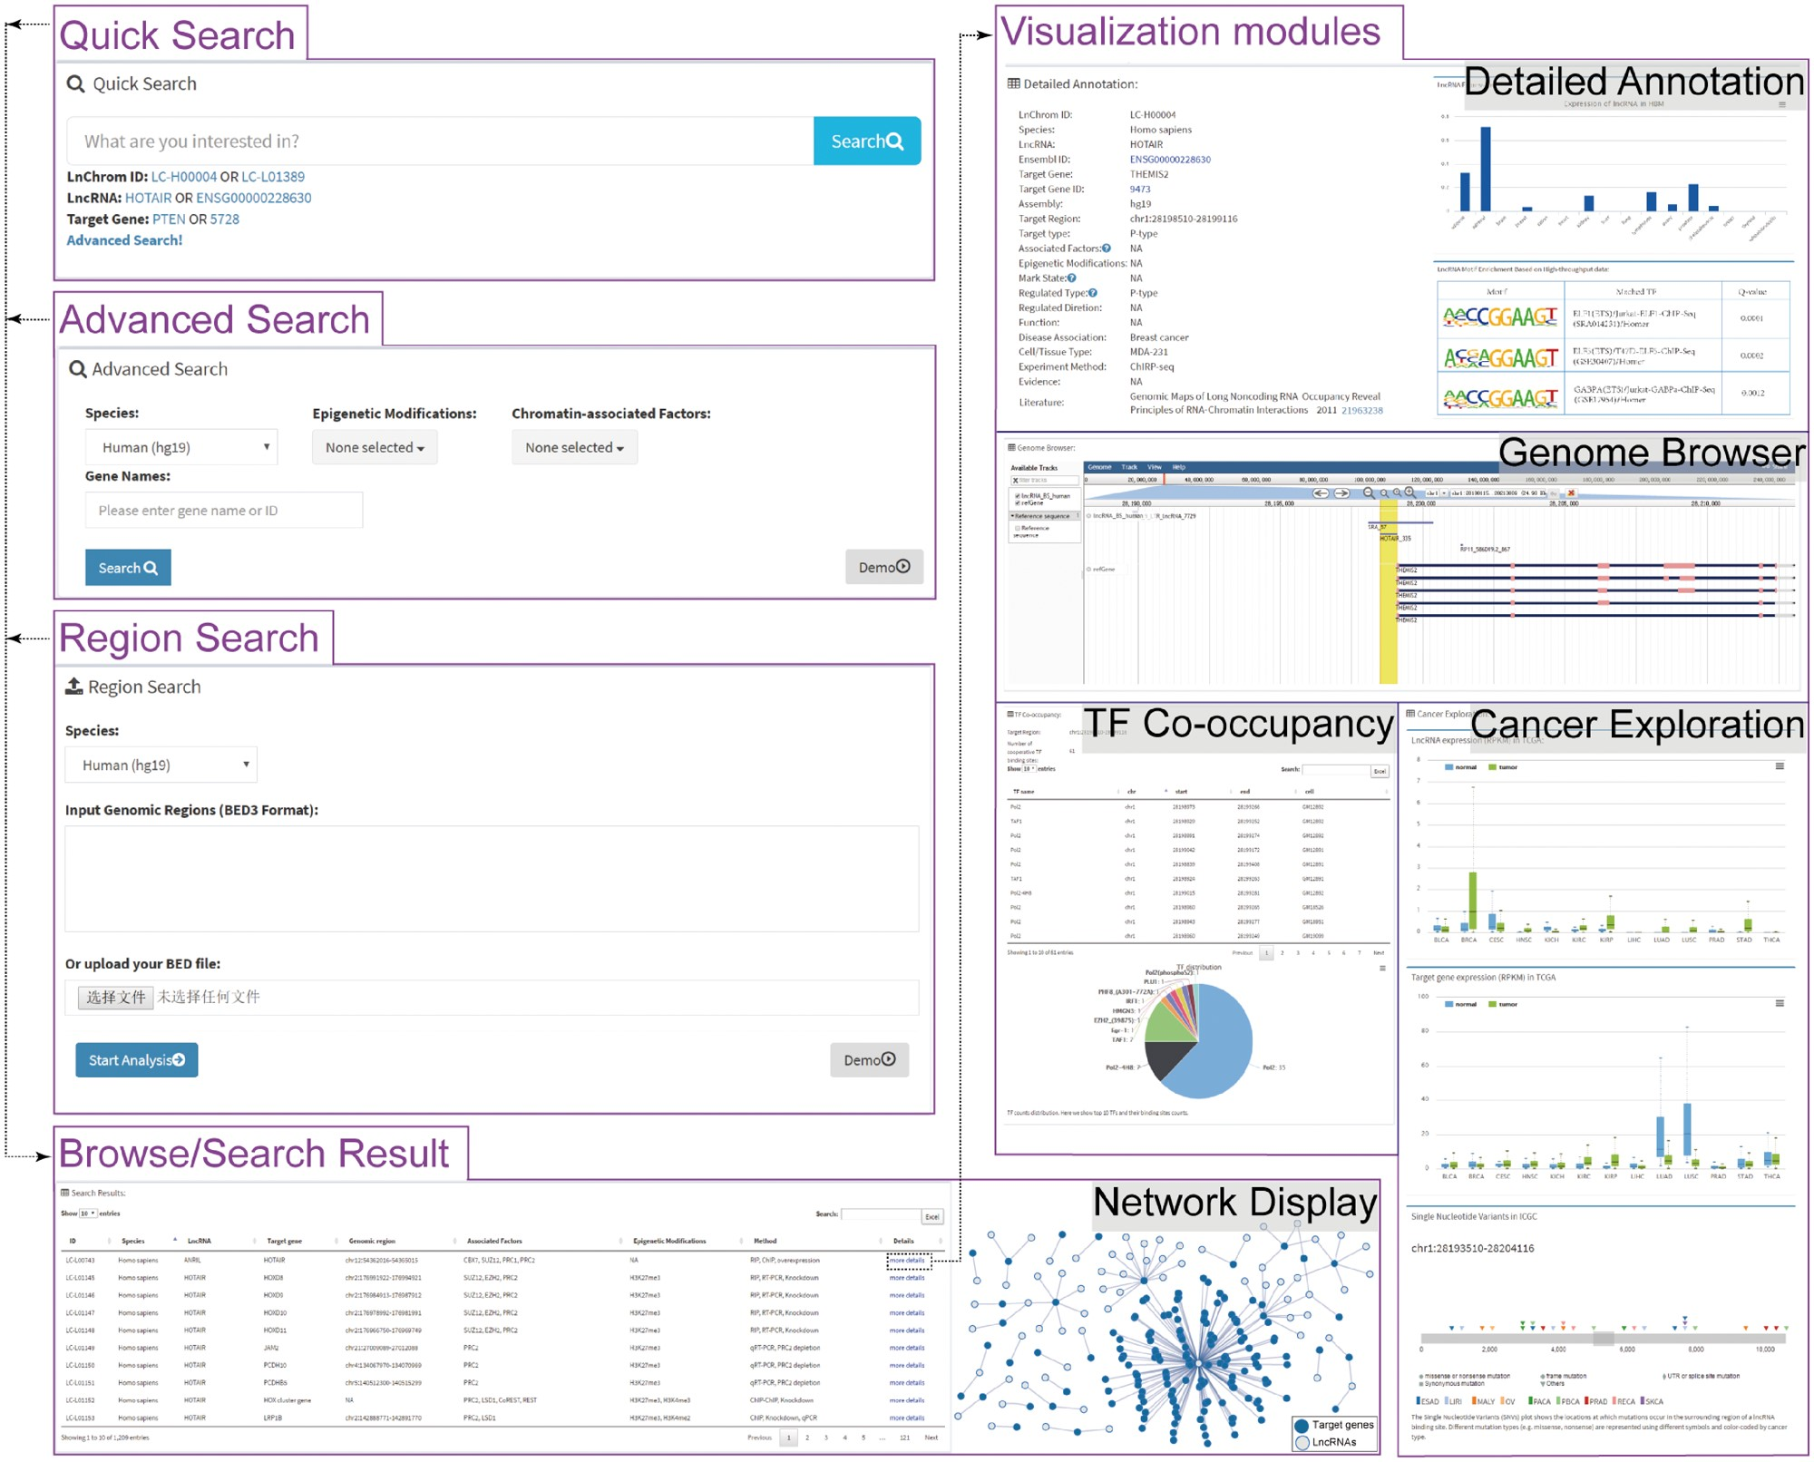
Figure 2. Schematic view of the LnChrom web interface. Users can query the resource through the ‘Quick search’, ...
Notes:
Figure 2. Schematic view of the LnChrom web interface. Users can query the resource through the ‘Quick search’, ‘Advanced search’, ‘Region search’ and ‘Browse’ panels, and the results include a brief table and a network display of the interactions. Users interested in individual interactions can click ‘more details’ within the table to access the visualization modules, which include ‘Detailed Annotation’, ‘Genome Browser’, ‘TF Co-occupancy’ and ‘Cancer Exploration’. In general, these modules were developed by integrating multi-omics data to gain insight into the regulatory mechanisms of lncRNAs. The ‘Detailed Annotation’ module illustrates a set of metadata that was curated from the original literature, lncRNA expression across different tissues from the Human Body Map project and sequence motif discovery of the lncRNA binding sites. ‘Genome Browser’ provides an intuitive illustration of the lncRNA binding sites and gene annotation. ‘TF Co-occupancy’ shows the potential cooperative TFs of lncRNAs in humans based on an integration of the binding sites for 161 TFs from the ENCODE project. The ‘Cancer Exploration’ module provides the expressions of lncRNAs and their target genes from the TCGA project and the genetic mutations around the lncRNA binding sites across cancers from the ICGC project.
Unless provided in the caption above, the following copyright applies to the content of this slide: © The Author(s) 2018. Published by Oxford University Press.This is an Open Access article distributed under the terms of the Creative Commons Attribution Non-Commercial License (http://creativecommons.org/licenses/by-nc/4.0/), which permits non-commercial re-use, distribution, and reproduction in any medium, provided the original work is properly cited. For commercial re-use, please contact journals.permissions@oup.com

