Slide 1
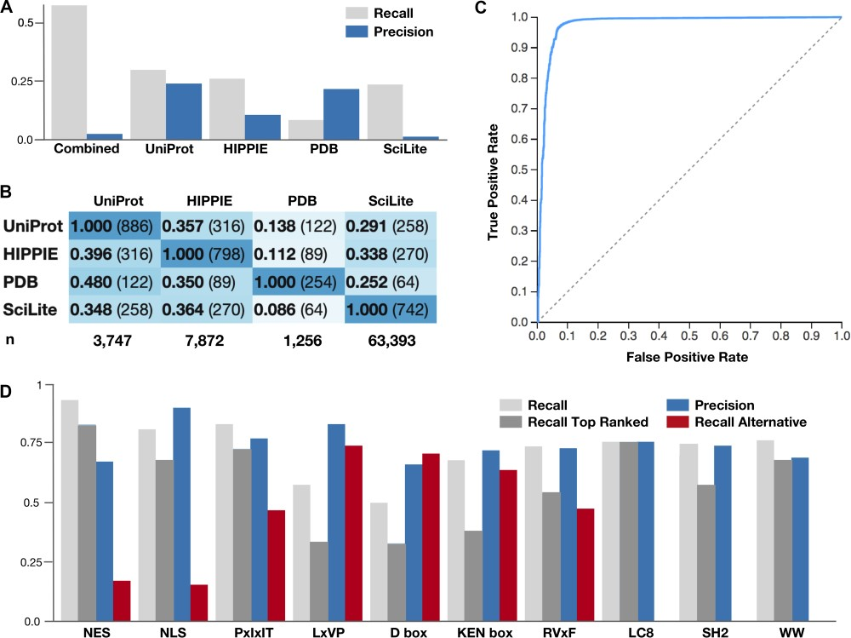
Figure 2 Benchmarking results for the sources of article protein annotation and classification. (A) The ability of ...
Notes:
Figure 2 Benchmarking results for the sources of article protein annotation and classification. (A) The ability of each source of article protein annotation to correctly reannotate the proteins manually curated for motif articles by the ELM resource. Recall is the fraction of UniProt accessions annotated for the articles in the ELM resource that were returned. Precision is the fraction of UniProt accessions returned for the ELM resource by each source of article protein annotation that are correct. (B) The overlap of the correctly identified UniProt accessions between each article annotation resource. The denominator of the proportion relates to the row. (C) ROC curve for the 5-fold cross-validation of the ELM class annotation of the ELM training set. Scores are calculated for a single fold scoring set against classifiers trained with the four remaining folds as a training set. Data describe a binary classification pooling the negative classes for each class in the classifier. (D) The ability of the article.ELM classifier to identify the correct ELM class in 10 manually curated, real-world motif article datasets. Recall and precision are shown, along with the ability of the classifier to recognize the curated motif class as the top-scoring class (Recall Top Ranked) and its ability to recognize a related, alternative motif (Recall Alternative). A detailed and up-to-date version of the data shown here is available at http://slim.icr.ac.uk/articles/benchmarking/.
Unless provided in the caption above, the following copyright applies to the content of this slide: © The authors 2020. Published by Oxford University Press on behalf of the Institute of Mathematics and its Applications. All rights reserved.This is an Open Access article distributed under the terms of the Creative Commons Attribution License (http://creativecommons.org/licenses/by/4.0/), which permits unrestricted reuse, distribution, and reproduction in any medium, provided the original work is properly cited.

