Slide 1
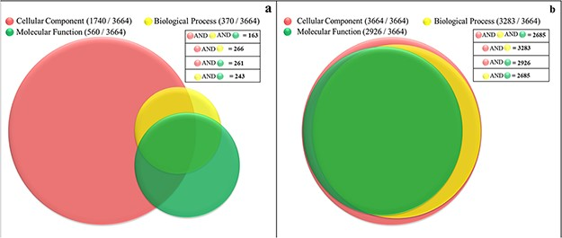
Figure 4 Functional characterization of soluble proteome of PvP01 strain of P. vivax. (a) Protein function information ...
Notes:
Figure 4 Functional characterization of soluble proteome of PvP01 strain of P. vivax. (a) Protein function information of the soluble proteome of PvP01 currently available in public resources. (b) Protein function information of soluble proteome of PvP01 furnished through the PvP01 web resource.
Unless provided in the caption above, the following copyright applies to the content of this slide: © The Author(s) 2020. Published by Oxford University Press.This is an Open Access article distributed under the terms of the Creative Commons Attribution License (http://creativecommons.org/licenses/by/4.0/), which permits unrestricted reuse, distribution, and reproduction in any medium, provided the original work is properly cited.

