Slide 1
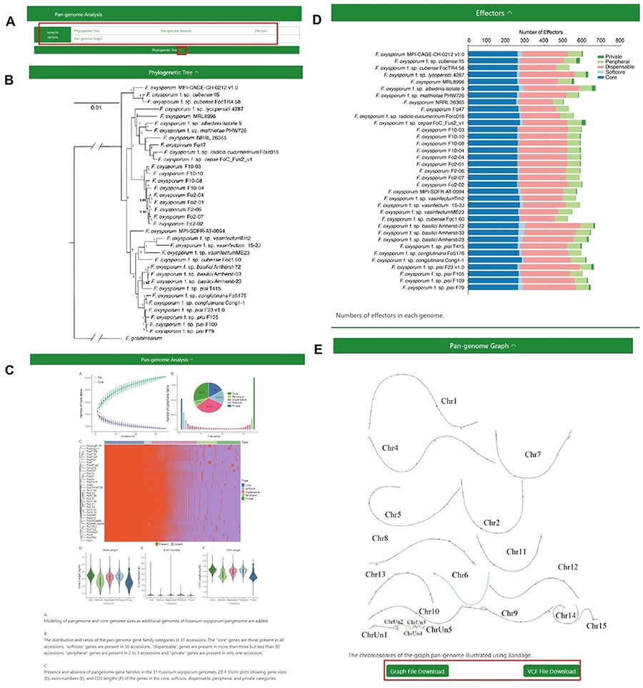
Figure 3. The Pangenome Analysis section under the Pangenome module. (A) Quick access links. (B) Maximum-likelihood ...
Notes:
Figure 3. The Pangenome Analysis section under the Pangenome module. (A) Quick access links. (B) Maximum-likelihood tree using single-copy orthologous protein sequences in 35 Fusarium oxysporum genomes. Fusarium graminearum was used as an outgroup. (C) (Top left) Modeling of pangenome and core-genome sizes as additional genomes of F. oxysporum pangenome are added. (Top right) The distribution and ratios of the pangenome gene family categories in 35 accessions. The ‘core’ genes are those present in all accessions, ‘softcore’ genes are present in 34 accessions, ‘dispensable’ genes are present in more than 3 but less than 34 accessions, ‘peripheral’ genes are present in 2 to 3 accessions and ‘private’ genes are present in only 1 accession. (Center) Presence and absence of pangenome gene families in the 35 F. oxysporum genomes. (Bottom) Violin plots showing gene sizes (left), exon numbers (middle) and CDS lengths (right) of the genes in the core, soft-core, dispensable, peripheral and private categories. (D) Numbers of effectors in each genome. (E) Visualization of the chromosomes in the graph genome with Bandage.
Unless provided in the caption above, the following copyright applies to the content of this slide: © The Author(s) 2024. Published by Oxford University Press.This is an Open Access article distributed under the terms of the Creative Commons Attribution License (https://creativecommons.org/licenses/by/4.0/), which permits unrestricted reuse, distribution, and reproduction in any medium, provided the original work is properly cited.

