Slide 1
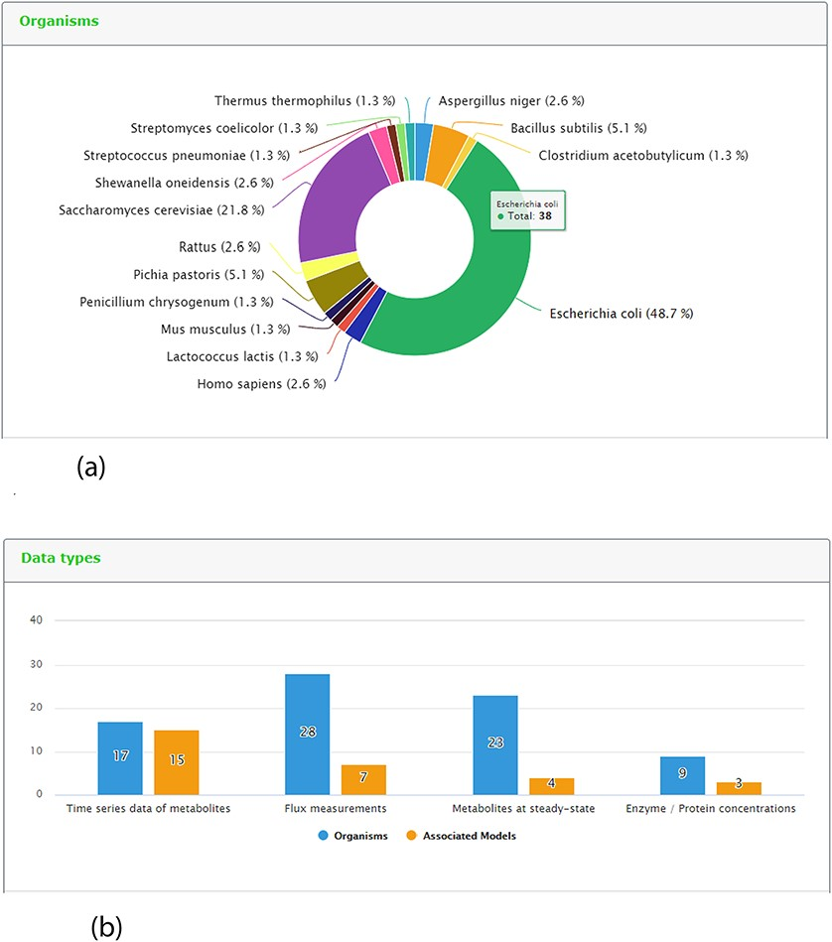
Figure 5. Representative screenshots from the new content statistics page tab. (a) Overview of organisms statistics. ...
Notes:
Figure 5. Representative screenshots from the new content statistics page tab. (a) Overview of organisms statistics. (b) Overview of data type and associated model statistics.
Unless provided in the caption above, the following copyright applies to the content of this slide: © The Author(s) 2020. Published by Oxford University Press.This is an Open Access article distributed under the terms of the Creative Commons Attribution License (http://creativecommons.org/licenses/by/4.0/), which permits unrestricted reuse, distribution, and reproduction in any medium, provided the original work is properly cited.

Slide 2
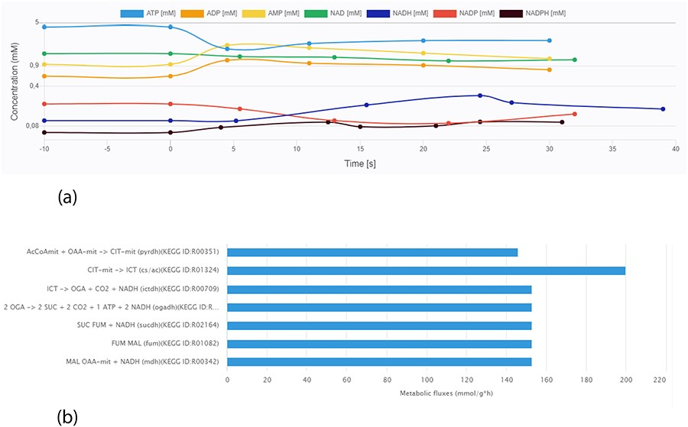
Figure 6. Screen images from different data types that the user can preview from the data sets. (a) Example of ...
Notes:
Figure 6. Screen images from different data types that the user can preview from the data sets. (a) Example of time-course data for the Data EntryID 30. (b) Example of flux distribution for the Data EntryID 73.
Unless provided in the caption above, the following copyright applies to the content of this slide: © The Author(s) 2020. Published by Oxford University Press.This is an Open Access article distributed under the terms of the Creative Commons Attribution License (http://creativecommons.org/licenses/by/4.0/), which permits unrestricted reuse, distribution, and reproduction in any medium, provided the original work is properly cited.

Slide 3
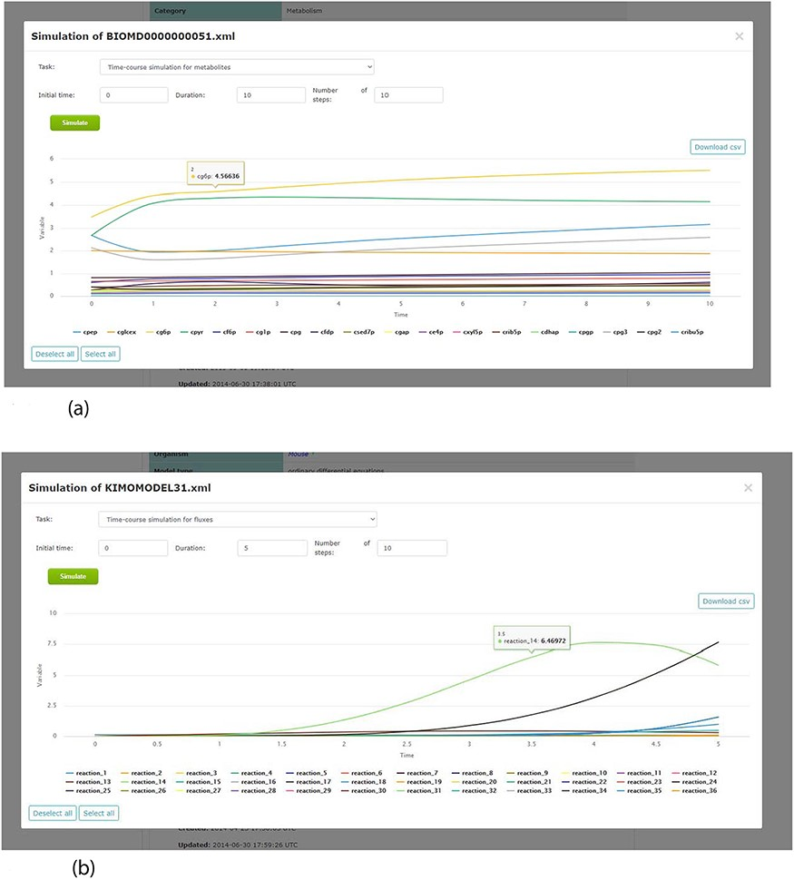
Figure 7. Screenshots of the simulation web interface for two different associated models stored in KiMoSys. The CSV ...
Notes:
Figure 7. Screenshots of the simulation web interface for two different associated models stored in KiMoSys. The CSV file is available to download the simulated data. (a) Example of metabolites time-course simulation with the Model EntryID 13. (b) Time profiles for the reaction fluxes simulation obtained with the Model EntryID 31.
Unless provided in the caption above, the following copyright applies to the content of this slide: © The Author(s) 2020. Published by Oxford University Press.This is an Open Access article distributed under the terms of the Creative Commons Attribution License (http://creativecommons.org/licenses/by/4.0/), which permits unrestricted reuse, distribution, and reproduction in any medium, provided the original work is properly cited.

Slide 4
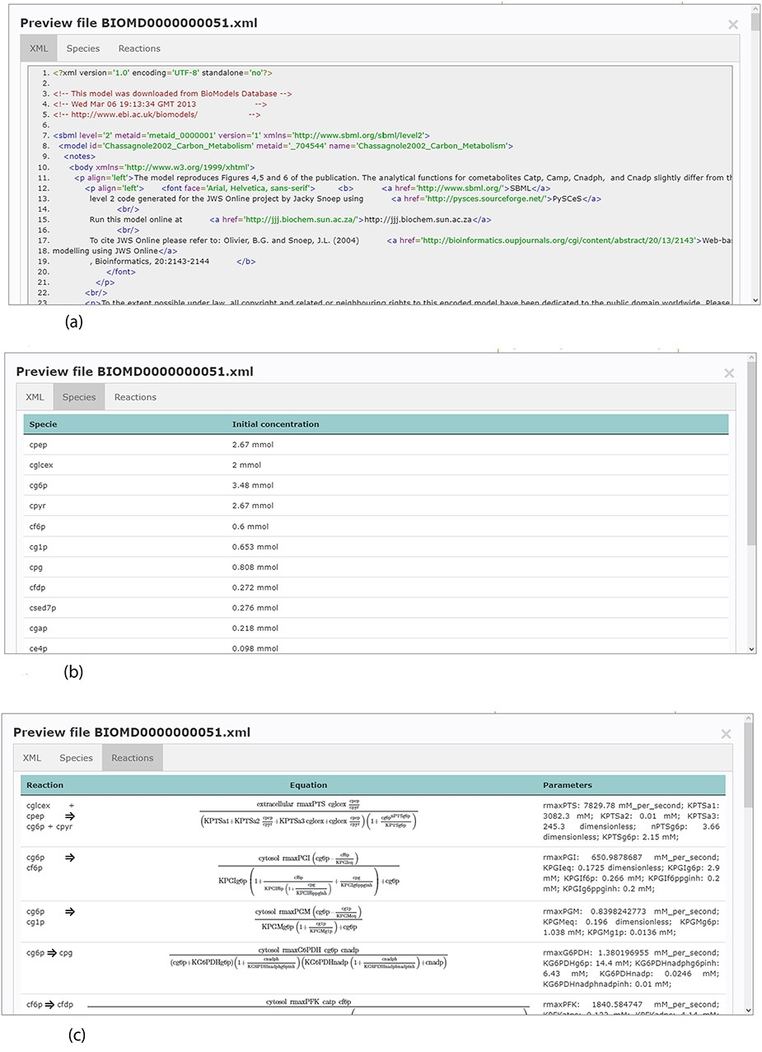
Figure 4. Example of an SBML model file preview (Model EntryID 13). (a) Snapshot of the XML file preview. (b) ...
Notes:
Figure 4. Example of an SBML model file preview (Model EntryID 13). (a) Snapshot of the XML file preview. (b) Screenshot for the model species and initial concentrations. (c) Screenshot of the model reactions, rate equations and kinetic parameters.
Unless provided in the caption above, the following copyright applies to the content of this slide: © The Author(s) 2020. Published by Oxford University Press.This is an Open Access article distributed under the terms of the Creative Commons Attribution License (http://creativecommons.org/licenses/by/4.0/), which permits unrestricted reuse, distribution, and reproduction in any medium, provided the original work is properly cited.

Slide 5
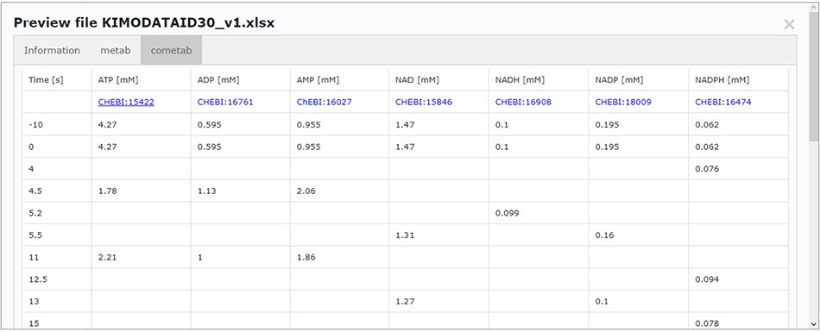
Figure 3. Screenchot depicting a data file preview (example for DataEntry ID 30). Here, the user can navigate through ...
Notes:
Figure 3. Screenchot depicting a data file preview (example for DataEntry ID 30). Here, the user can navigate through each tab.
Unless provided in the caption above, the following copyright applies to the content of this slide: © The Author(s) 2020. Published by Oxford University Press.This is an Open Access article distributed under the terms of the Creative Commons Attribution License (http://creativecommons.org/licenses/by/4.0/), which permits unrestricted reuse, distribution, and reproduction in any medium, provided the original work is properly cited.

Slide 6
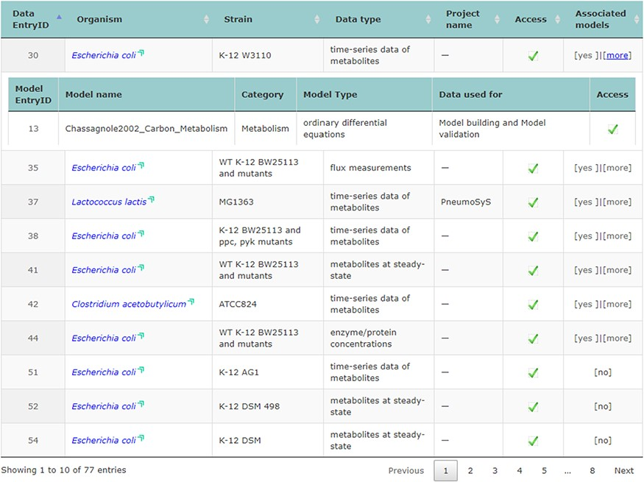
Figure 2. Screenshot of the main repository table.
Notes:
Figure 2. Screenshot of the main repository table.
Unless provided in the caption above, the following copyright applies to the content of this slide: © The Author(s) 2020. Published by Oxford University Press.This is an Open Access article distributed under the terms of the Creative Commons Attribution License (http://creativecommons.org/licenses/by/4.0/), which permits unrestricted reuse, distribution, and reproduction in any medium, provided the original work is properly cited.

Slide 7
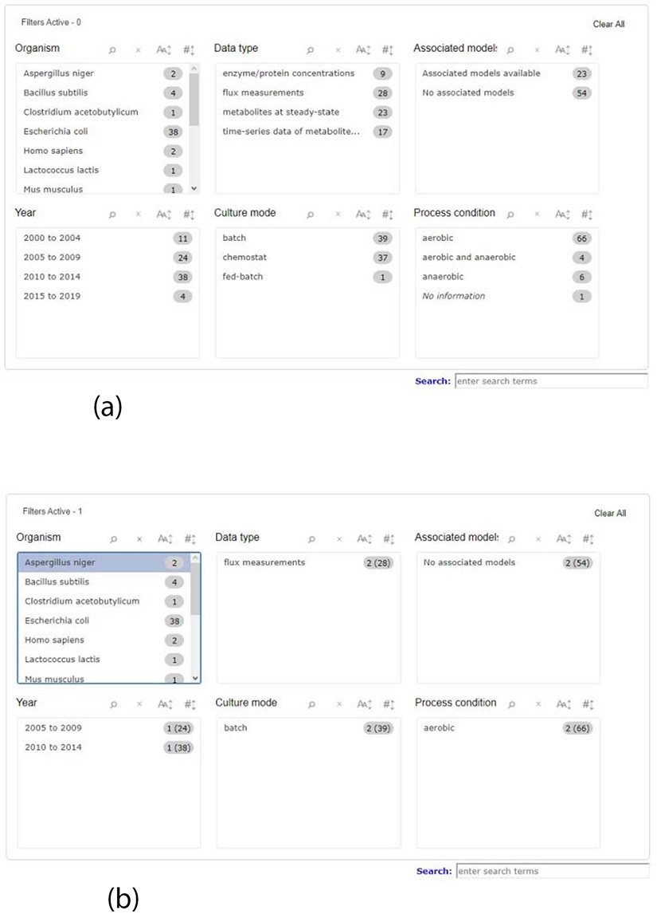
Figure 1. Screenshot of the new filter panel and its interactions. Ahead of each item, there is a number that ...
Notes:
Figure 1. Screenshot of the new filter panel and its interactions. Ahead of each item, there is a number that represents its amount present in the database. (a) A filter panel for the repository table. (b) An example of the new filter panel after the selection of an item; the panel refreshes according to the selected filter and the remaining available options. The numbers are updated: the value outside the parentheses is the remaining amount of data entries that exist according to the filters selected, while the value inside the parentheses is the total number present in the database.
Unless provided in the caption above, the following copyright applies to the content of this slide: © The Author(s) 2020. Published by Oxford University Press.This is an Open Access article distributed under the terms of the Creative Commons Attribution License (http://creativecommons.org/licenses/by/4.0/), which permits unrestricted reuse, distribution, and reproduction in any medium, provided the original work is properly cited.

