Slide 1
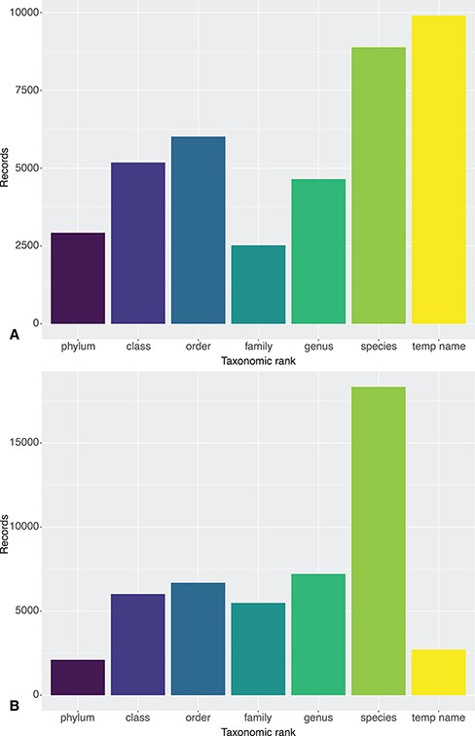
Figure 2. Taxonomic resolution of Clarion-Clipperton Zone DeepData records as published on 12 July 2021: (A) from ...
Notes:
Figure 2. Taxonomic resolution of Clarion-Clipperton Zone DeepData records as published on 12 July 2021: (A) from DeepData itself and (B) via the OBIS ISA node. The record sets primarily differ in the number of temporary name records (9936 on DeepData and 2715 on OBIS) and species-level records (8883 on DeepData and 18 329 on OBIS). These differences are the result of mismapping of DwC by the ISA Secretariat, discussed in section 4.5. Note that temporary names here may include names at levels higher than species, i.e. temporary/informal species names (morphospecies), and also temporary names for higher taxon ranks, e.g. undescribed genera and incomplete identifications using open nomenclature. See Rabone et al. (2022) (39) for further discussion of informal names.
Unless provided in the caption above, the following copyright applies to the content of this slide: © The Author(s) 2023. Published by Oxford University Press.This is an Open Access article distributed under the terms of the Creative Commons Attribution License (https://creativecommons.org/licenses/by/4.0/), which permits unrestricted reuse, distribution, and reproduction in any medium, provided the original work is properly cited.

