Slide 1
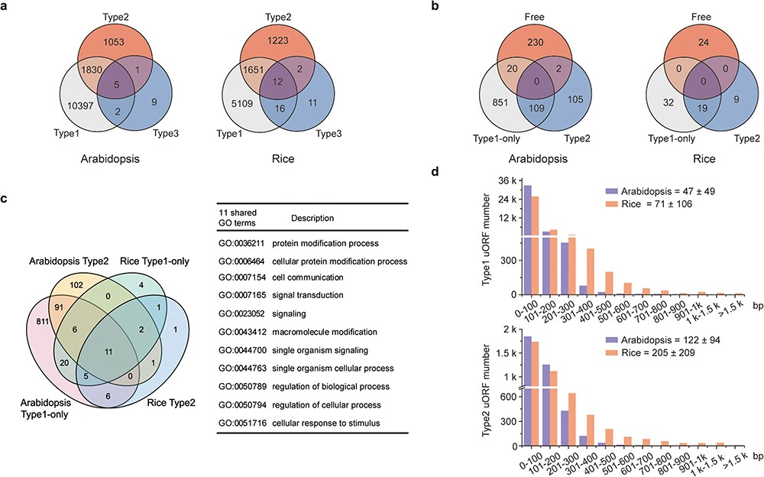
Figure 2 Characterization of uORFs in Arabidopsis and rice. (a) Venn diagram of uORF-containing genes with different ...
Notes:
Figure 2 Characterization of uORFs in Arabidopsis and rice. (a) Venn diagram of uORF-containing genes with different uORF types. (b) Venn diagram of enriched GO terms of uORF-free-, Type1-only- and Type2- uORF-containing genes in Arabidopsis and rice. GO terms of P < 0.05 are used. (c) Venn diagram to show GO terms shared in Arabidopsis and rice uORF-containing genes. 51 out of 57 enriched GO terms of rice uORF-containing genes are also found in Arabidopsis. Eleven GO terms enriched in both Type1-only and Type2 uORF-containing genes of Arabidopsis and rice are detailed in the table. (d) Length distribution of Type1 and Type2 uORFs. Insert number shows Mean ± SD of uORF length (bp). The representative gene models of Arabidopsis reference accession Col-0 and rice reference cultivar Nipponbare are used for analysis.
Unless provided in the caption above, the following copyright applies to the content of this slide: © The Author(s) 2020. Published by Oxford University Press.This is an Open Access article distributed under the terms of the Creative Commons Attribution License (http://creativecommons.org/licenses/by/4.0/), which permits unrestricted reuse, distribution, and reproduction in any medium, provided the original work is properly cited.

